Slide 1
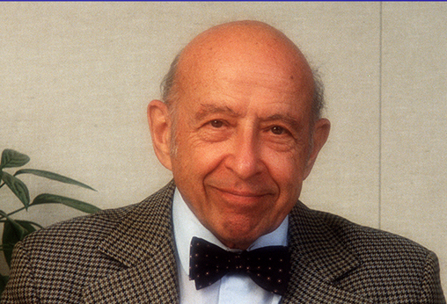
Some Pre-EPRI Publications of Chauncey

