Slide 1
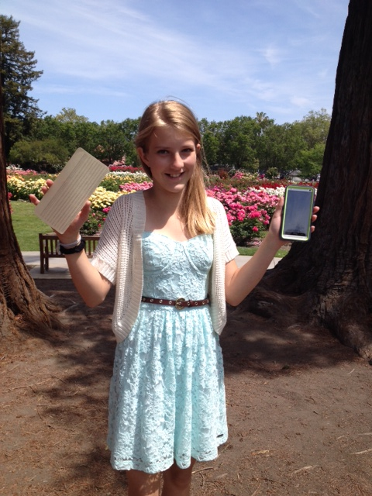
12-Year Old Devin Grant’s “ Big Data” Homework Assignment
How many of GrandPa’s really silly 1953 IBM Punched Cards does it take...
...to fill up a 32 gig iPhone?
Well?
A stack about 30 miles high!
> 3000 miles in a 4 TB home cloud!
Wow!* That’s really “Big Data! ”
So What’s Next?
Putting Your 1’s & 0’s in a Black Hole?
*Assumptions:
120 bytes/card
Thickness = 0.007 inches

