Slide 1
IASS Study Proposal Paul M. Grant 17 February 2013
A Methane/Electricity ePipe Infrastructure to Socio-economically and Enviro-responsibly service the Emerging Energy Needs of the European Union

Slide 2
The Global Energy Challenge
An expanding global population aspiring to the energy-consumption standard of living existing in Europe and North America and and targeted by the emerging societies of middle and western Asia, the Indian subcontinent, Africa and South America.
Possible adverse climate impact arising from the combustion products of increased amounts of fossil fuels consumed in pursuit of their objective.
Limited ability to address such needs via renewable energy alternatives and associated physical and political constraints, e.g., the socio-eco-invasive impact imposed by widespread deployment of solar, wind, and bio-sourced generation.
Vast reserves of natural gas have been uncovered worldwide, and attendant cost-effective retrieval technologies developed for their exploitation. A number of economic imperatives are certain to drive that exploitation worldwide (See US-EIA 2011 Report: World Shale Gas Resources: An Initial Assessment of 14 Regions Outside the United States, available here).
It is essential such exploitation of our planet’s methane reserves be carried out in as environmentally, socio-economic responsible manner as possible, both regarding extraction, transmission and end use, and likewise consideration of candidate replacement technologies 3-4 decades in the future.

Slide 3
One Approach to Fulfillment: The Methane/Electricity ePipe (Nota Bene: “The Fine Print”)
Dual-Use of a common right-of-way (ROW) to co-transport natural gas (methane) and electricity.
Electricity component to be generated at the gas field wellhead via 50% Carnot-efficient combined cycle turbine technology (CCGT), possibly employing superconducting stator/rotor designs.
Capture CCGT H₂O & CO₂ exhaust and transform, using emerging technologies, into basic hydrocarbon resources (methanol, ethanol, propanol...) for application in the chemical and medical enterprises.
Transport wellhead generated electricity via high current capacity “high temperature” superconducting cables (HTSC):
...in a “common” cable carrying cryogenic liquid methane and electricity over LN$2$ cooled HTSC.
...or...in two separate embodiments sharing a common ROW:
A conventional, but of “advanced design,” high pressure gas or LNG pipeline.
An HTSC cable comprised of either:
Present successful and proven cuprate-based “wires/tapes/cables” refrigerated by liquid nitrogen, or..
MgB₂ “wire/cables” refrigerated by an appropriate mixture of gaseous He and H₂.
Commence planning for eventual depletion of global methane reserves by 2050 and insertion of new generation technologies at the wellhead “footprint” to utilize the now-pre-existing chemical/electrical thoroughfares:
Electricity Generation: Advanced clean, safe and renewable/recycleable nuclear fission plants based on essentially inexhaustible supplies of thorium ore...e.g., the Energy Amplifier (latest here).
Chemical Generation : Replace methane chemical resources with hydrogen generated electrolytically from H₂O (there are issues...click here), and distribute over existing upgraded natural gas pipelines/
Transmission: Insertion in existing ROW upgraded HTSC cables utilizing MgB₂ + liquid H₂ cryogens.

Slide 4
Proposed Study Scope
Review past “power corridor dual-use studies” in the US
J. R. Bartlit, F. J. Edeskuty and E. F. Hammel, “Multiple Use of Cryogenic Fluid Transmission Lines,” Proc. ICEC4, Eindhoven, 24/26 May 1972. pdf
S. M. Schoenung, W. V. Hassenzahl and P. M. Grant, “System Study of Long Distance Low Voltage Transmission Using High Temperature Superconducting Cable,” EPRI Report WO8065-12, March, 1997. pdf
P. M. Grant, ‘The SuperCable: Dual Delivery of Chemical and Electric Power,” IEEE Trans. Appl. Supercon. 15, 1810 – 1813 (2005). pdf
Gather/Accumulate data to examine possible EU opportunities
Research current plans/policies to extend existing, and deploy future, natural gas pipeline infrastructure throughout the European Union and its neighbors.
“Imagineer” specific scenarios to insert similar dual-use projects on the North American model onto the European scene.
One such scenario, but by no means unique, would be to consider a 1440 km “ePipe” from the Lublin gas fields in eastern Poland through Berlin to Brussels, as is addressed briefly in this proposal.
However, the study would survey all opportunities from the highlands of Scotland through Scandinavia to western Russia, southward to the Balkans, westward to Spain and northward to the English Channel (aka, la Manche).

Slide 5
Past/Present Dreams (US-Canada)

Slide 6
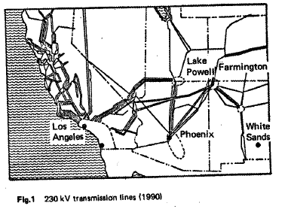
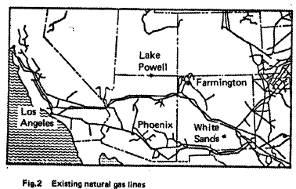
Multiple Use of Cryogenic Fluid Transmission Lines
J. R. Bartlit, F. J. Edeskuty and E. F. Hammel, “Multiple Use of Cryogenic Fluid Transmission Lines,” Proc. ICEC4, Eindhoven, 24/26 May 1972. pdf
A multi-use energy transportation line is envisaged which derives environmental and economic advantages by concurrently transporting liquified natural gas, liquid hydrogen and electricity conducted along either cryogenic (20 K) or superconducting (4 K) cables. Operating parameters are given for a potential application of a 600-mile pipeline carrying gas and electricity flowing from New Mexico to Los Angeles, California, and liquid hydrogen hydrogen flowing from Los Angeles to New Mexico for use in the space shuttle program. Estimated flow-rates, pipe sizes, pressure and voltage losses, heat leaks and refrigeration requirements are given and compared with losses incurred in conventional transmission.

Slide 7
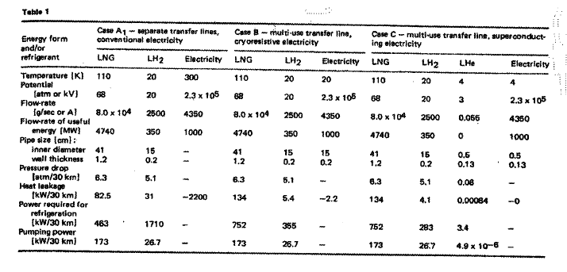
(a)

Slide 8
II. System Study of Long Distance Low Voltage
Transmission Using an HTSC Cable*
S. M. Schoenung, W. V. Hassenzahl and P. M. Grant, EPRI Report WO8065-12, March, 1997. pdf
High temperature superconductors (HTS) offer a potential opportunity for long
distance transmission of electricity at relatively low voltage. An HTS transmission line
could be less expensive than high voltage dc transmission (HVDC) because of reduced
convertor costs and lower line losses.
This preliminary analysis of an HTS low voltage dc transmission system suggests
that such a system could be economically competitive with both HVDC and gas
pipeline transport of bulk energy over long distances. The largest single cost item is the
superconducting layer. If this can be provided at a cost around $5/kA-m at the selected operating temperature, then the system is an attractive option.
The cost of delivered electricity (¢/kWh) is strongly dependent on the cost of fuel at the
source. The trade-off between systems is impacted most by capital costs and parasitic
requirements.
*This is an extraordinarily thorough engineering/economy examination of almost all aspects
of the “dual use common corridor for methane/electricity co-transport.” It was never published
and exists solely in the form of an EPRI report here.

Slide 9
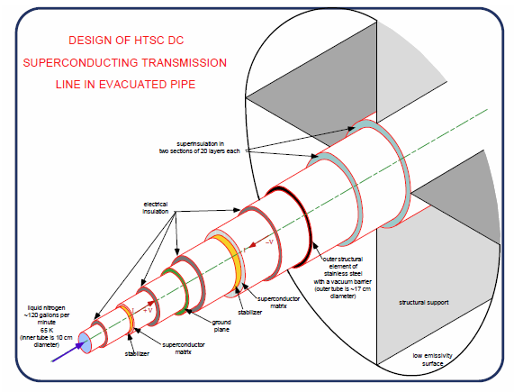
II. (a)
Generic ePipe Layout
Generic ePipe Design

Slide 10
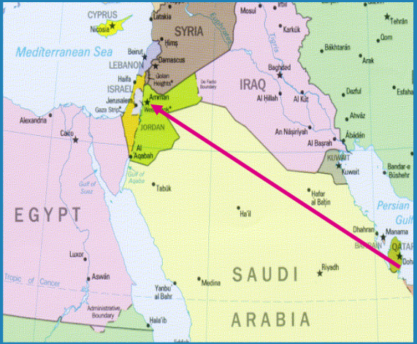
II. (b)

Slide 11
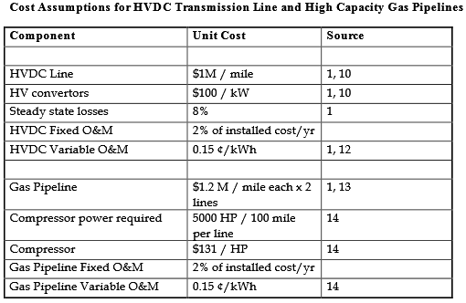
II. (c)
(Con Cuidado: as of 1997! )

Slide 12
Cryodelivery Systems for the Cotransmission of Chemical and Electrical Power
Paul M. Grant, AIP Conf. Proc. 823, 291(2006); doi: 10.1063/1.2202428 pdf
The following pages are abstracted from the citation below:
THE LNG HYBRID SUPERCABLE
Realistically, fossil fuels will continue to be exploited for at least three more decades.
However, there is underway a major movement away from high carbon content sources as
seen by the increasing movement toward natural gas (mostly methane) as witnessed by the fact
that some 18% of the electricity generated in the US comes from natural gas-fired turbines,
whereas it was almost zero 20 years ago, and is expected to increase dramatically as more
restrictions are placed on coal generation. Natural gas production and use in the “lower 48” of
the United States has begun to increase faster than new reserves are being discovered and
exploited. It is anticipated that much of the future supply to the US will be by tanker transport
and offload of liquefied natural gas (LNG) and additional pipelines constructed from the Artic
Ocean shelf of North America.
An example of the latter is the Mackenzie Valley Project, a 1220 km, $18 B high
capacity pipeline to be built from gas fields in the Mackenzie River delta in the Northwest
Territory to existing distribution stations in Alberta, scheduled for completion by 2010. A
map of the pipeline route and associated pressurization plants is shown in Figure 5.

Slide 13
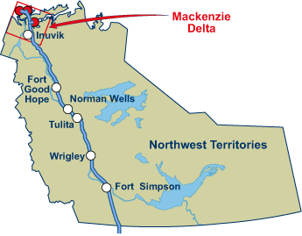
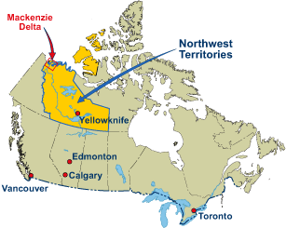
(a)
FIGURE 5. Route of the projected Mackenzie Valley Pipeline running 1220 km through the Canadian Northwest Territory from the Mackenzie River Delta on the Artic Ocean to northern distribution channels in the province of Alberta [http://www.mackenziegasproject.com]. When completed, the pipeline will convey 1.6 US billion cubic feet per day, the equivalent of 18 GW thermal at the high heat value of methane, approximately that of the electric power capacity of the Three Gorges hydroelectric facility in China.

Slide 14
MVP Specs (NB: as of 2006! )
(b)
Pipeline Length | 1220 km (760 mi)
Diameter | 30 in (76 cm)
Gas Pressure | 177 atm (2600 psia)
Pressurization Stations | ~250 km apart
Flow Velocity | 5.3 m/s (12 mph)
Mass Flow | 345 kg/s
Volume Flow | 1.6 Bcf/d (525 m³/s)
Power Flow | 18 GW (HHV Thermal)
Construction Schedule | 2006 - 2010
Employment | 25,000
Partners | Esso, APG, C-P, Shell, Exxon
Cost | $ 7.5 B (all private)

Slide 15
(c)
Since a significant portion of the natural gas, perhaps as much as 33%, to be eventually transported over the Mackenzie Valley pipeline will be used to generate electricity, let us then consider a possible scenario for future gas pipeline projects which would place the generation plants at the wellhead The electric power thus produced would then be subsequently transmitted, along with liquefied natural gas, in the manner of an LNG SuperCable as envisioned in Figure 6.
Electrical Insulation
“Super-Insulation”
Thermal Barrier to LNG
Liquid Nitrogen @ 77 K
Superconductor
LNG @ 105 K
1 atm (14.7 psia)
FIGURE 6. Monopole cross-section of a conceptual Liquidfied Natural Gas SuperCable. The cryogen is liquid nitrogen flowing through the center cylindrical tube. Note the presence of a heat shield between the superconductor layer and the LNG channel in order to keep its temperature above 86 K, the freezing point of methane.

Slide 16
(d)
Table 4 addresses a scenario using the Mackenzie Valley Project as a template. One –
third of the field gas available is diverted to directly generate electricity. The remaining
methane is liquefied and it and electricity are “shipped south” on an LNG Hybrid SuperCable. For a standard long distance gas pipeline, re-compression and heating (methane is cooled by expansion as it moves through the pipeline!) stations must be place periodically (100 – 250 km) along its path. For the LNG Hybrid SuperCable, these stations would be replaced by cryogen pumping and refrigeration units.
Should the LNG Hybrid SuperCable model indeed be applied to future exploitation of
remote natural gas fields similar to those of the Mackenzie River Delta, when those reserves become exhausted, their very remoteness would make suitable locations for the construction of high temperature gas cooled nuclear reactors capable of both hydrogen and electricity generation with the product shipped on the former LNG SuperCable appropriately converted to carry hydricity.

Slide 17
(e)
TABLE 4. Wellhead electricity generation scenario via combined cycle gas turbine generators located on the gas fields of the Mackenzie River Delta delivered over an LNG SuperCable running along the route of the proposed Mackenzie Valley Pipeline.
NB: Data as of 2006!
Electricity Conversion Assumptions
Wellhead Power Capacity | 18 GW (HHV)
Fraction Making Electricity | 33%
Thermal Power Consumed | 6 GW (HHV)
Left to Transmit as LNG | 12 GW (HHV)
CCGT Efficiency | 60%
Electricity Output | 3.6 GW (+/- 18 kV, 100 kA)
SuperCable Parameters for LNG Transport
CH₄ Mass Flow (12 GW (HHV))
230 kg/s @ 5.3 m/s
LNG Density (100 K)
440 kg/m³
LNG Volume Flow
0.53 m³/s @ 5.3 m/s
Effective Pipe Cross-section
0.1 m²
Effective Pipe Diameter
0.35 m (14 in)

Slide 18
Other Regional Opportunities? (EU)

Slide 19
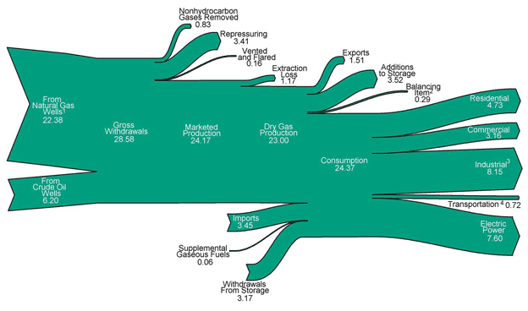
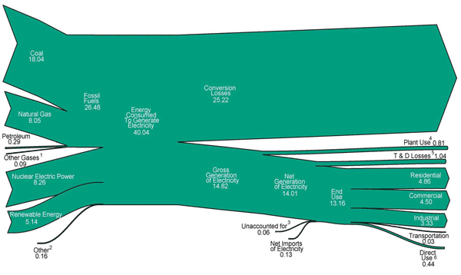
US Natural Gas Generation/End Use – 2011
Units = 10¹² ft³
= 1.35 x 10⁴ Twh
What/where are the equivalent data for the EU?
~25% ?
US Electricity Generation/End Use – 2011
Units = 10¹⁵ BTU
= 2.933 x 10³ Twh

Slide 20
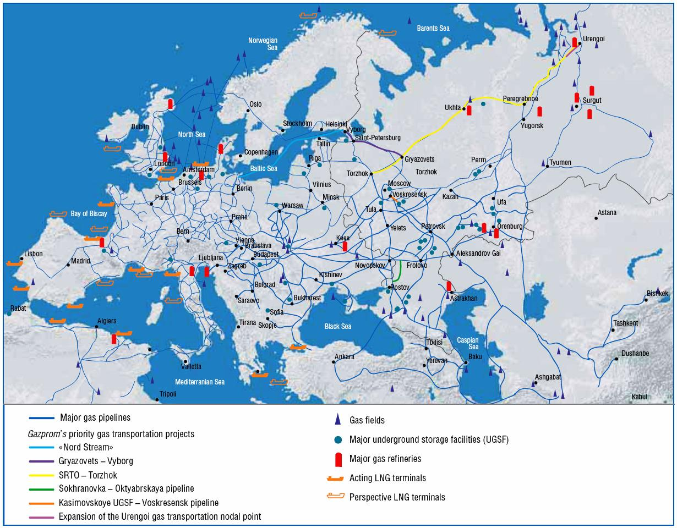
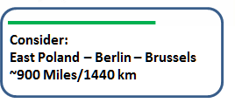
From Where? Poland! ..... To Where? Brussels!
One Possible Scenario (an EU Mackenzie Valley?)
Existing European Gas Pipelinesx

Slide 21
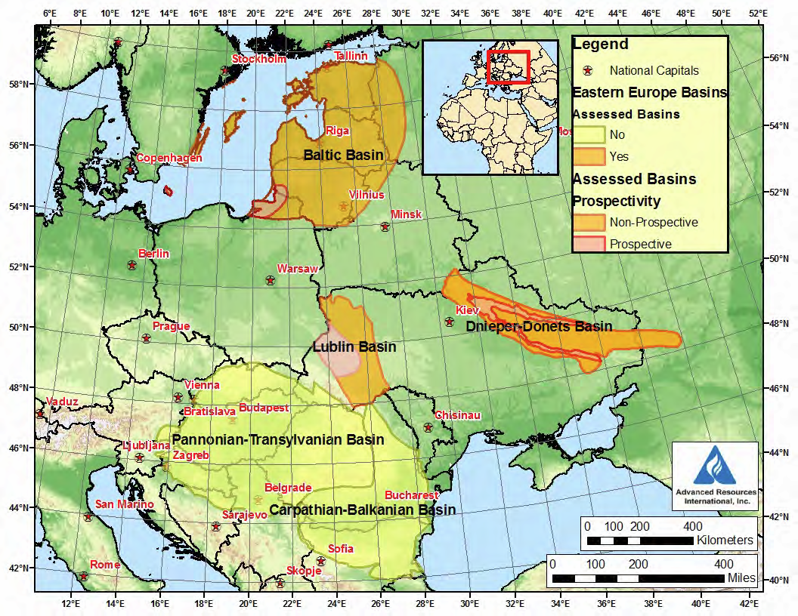
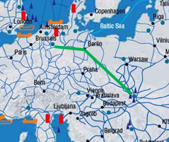
Details
The Wola Obszańska* (Lublin) gas field in Poland was discovered in 1989. It began production in 1992 and produces natural gas. The total proven reserves of the Wola Obszańska gas field are around 37 billion cubic feet (1×10⁹m³).
o Wroclaw
*https://en.wikipedia.org/wiki/Wola_Obsza%C5%84ska_gas_field
On Site Development
Allocate immediate resources to implement advanced IASS technology to recover methanol/ethanol from CCGT H₂O, CO₂ emissions.
Allocate future siting areas to implement recycleable, reprocessable thorium-based fission technology along with hydrogen generation.

Slide 22
”Polish-Pipe-Dream” vs. North American & MVP Numbers
(Natural Gas Delivery Statistics...Sources/Comparisons)*
Sources | Reserves 10⁹ cu⋅ft | Reserves Twh | wrt US | wrt MVP
US Total | 28,600 | 3.86⋅10⁵ | - | -
MVP | 7060 | 9.34⋅10⁴ | 25% | -
Lublin** | 37 | 5.00⋅10² | 0.13% | 0.52%
Lublin – Berlin Pipeline Corridor “electrons/CH₄ Energy Delivery ePipe Split”
Total Delivered Power (GW) | CH₄ Portion (GW) | “electrons” Portion (GW)*** | CCGT efficiency – 50% (GW) | Years Until Exhaustion**
2.5 | 1.0 | 1.0 | 0.5 | 22.3
*US-DOE-EIA: http://www.eia.gov/analysis/studies/worldshalegas/ Table I (note only proven reserves data are used, not possible recoverable shale deposits).
**https://en.wikipedia.org/wiki/Wola_Obsza%C5%84ska_gas_field (if nearby Ukrainian are available provable reserves were to be included, perhaps 5 times this number could be realized).
***See EPRI Report WO8065-12, March, 1997 (pdf), EPRI Report 1020458 (pdf), for possible HTSC cable designs.

Slide 23
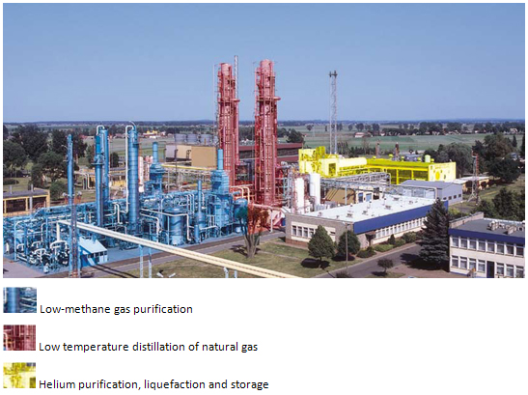
Oh...BTW...along the way, there’s...
Krio Odolanow
A hundred kilometres to the north-east of Wroclaw there is KRIO Odolanów, the branch of Polish Oil and Gas Company, which operates the only installation in Europe for helium recovery from natural gas. The technology utilized in KRIO Odolanów is based on cryogenic processes and its two main products are liquid helium and liquefied natural gas.
So...why not inject some He...and...maybe a little H₂...as self-contained permanent refrigerants?

Slide 24
Proposed IASS ePipe Study Focus Topics
Design of HTSC Cable, Finances, Infrastructure – Support Resources
EPRI Report WO8065-12, March, 1997. pdf
AIP Conf. Proc. 823, 291(2006); doi: 10.1063/1.2202428 pdf
EPRI Report 1020458, pdf
Satisfaction of EU socio-economic energy delivery objectives, especially near-term CO₂ recovery/reuse
Mid-21st century replacement of depleted methane reserves by advanced, environmentally respectful, nuclear fission alternatives to deliver electrons and protons (H⁺) throughout the EU

Slide 25
The IASS ePipe “Dream Team”
Organizers/Coordinators
Paul Grant (in residence)
Steve Eckroad
Selected IASS Staff*
Consulting Support
William Hassenzahl, AdvEnergy
Nexans/Columbus
BASF
PGNiG
Gazprom
Naftogaz
Fermilab/CERN
Selected EU university/MPI expertise
Selected EU/German government agency relevant staff
Study Team Report Due
Mid-Summer 2013
*To include C. Rubbia, of course

