Slide 1
Wind vs. Nuclear
Selected Graphics (2000 – 2012)
Paul M. Grant
www.w2agz.com

Slide 2
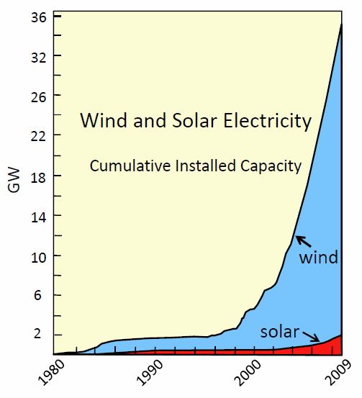
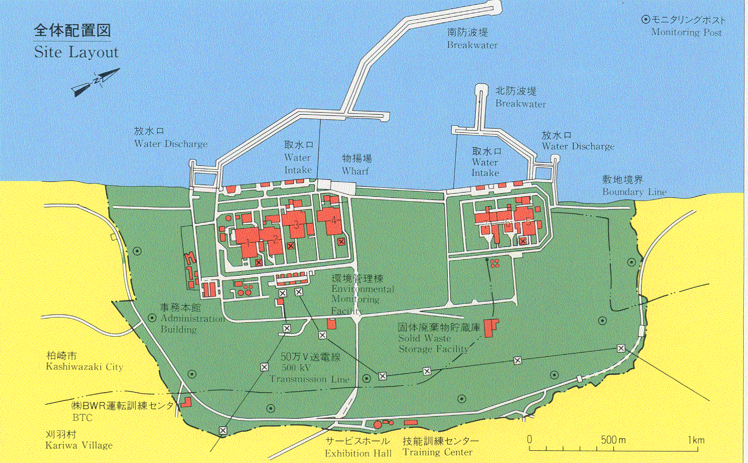
Wind Power Factoids
Comment: This graphic compares the land/sea area required by a wind farm to replace that of Japan’s west coast Kashiwazaki-Kariwa nuclear power facility.
KK Wind Equivalent (8 GW)
Power per Tower 8 MW
Number of Towers 1000
Inter-tower Distance 1000 ft
Total Area (miles x miles) 43.5 x 43.5
1 mile
Kashiwazaki Kariwa: 8 GW !

Slide 3
Comment: The Diablo Canyon nuclear power facility in the Los Padres national forest on the mid-California coast. The two reactors comprise a total of approximately 2.2 GW continuously dispatchable power.

Slide 4
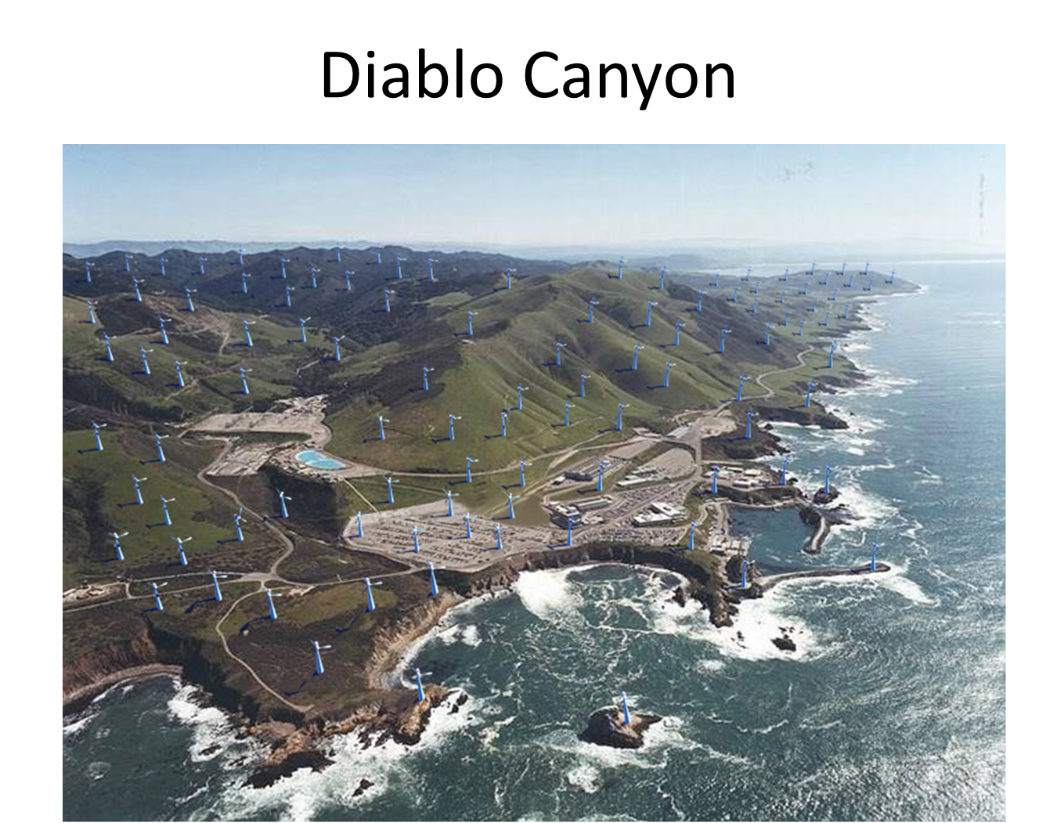
Comment: Approximately 25% of the land area required to “replace” Diablo Canyon with 1 MW wind towers spaced 1000 feet apart.

Slide 5
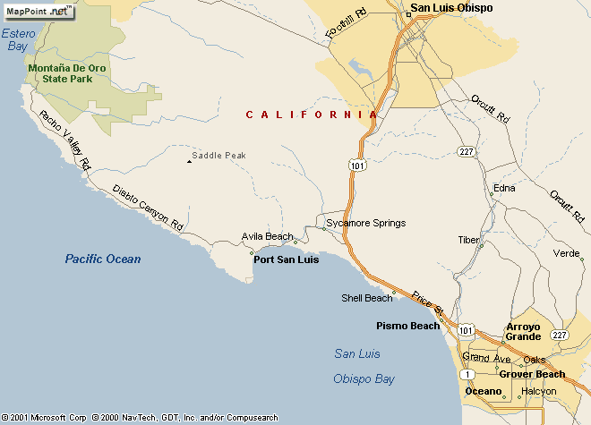
California Coast Power
Comment: Total land area required to “replace” Diablo Canyon with 1 MW wind towers spaced 1000 feet apart. Given a 30% overall “availability” of current wind farm output, more that 3x the depicted land area would be needed.
Diablo Canyon
2200 MW
Power Plant
Wind Farm
Equivalent
1 Mile

Slide 6
Visit www.wind-watch.org

