Slide 1

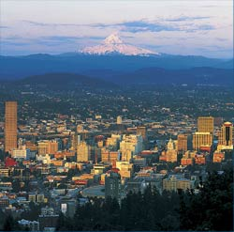

Superconducting Fluctuations in One-Dimensional Quasi-periodic Metallic Chains
Does the
Hold the Key to Room Temperature Superconductivity?
Session T41: T41.00008, Room F152, Wednesday, 4:42 PM
Paul Michael Grant
APS Senior Life Fellow
IBM Research Staff Member Emeritus
EPRI Science Fellow (Retired)
Principal, W2AGZ Technologies
Aging IBM Pensioner
(research supported under the IBM retirement fund)

Slide 2



St. Patrick’s Day - 2010
Bridget Ann Mullen-Whalen

Slide 3
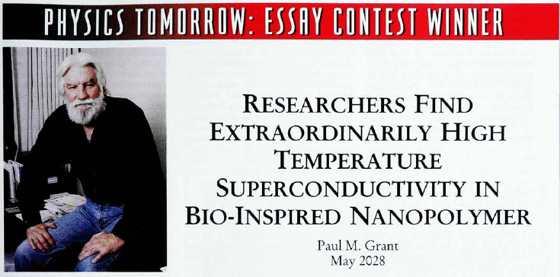
50th Anniversary of Physics Today, May 1998
http://www.w2agz.com/Publications/Popular%20Science/Bio-Inspired%20Superconductivity,%20Physics%20Today%2051,%2017%20%281998%29.pdf
May, 2028
(still have some time!)

Slide 4
“Bardeen-Cooper-Schrieffer”
Where
= Debye Temperature (~ 275 K)
= Electron-Phonon Coupling (~ 0.28)
μ* = Electron-Electron Repulsion (~ 0.1)
a = “Gap Parameter, ~ 1-3”
Tc = Critical Temperature ( 9.5 K “Nb”)

Slide 5
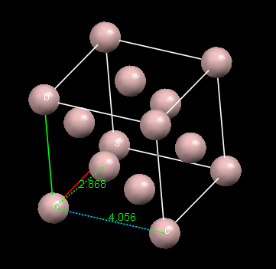
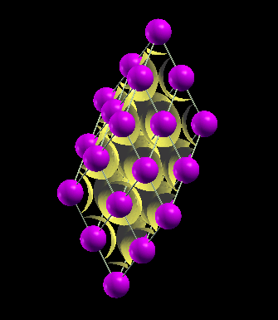
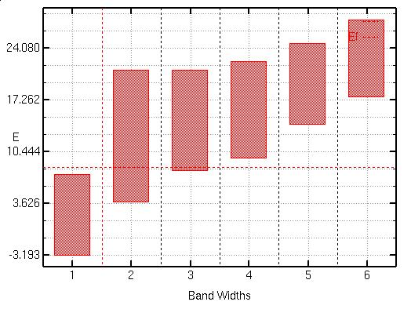
“3-D”Aluminum,T_{C} = 1.15 K
“Irrational”

Slide 6
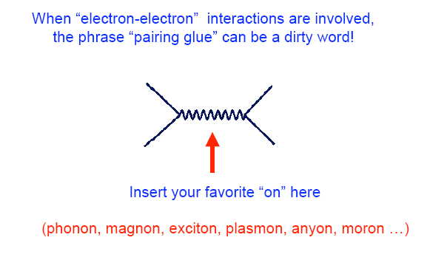
Fermion-Boson Interactions
“Put-on !”
Notes:
6

Slide 7
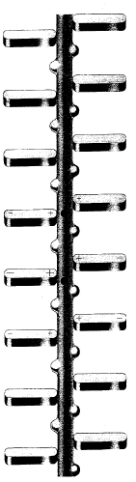
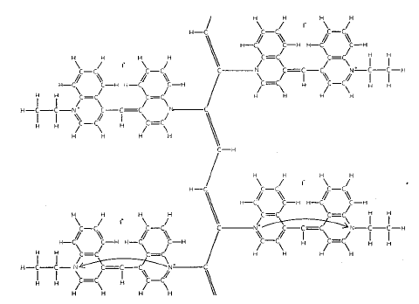
Little, 1963
1D metallic chains are inherently unstable to dimerization and gapping of the Fermi surface, e.g., (CH)x. Ipso facto, no “1D” metals can exist!
₊
-
-
₊
₊
-
-
₊
₊
-
-
₊
Diethyl-cyanine iodide

Slide 8
NanoConcept
What novel atomic/molecular arrangement might give rise to higher temperature superconductivity >> 165 K?

Slide 9
NanoBlueprint
Model its expected physical properties using Density Functional Theory.
  DFT is a widely used tool in the pharmaceutical, semiconductor, metallurgical and chemical industries.
  Gives very reliable results for ground state properties for a wide variety of materials, including strongly correlated, and the low lying quasiparticle spectrum for many as well.
This approach opens a new method for the prediction and discovery of novel materials through numerical analysis of “proxy structures.”

Slide 10
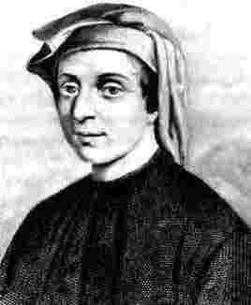
Fibonacci Chains
“Monte-Carlo Simulation of Fermions on Quasiperiodic Chains,”
P. M. Grant, BAPS March Meeting (1992, Indianapolis)

Slide 11

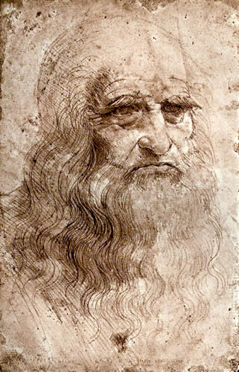
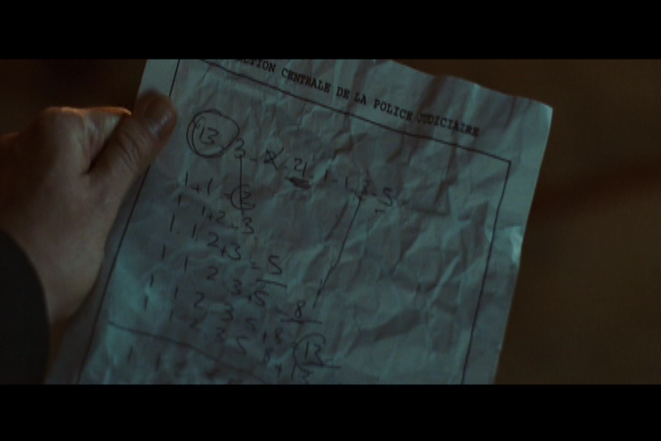

Slide 12
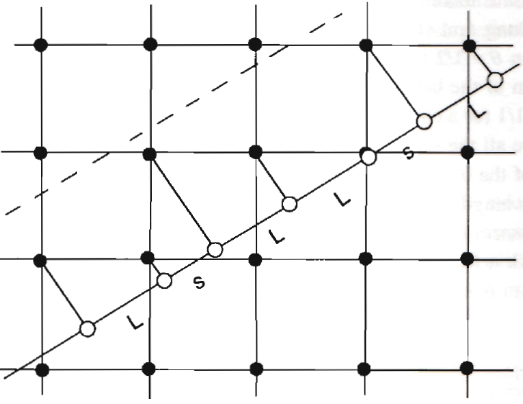
A Fibonacci “Dislocation Line”
Al
Al
Al
Al
SRO !
STO ?
Al
Al
Al
tan θ = 1/τ ; τ = (1 + √5)/2 = 1.618… ; θ = 31.717…°
L = 4.058 Å (fcc edge) s = 2.869 Å (fcc diag)

Slide 13
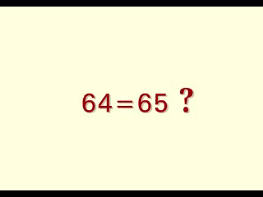
64 = 65

Slide 14
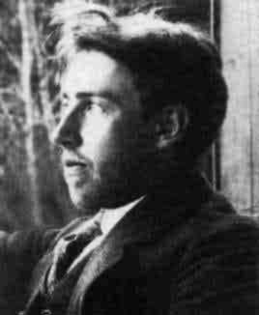
“Not So Famous Danish Kid Brother”
Harald Bohr
Silver Medal, Danish Football Team, 1908 Olympic Games

Slide 15
Almost Periodic Functions
“Electronic Structure of Disordered Solids and Almost Periodic Functions,”
P. M. Grant, BAPS 18, 333 (1973, San Diego)

Slide 16
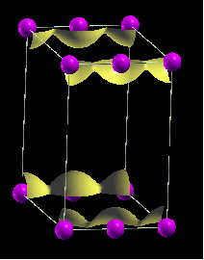
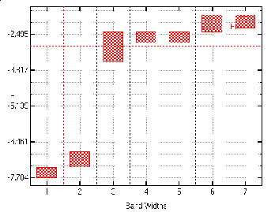
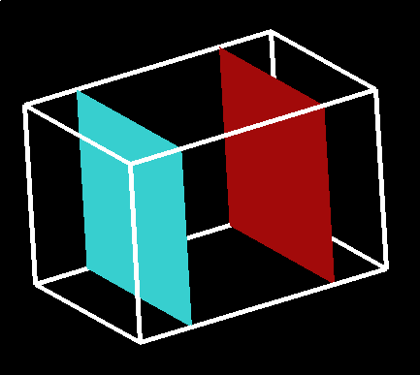
Doubly Periodic Al Chain
(a = 4.058 Å [fcc edge], b = c = 3×a)
a
Notes:
Run 03-11-10_3
Al_Chain_02
Simple Linear Al 1D Chain
Double cell with atoms equally spaced along Al fcc edge = 4.058 Ang, b,c = 3*a, a* = 2*4.058 = 8.116 Ang
Machine 6200
QE e-4.0
Fibo G 6
nat 2
a (au,Ang) 15.34 8.12 a2 (au,Ang) 7.67 4.06 a3 (au,Ang)
b (au,Ang) 23.01 12.18 c (au,Ang) 23.01 12.18 ecutwfc(ry) 19
MP-Mesh 16
SCF Time 31m 8.89s
NSCF Time 1h47m
GSE(ry) -7.89
Ef(eV) -2.92

Slide 17
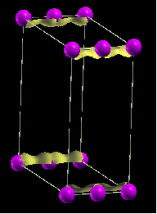
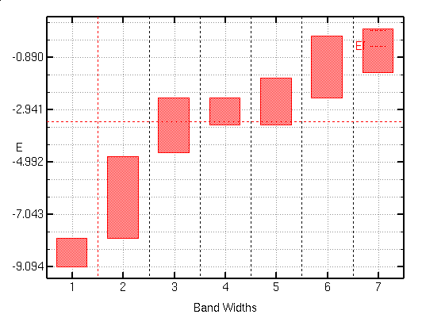
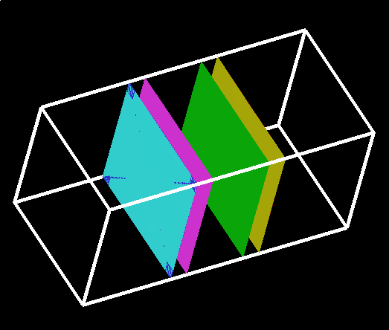
Doubly Periodic Al Chain
(a = 2.869 Å [fcc diag], b = c = 6×a)
a
Notes:
Run 03-11-10_2
Al_Chain_01
Simple Linear Al 1D Chain
Double cell with atoms equally spaced along Al fcc diagonal = 2.862 Ang, b,c = 3*a, a = 2*2.862 = 5.724 Ang
Machine 6200
QE e-4.0
Fibo G 6
nat 2
a (au,Ang) 10.82 5.73 a2 (au,Ang) 5.42 2.87 a3 (au,Ang)
b (au,Ang) 23.01 12.18 c (au,Ang) 23.01 12.18 ecutwfc(ry) 19
MP-Mesh 16
SCF Time 1h 1m
NSCF Time 3h 3m
GSE(ry) -8.02
Ef(eV) -3.42

Slide 18
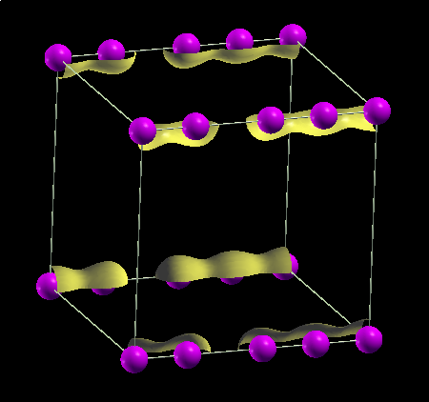
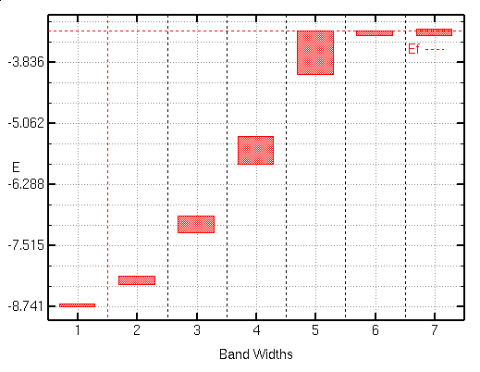
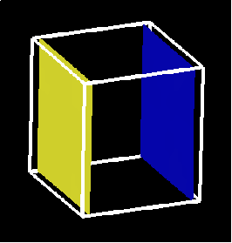
Quasi-Periodic Al Chain
Fibo G = 6: s = 2.868 Å, L = 4.058 Å
(a = s+L+s+s = 12.66 Å, b = c ≈ 3×a)
s
L
s
s
Notes:
Run 03-12-10_2
Al_Fibo_05
Gen 6 Fibonacci Chain Selections
Three Al atoms based on fcc distances...b, c scaled to 3 * a0 (4.058)
Machine 6200
QE e-4.0
Fibo G 6
nat 4
a (au,Ang) 23.93 12.66 a2 (au,Ang) 5.42 2.87 a3 (au,Ang) 13.09 6.93 a4 (au,Ang) 18.51 9.79 b (au,Ang) 23.01 12.18 c (au,Ang) 23.01 12.18 ecutwfc(ry) 19
MP-Mesh 16
SCF Time 2h48m
NSCF Time 6h32m
GSE(ry) -15.99
Ef(eV) -3.20

Slide 19
Conclusions
1D Quasi-periodicity can defend a linear metallic state against CDW/SDW instabilities (or at least yield an semiconductor with extremely small gaps)
Decoration of appropriate surface bi-crystal grain boundaries or dislocation lines with appropriate odd-electron elements could provide such an embodiment.

Slide 20
Homework
Computational physics and chemistry has attained the potential to assess the physical possibility of other-than-phonon mediated superconductivity via examination of “proxy structures” such as the example proposed in this talk.
However, better and more comprehensive “post-processing” software tools are required to supplant and substitute for Eliashberg-McMillan based algorithms.
The formalism already exists within the framework of the momentum-dependent dielectric function, ε(q, ω+iγ), e.g., the generalized Lindhard expression and/or the work of Kirzhnitz, Maksimov and Khomski……., but no code implementation is currently available (as far as I know…possibly soon from Yambo)!
Éireann go Brách

