Slide 1
Setup

Slide 2
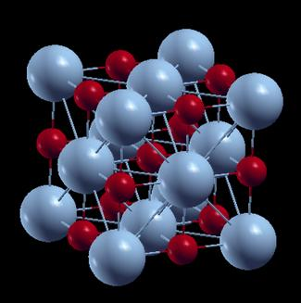
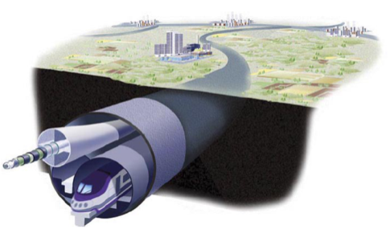

Challenges Confronting High Temperature Superconducting Materials:
From Nanoscale Theories
to
Exascale Energy Applications
Paul M. Grant
W2AGZ Technologies
EPRI Science Fellow (Retired)
IBM Research Staff Member/Manager (Emeritus)
Aging IBM Pensioner
Research Supported by IBM Retirement Fund
2014 MRS Spring Meeting
Symposium T
Marriott Marquis
21-25 April 2014, San Francisco, CA
Paper T7.03
Yerba Buena Level, Salon 15
2:30 PM
Wednesday, 23 April 2014
Notes:
2
2
2

Slide 3
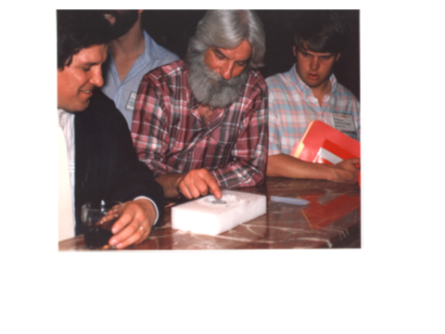
HTSC Symposium, MRS Spring Meeting, Anaheim, 23-24 April 1987
“The Altamont of Materials”

Slide 4
It is now 27 years to the day after “Altamont,” yet two major issues remain unresolved:
“The Nanoscale:”
How does HTSC even occur? We know it’s BCS, so what’s the “pairing glue?”
“The Exascale:”
Despite more than 20 years of very successful HTSC wire development possessing outstanding critical state properties, and its use in equally outstanding and successful power application demonstrations in the US, Japan, China, Korea, Germany, Russia..., there remains no significant deployment of such technology by either government agencies or investor-owned utilities.
How come?

Slide 5
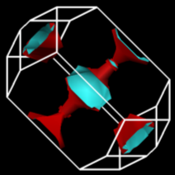
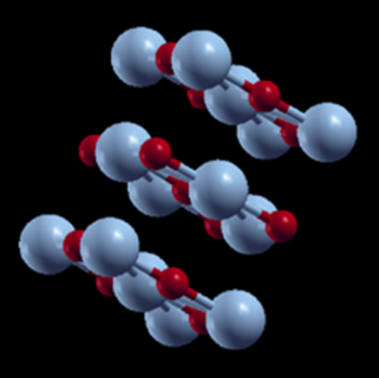
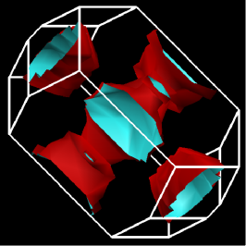

The Colossal Quantum Conundrum
T
U~U₀ exp(-α g), g < g*; 0, g > g*
NB1: These BZ’s & FS’s reflect an af-ordered, 2x periodic primitive unit cell.
U = 3
“Real Metal”
“Fermi Liquid”
Our Proxy HTSC!
“Funny Metal”
“Pseudogap”
“Fond AF Memories”
“SDW”
“NEEL”
“A-F”
“Funny Metal”
“Pseudogap”
“Fond AF Memories”
“Undoped Rocksalt
Copper Monoxide”
U = 6
U = 0
NB2: For U < 6 eV, it’s a metal!
Superconductivity
“Insulator”
g*
“Conductor”
g
Somewhere in here there has to be “BCS-like” pairing!

Slide 6
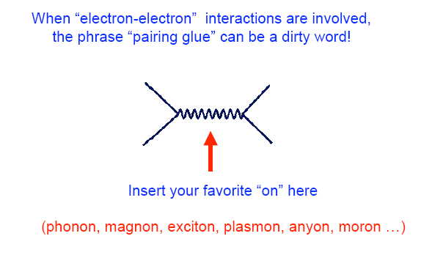
IOW, What’s theFermion-Boson Interaction That Leads to HTSC?
“Put-on !”
Notes:
6

Slide 7
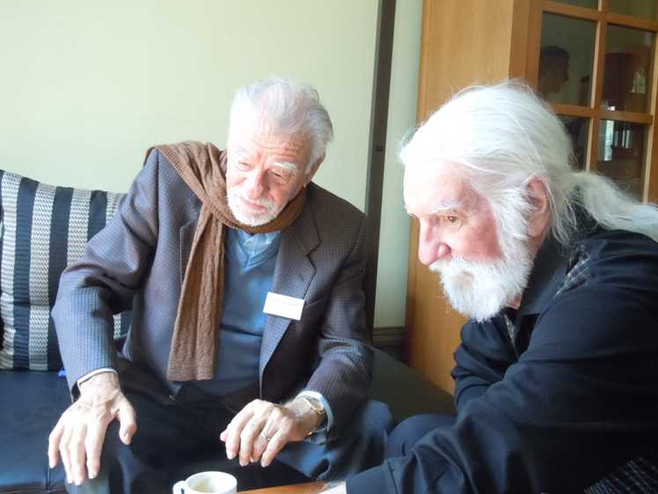
The Pairing Glue
“Alex says it’s phonons”
OK, OK...J-T polarons and/or bipolarons (after Chakravarty/Hoest)
Could he be right after all?

Slide 8
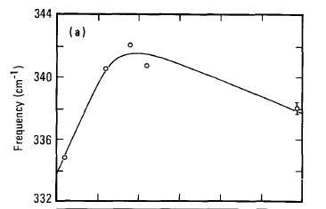

Hey! Maybe, they’re there!
Macfarlane, Rosen, Seki, SSC 63, 831 (1987)
(These data were taken in early March, 1987, a week before “Woodstock”)
Raman Spectroscopy of YBCO

Slide 9
More Phonon Phootprints!
Pyka, et al., PRL 70, 1457, (1993)
Harashima, et al., Physica C263, 257 (1996)

Slide 10
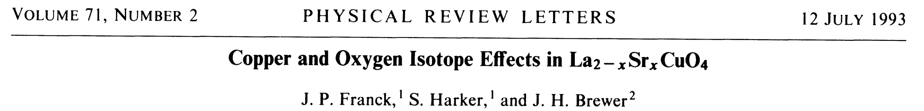
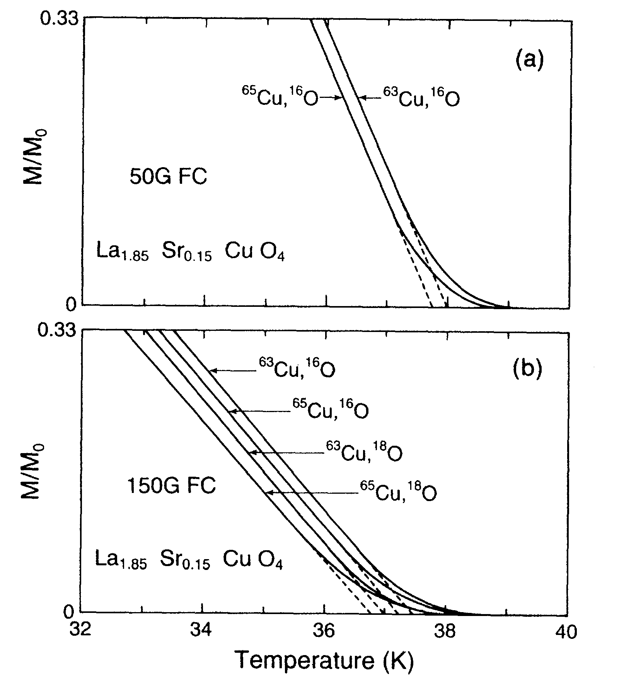
...and More!

Slide 11
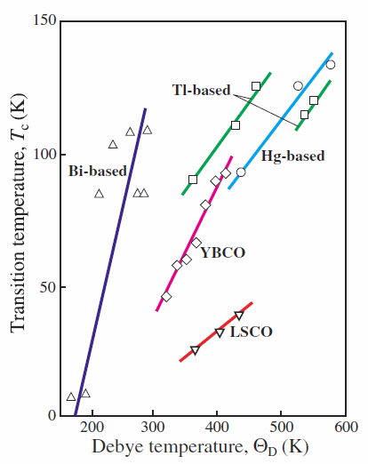
Finally, T_{C} scales (roughly) with Θ_{D} !
Nota Bene!
“S” denotes Ca, Sr, Ba
Ledbetter, Physica C 235, 1325 (1994)

Slide 12
What Can DFT(LDA+U) Along With Eliashberg-McMillan-Allen-Dynes (EMAD) Formalism Tell Us About e-p Mediated Pairing in the Copper Oxide Perovskites?
Assume the simplest and highest symmetry possible Cu-monoxide to model (e.g. cubic or tetragonal rocksalt CuO...see Grant (Proc IOP (2008) and Siemons, et al., PRB (2009)).
Apply the Quantum-Espresso DFT Package to calculate the eigenspectrum and e-p coupling for these proxy structures, followed by application of EMAD to estimate Tc (Grant, Proc. MRS, to appear).
Perform the above for both hole and electron doping levels ±0.15|e|/CuO under the assumption these levels of carrier densities effectively screen Hubbard U (see “Quantum Conundrum”)

Slide 13
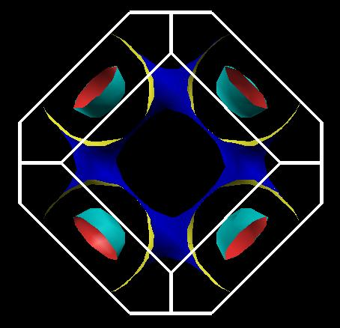
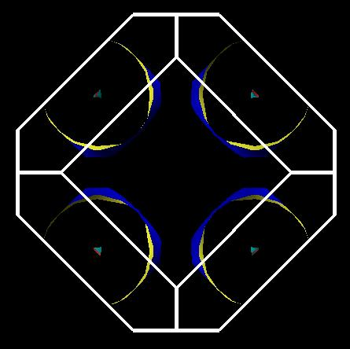
So let’s do it and “compute” what happens!
Assumptions: ≈ 440 °K, μ* ≈ 0.01, a = 3.06 Å, c/a = 1.3 (nmTet cell)
q = 0.15 |e|/CuO (holes)
q = -0.15 |e|/CuO (electrons)
λ = 1.2
λ = 0.7
≈ 43 °K
≈ 25 °K

Slide 14
OK...What’s Next (Materials-Wise)?
Force-epi 10 monolayers of tet-CuO
  Overlay with 2 monolayers of Li as “neighborhood” dopant...look for SC
  “Topological Metal?” ☺
Look for explicit “phonon-spinon” coupling:
  “Paramagnetic Dispersion Measurements at 77.3 °K,” C. Starr (MIT). Examines the coupling between spins and phonons in transition metal carbonates and hydrates.
  Published in Phys. Rev. 60, 241 (1941!)
  Have such studies been done on the copper oxide perovskites? If not, why not?
Apparently no DFT(LDA+U) tools yet exist to calculate electron-phonon λ in the presence of a finite Hubbard U...why not?

Slide 15
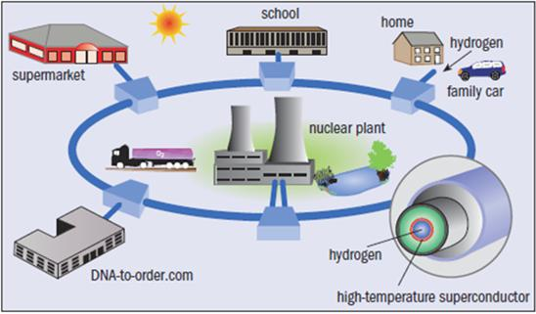
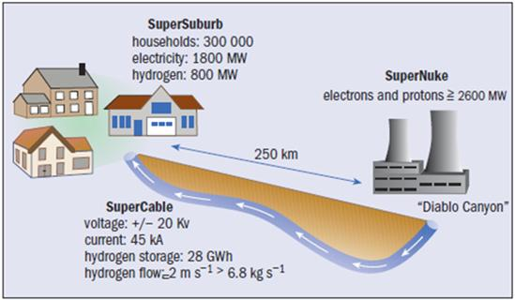
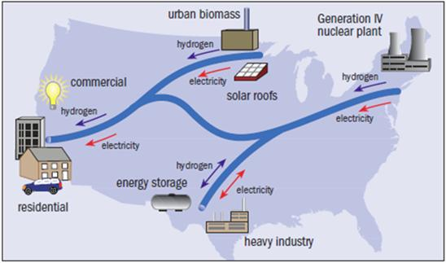
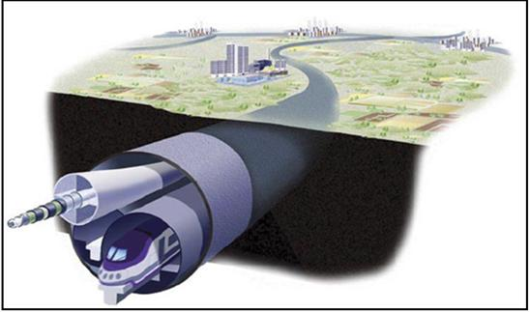
Now for something slightly bigger... by 10¹⁹ (Exascale!)
SuperCity
SuperSuburb
SuperGrid
SuperTrain

Slide 16
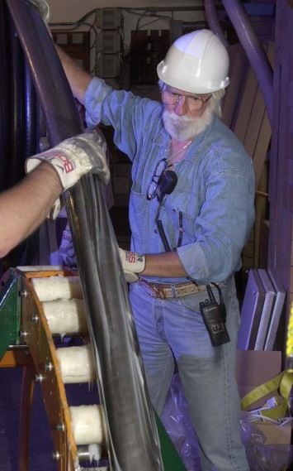
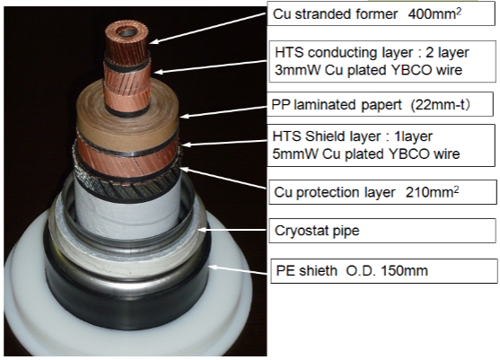
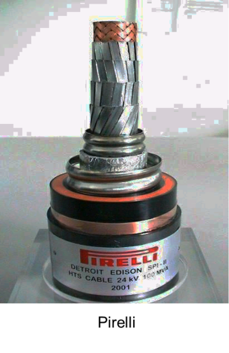
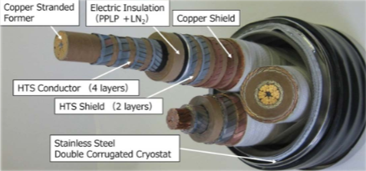
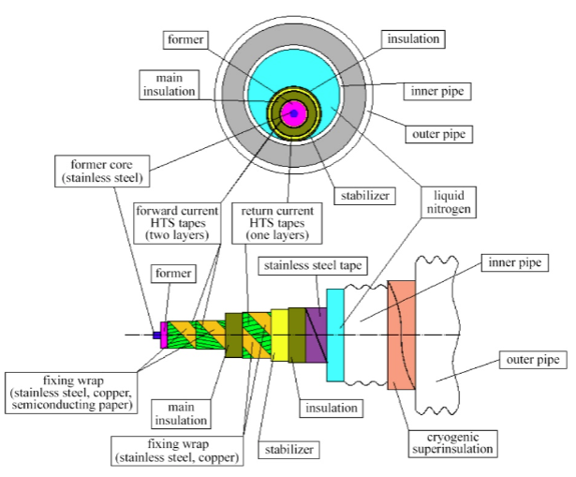
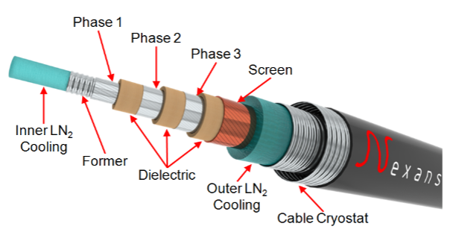
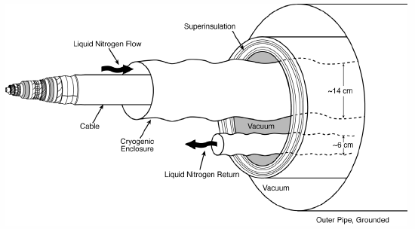
HTSC SuperCables:
Past, Present, and...Future?
~ 1997
Sumitomo 66 kV 3-in-1
Furakawa, 275 kV, 3 kA
EPRI SCDC
100 kV, 100 kA, 10 GW
St. Petersburg, Russia
~ 2013

Slide 17
Required Reading!
(Thanks to Steve Eckroad, EPRI)
Two EPRI Reports (available free from epri.com or w2agz.com)
  (2012) Superconducting Power Equipment; Technology Watch 2012 (1024190)
  (2013) SIU: Superconductivity for PDA (03002001)
Bottom Lines:
  Work continues on wire improvement and power application demonstration, although not at the pace of a decade ago.
  HTSC materials performance and costs have matured.
  What’s needed is a strong business case for HTSC power applications.
  Does there exist a “compelling need,” now or in the next decade, to effect a major and continuing deployment of HTSC in the electricity enterprise?

Slide 18
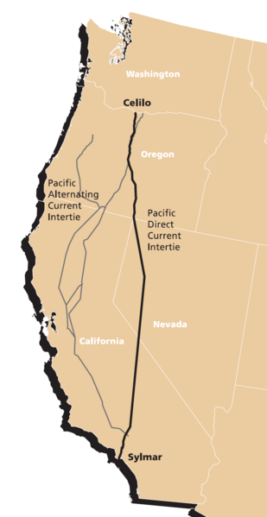
Pacific Intertie
HVDC, +/- 500 kV, 3.1 kA, 3.1 GW
1,362 km
~50% of LA Power Consumption
T&D Losses ~ 10%
Tear down the PI and replace with HTSC underground cables to capture this saving?
Ain’t gonna happen, baby!
Not a “compelling need!”
Even should the cost of the wire be zero!

Slide 19
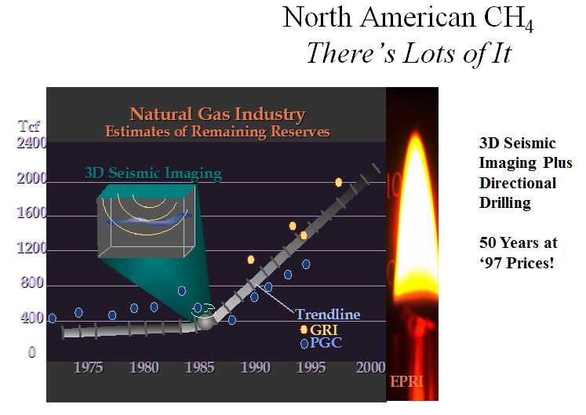
However, do we have a “compelling new opportunity?”
P.M. Grant, EPRI, 1998

Slide 20
Why not make dual-use of emerging gas pipeline rights-of-way to transport electricity via HTSC cables?
Natural Gas & Electricity!
“Fraternal Twins,”
Smart Grid News
16 April 2013
Wow!
2012 USA Electricity Generation by Primary Fuel Source

Slide 21
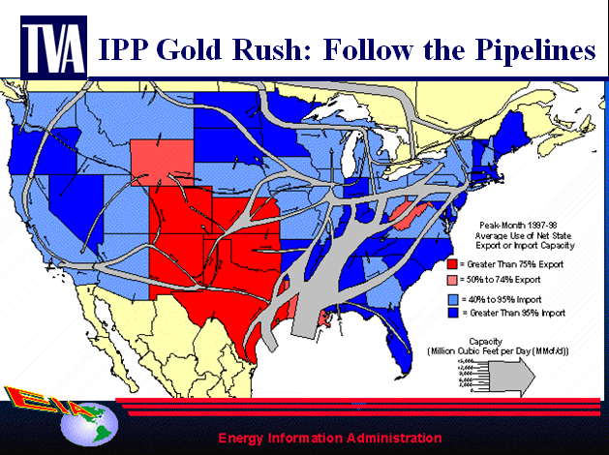
Not exactly a new idea!
(Terry Boston, TVA VP, 2001)

Slide 22
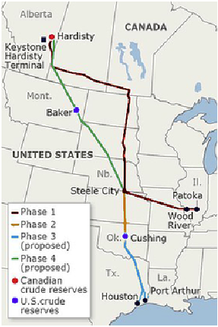
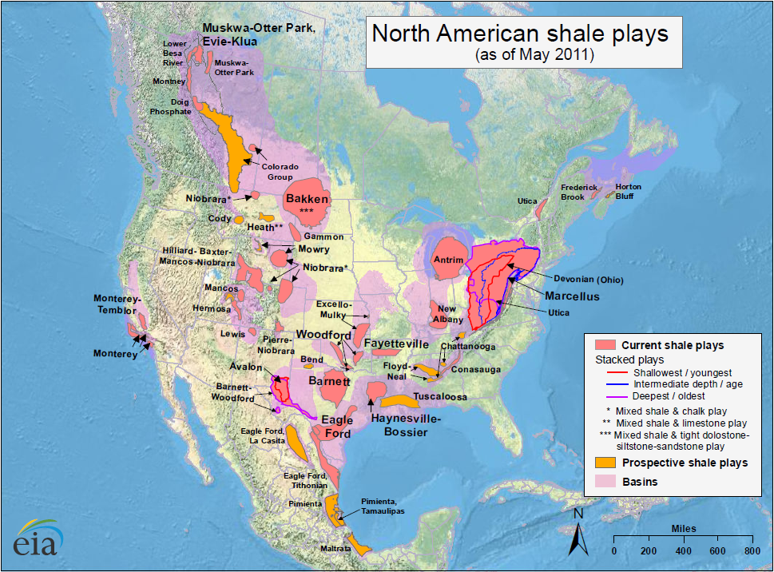
Does “Keystone XL” Provide a “Compelling Opportunity” to
“Raise Our Fraternal Twins?”
Let’s encourage DOE to enlist EPRI, GTI, EIPC, INGAA,...in a collaboration to conduct an “engineering economy” study focused on the dual-use ROW concept.

Slide 23
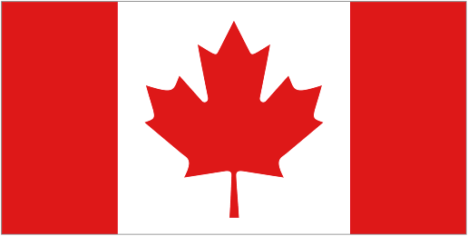
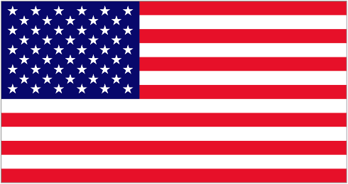
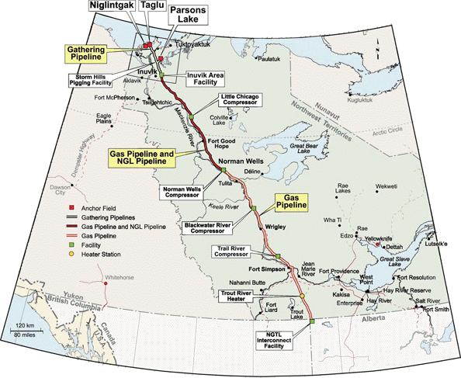
...and in the long term...
Electricity Conversion Assumptions
Wellhead Power Capacity | 18 GW (HHV)
Fraction Making Electricity | 33%
Thermal Power Consumed | 6 GW (HHV)
Left to Transmit as LNG | 12 GW (HHV)
CCGT Efficiency | 60%
Electricity Output | 3.6 GW (+/- 18 kV, 100 kA)
“Cryodelivery Systems for the Cotransmission of Chemical and Electric Power,”
P.M. Grant, AIP Conf. Proc. 823, 291 (2006).

Slide 24
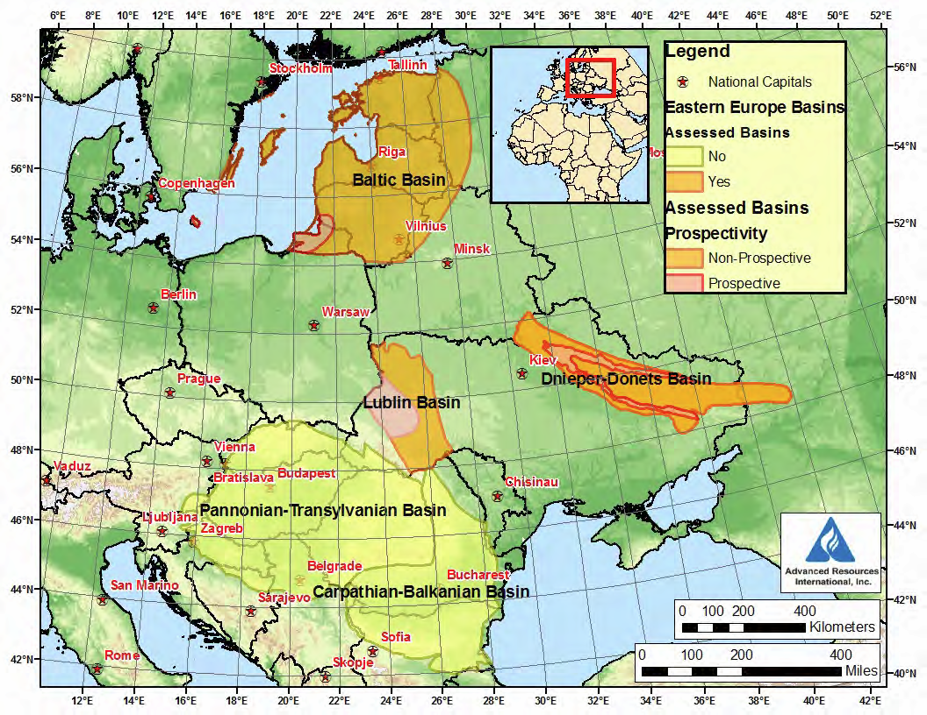

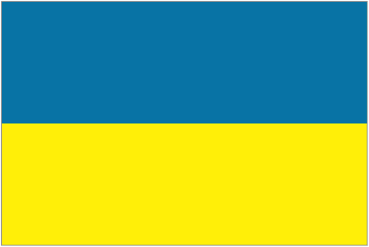
Let’s Not Forget Europe!
The Wola Obszańska (Lublin) gas field in Poland/Ukraine was discovered in 1989. It began production in 1992 and produces natural gas. The total proven reserves of the Wola Obszańska gas field are around 37 billion cubic feet (1×10⁹m³). “Dual-Pipe” to Berlin?
o Wroclaw

Slide 25
Back to the Future
(of Nanoscale!)
The Grand Challenge of Materials Science:
Can we make a room temperature superconductor?
  Bill Little says “yes” (1963)...simply surround a 1D metal chain with polarizable molecules and use “excitons” as the “pairing boson.”
  Problem: Periodic 1D metals are unstable and want to became insulators (dimerization).
Solution:
  Create a 1D Fibonacci (quasiperiodic) chain of “metal” atoms that resists CDW and dimerization “gapping” instabilies on a suitable “polarizable” substrate.
  How? “Decorate” a dislocation line on the [100] surface of STO, SRO, Si...

Slide 26
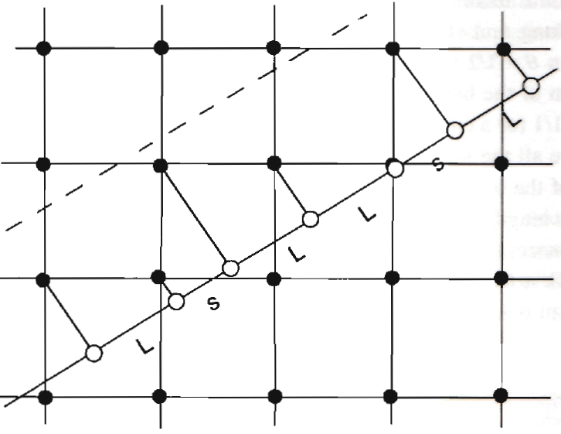
A Fibonacci “Dislocation Line”
From P.M. Grant, APS March Meeting, Portland, OR (2010)
Al
Al
Al
Al
SRO !
STO ?
Al
Al
Al
tan θ = 1/τ ; τ = (1 + √5)/2 = 1.618… ; θ = 31.717…°
L = 4.058 Å (fcc edge) s = 2.869 Å (fcc diag)

Slide 27

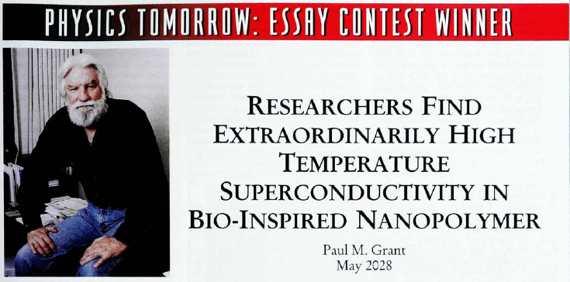
Does the
Hold the Key to Room Temperature Superconductivity?
50th Anniversary of Physics Today, May 1998

Slide 28
Lessons from
“Four Altamont Philosophers”
...for materials scientists under 50...

Slide 29

“You can’t always get what you want…”

Slide 30
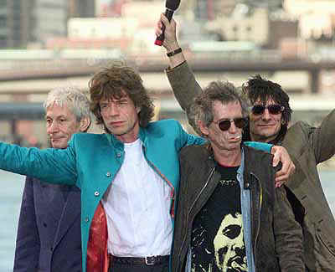
“…you get what you need!”

