Slide 1
Setup

Slide 2

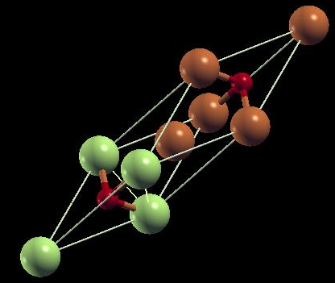
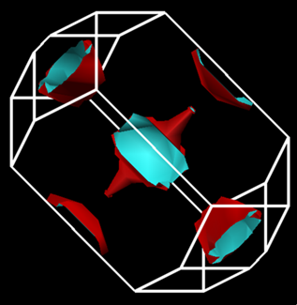
AFOSR Superconductivity
Program Review 2014
18 August 2014
Arlington, VA
A DFT Study of Tetragonal Rocksalt Proxy Copper Monochalcogenide Structures:
-- Implications for Possible High-Tc Superconductivity --
Paul M. Grant
W2AGZ Technologies
Robert H. Hammond
Stanford University
A Sheynem Dank, Biz Hundert,
Reb Harold!

Slide 3

– Our Computational Tool Box –
DFT + Hubbard U
  Quantum Espresso
    Bands, Fermiologies, States (DOS), Phonons
Graphics
  Xcrysden, XMGRACE
    Bandwidths, Fermi Surfaces, Projected DOS
Modeling
  Neel Temperatures a la Van Vleck/Anderson/Hubbard
  Superconductivity via Eliashberg/McMillan

Slide 4
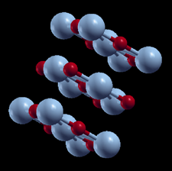
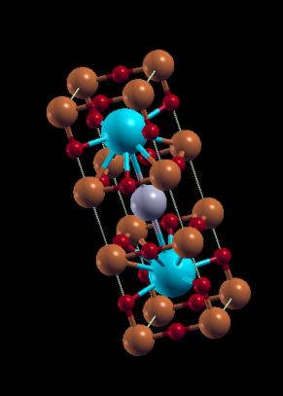
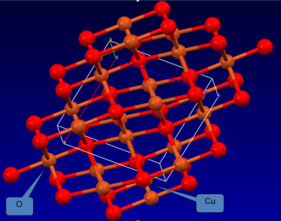
The Various Flavors of Copper “Monoxide”
Siemons, et al. (2009)
Grant (2008)
Franchini Group (2011)
Cococcioni Group (2011)
tet-rs-CuO
“1-2-3”
Relative Ground
State
Energies
Tennorite
Can we compute/synthesize
the S, Se, Te analogues
...and what would be their physical properties wrt magnetism and superconductivity?
“Configuration/Coordination Space”

Slide 5
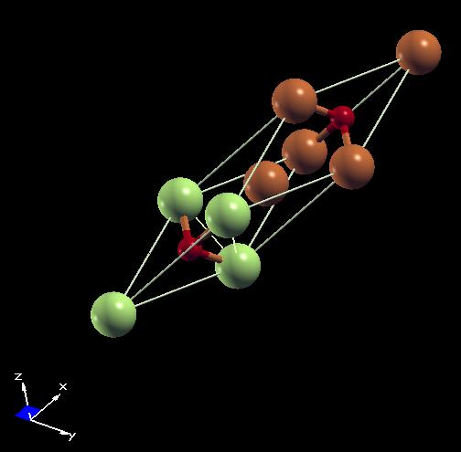
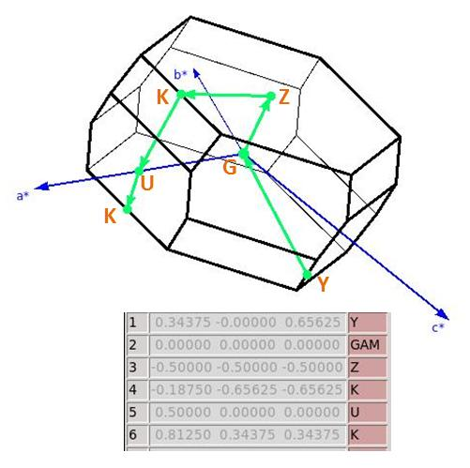

Rocksalt af-CuX Crystallography
nm-Translational Unit Cell
af-Primitive Cell
Cu (Blue)
Cu (Bronze, Green)
X (Red)
X (Red)
Brillouin
Zone
“U”
Note: The af-”translationally asymmetric unit”
contains
two Cu ions to correctly represent the doubly-periodic spin up/down ordering

Slide 6
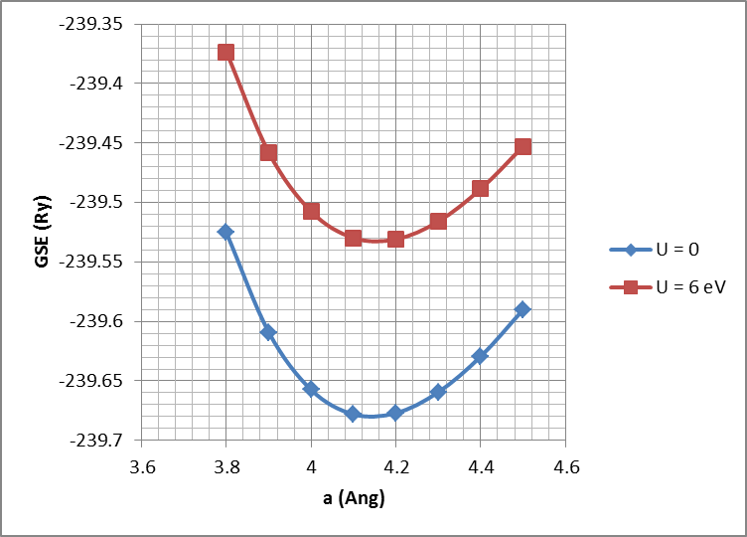
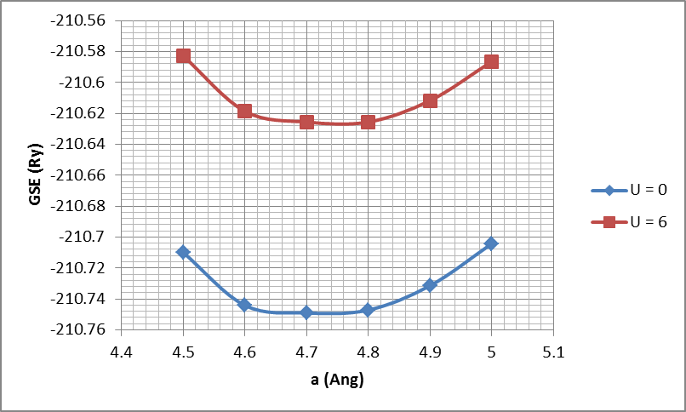
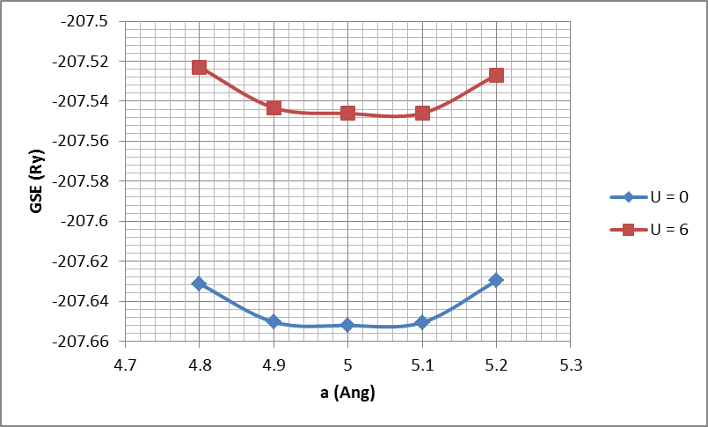
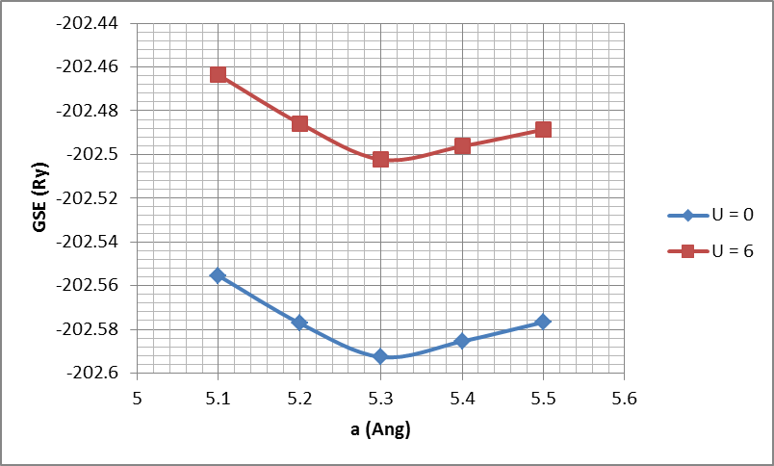
CuX (Cubic, Equilibrium Lattice Constant(s))
CuO (a ≈ 4.1 Å)
CuS (a ≈ 4.7 Å)
CuSe (a ≈ 5.0 Å)
CuTe (a ≈ 5.3 Å)

Slide 7
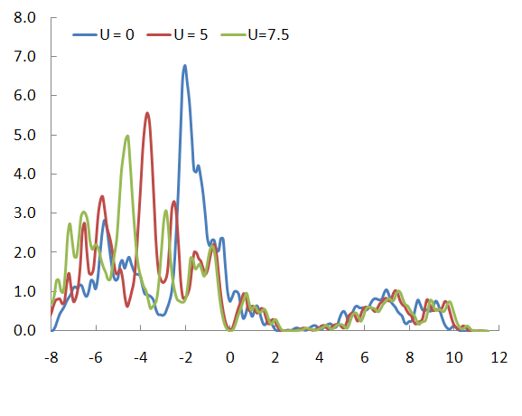
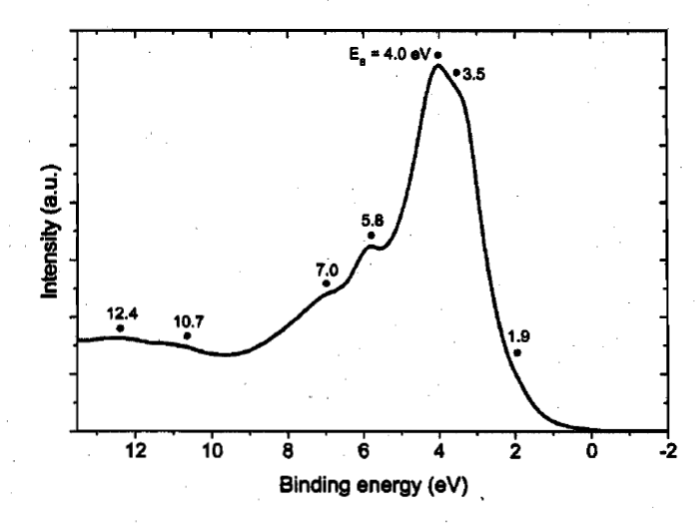
What Does Experiment Say About Rocksalt CuO?
It’s Tetragonal(!) for 4-6 monolayers forced-epi grown on STO yielding a film with lattice constants a = b = 3.905 Å, and c/a ≈ 1.3, representing a 5% basal-plane contraction down from pure cubic having a = b = c = 4.1 Å. (Siemons, et al, PRB 79, 195122 (2009))
He I UPS Spectrum
W. Siemons (PhD Thesis, Stanford)‏
E_{F}
N(E) (eV⁻¹)‏
E (eV)‏
See Fig. 9 in Grant, IOP-CS 129, 012042 (2008)

Slide 8
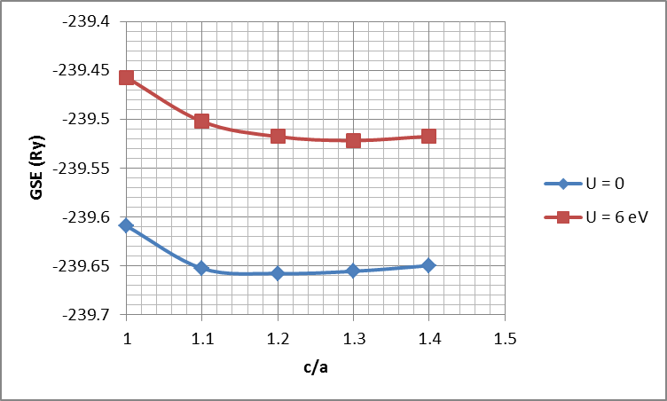
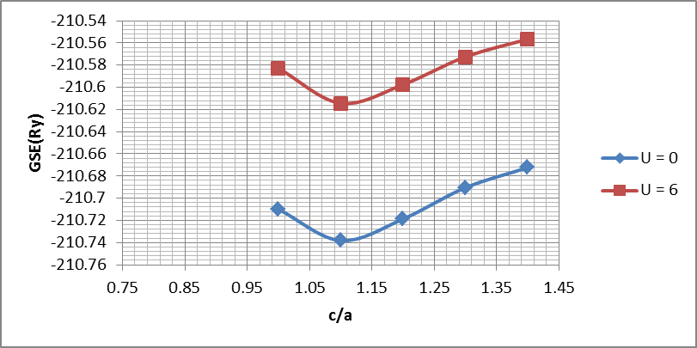
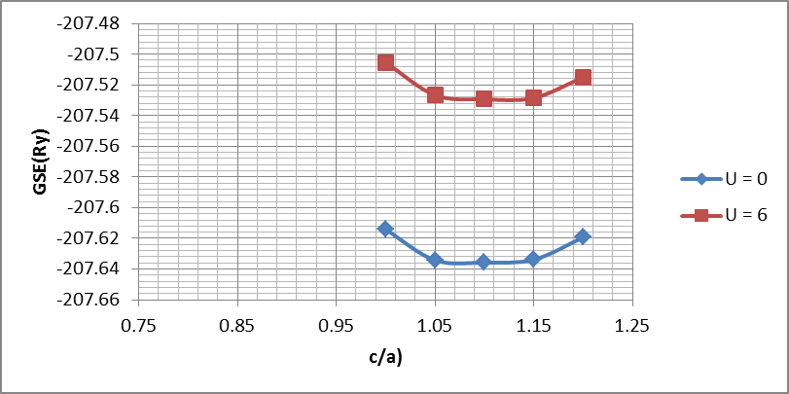
CuX (Tetragonal)
(Assuming a 5% contraction of the a, b lattice constants a la CuO on STO)
CuO (a = b ≈ 3.9 Å; c/a ≈ 1.3)
CuS (a = b ≈ 4.5 Å; c/a ≈ 1.1)
CuSe (a = b ≈ 4.75 Å; c/a ≈ 1.1)
CuTe (a = b ≈ 5.05 Å; c/a ≈ 1.1)

Slide 9
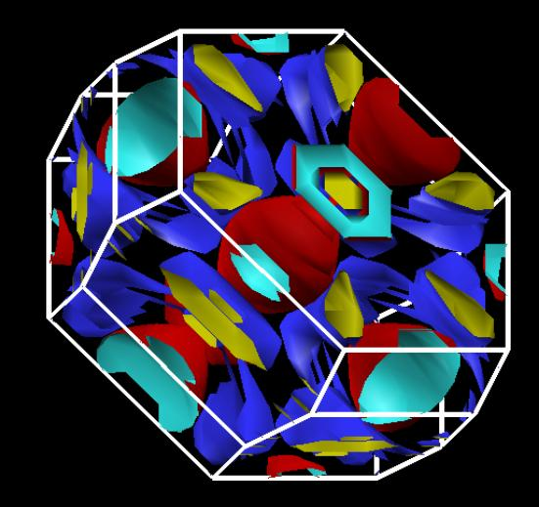
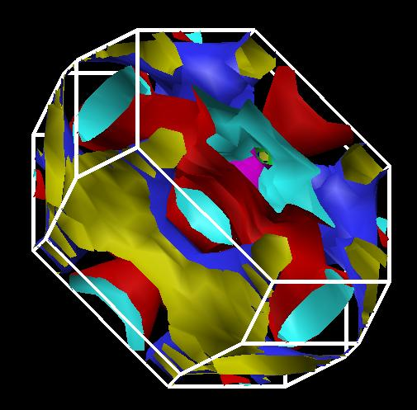
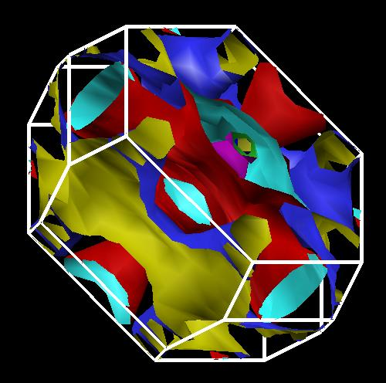
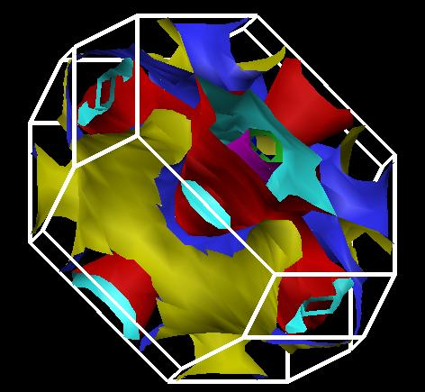
Cubic CuX
U= 0
CuO
CuS
CuSe
CuTe

Slide 10
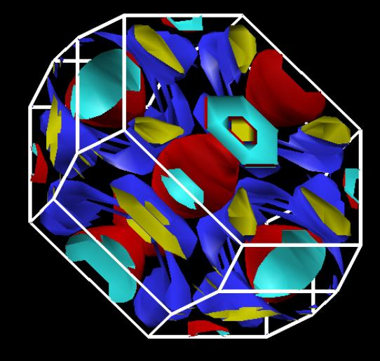
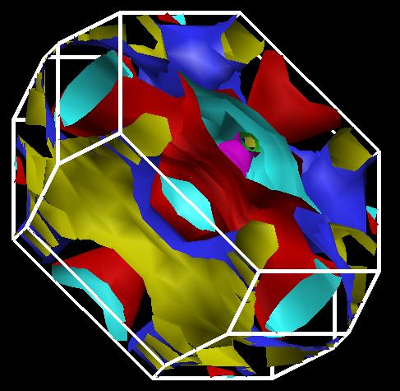
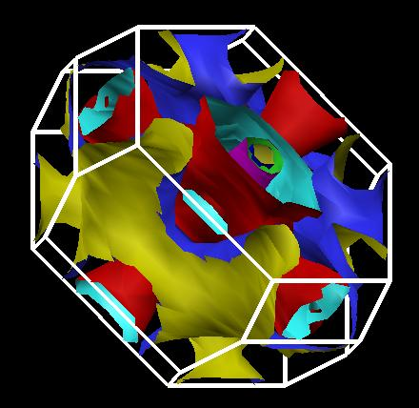
Cubic CuX
U= 6
CuO
CuS
CuSe
CuTe

Slide 11
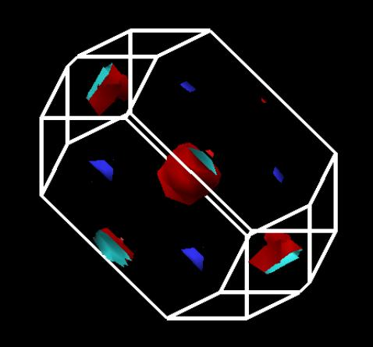
Tet-rs CuX
U= 0
CuO
CuS
CuSe
CuTe

Slide 12

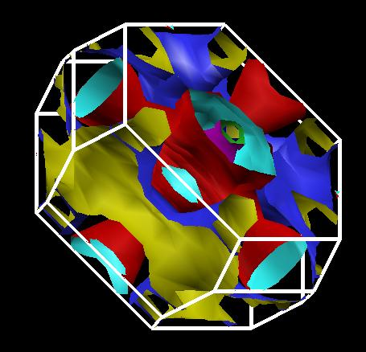
Tet-rs CuX
U= 6
CuO
CuS
CuSe
CuTe

Slide 13
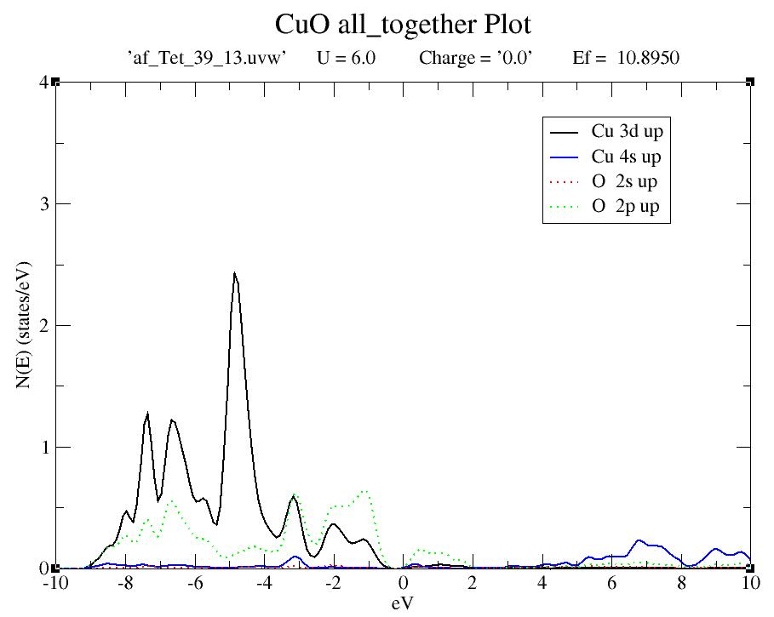
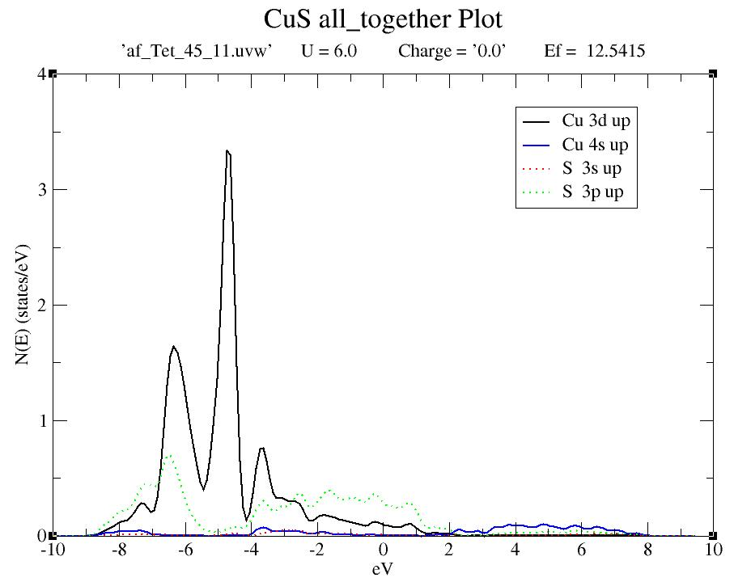

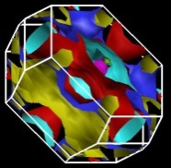
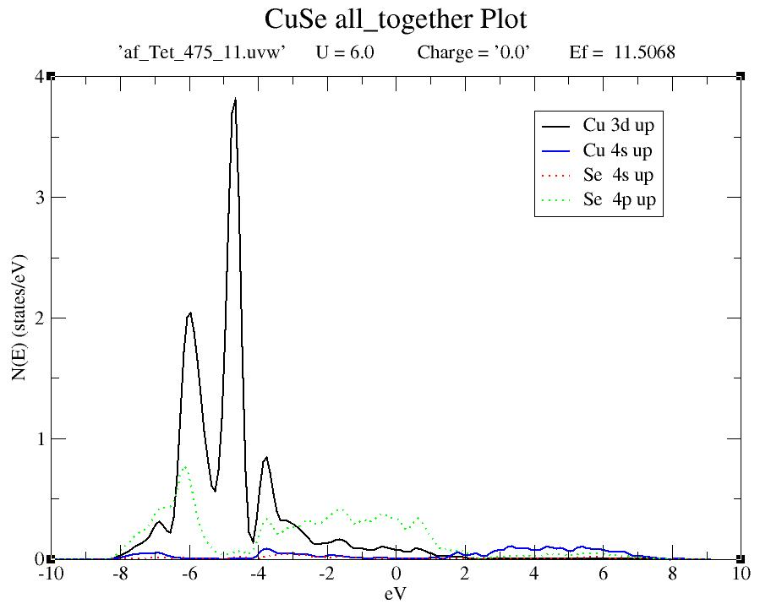
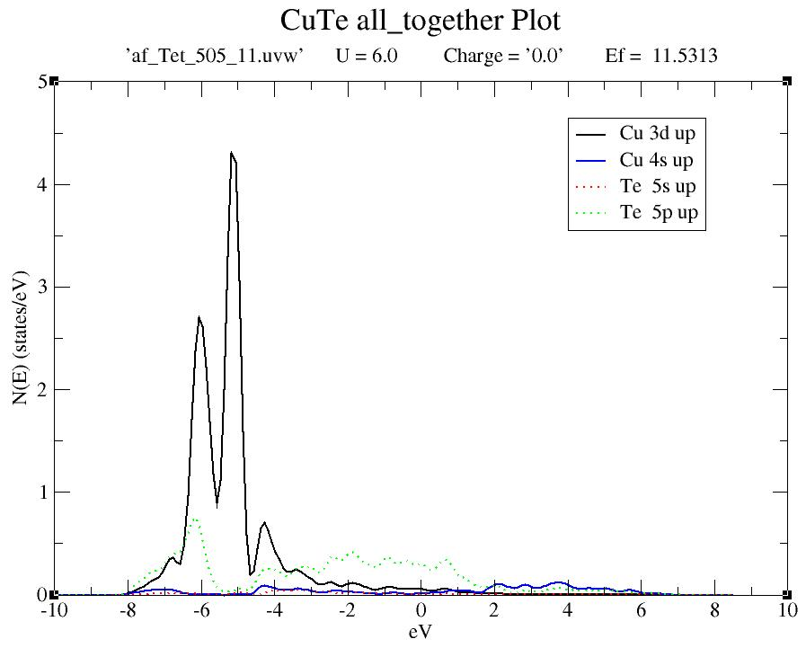
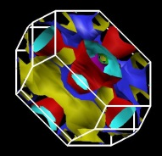

All Tet
All U=6
CuO
CuS
CuSe
CuTe

Slide 14
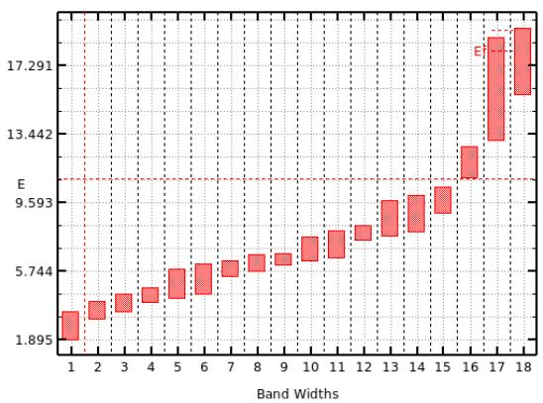
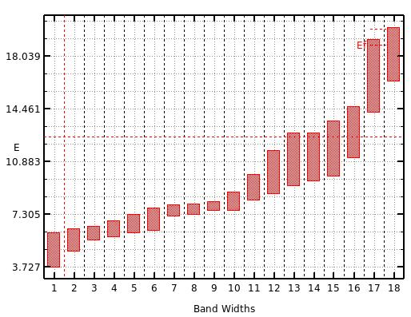

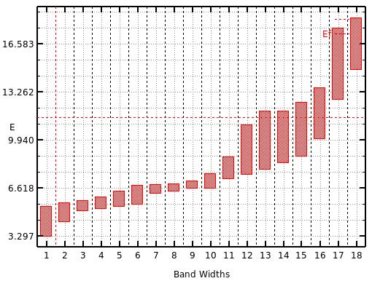
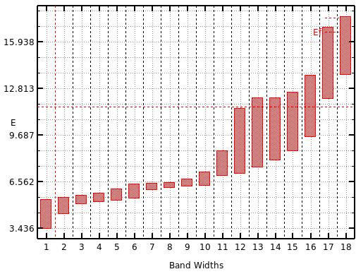
Bandwidths
All Tet. All U=6
CuO
CuS
CuSe
CuTe

Slide 15
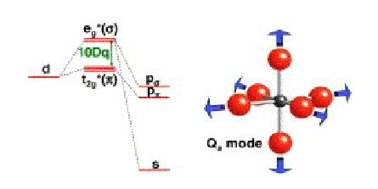
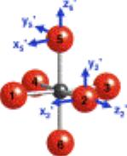
Van Vleck /Anderson/Hubbard
Model of Neél Temperature
Take the definition of “Exchange Energy” from Anderson (1959):
where t_{ij} is the transfer integral from the spin states on one TM ion, directly to a neighbor, or through an intervening anion, and U is the on-site Hubbard coulomb repulsion potential, e.g.,
Now, “plug into” Van Vleck (1938-42), within the “molecular field approximation,” to get T_{N}:
Here S is the net cationic spin and k_{B} the Boltzmann constant (8.61733•10⁻⁵ eV/°K).
The “transfer integrals” are given by,
where the ϕ’s are the “spin carrying” orbitals and H a “tight-binding-like Hamiltonian.”

Slide 16
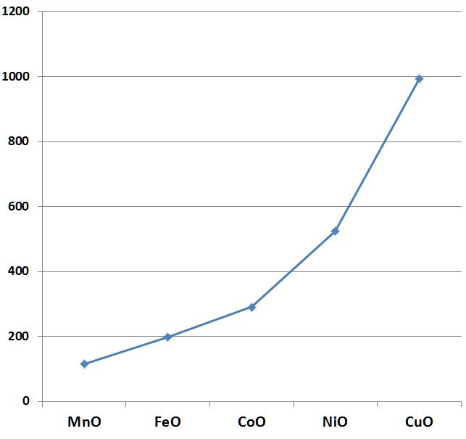
Néel Temperature vs. TMO
?
Tet-CuO
T_{N} (°K)
From Kittel
♦
Tenorite

Slide 17
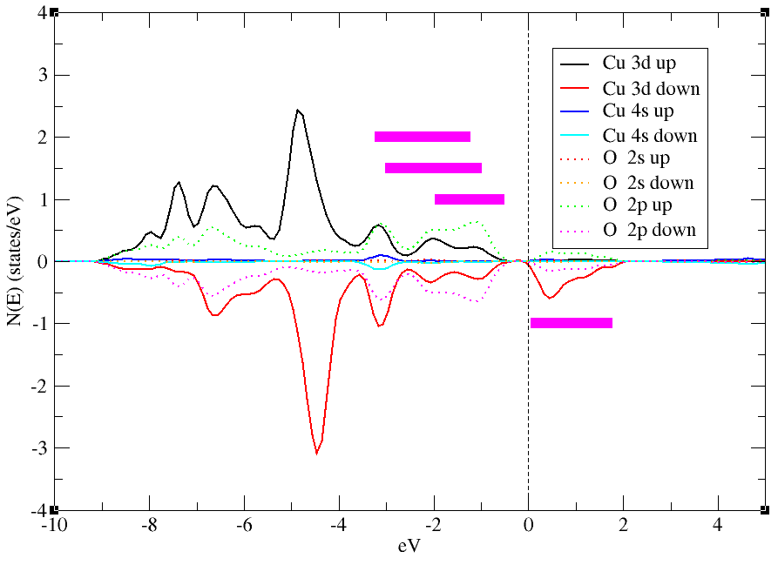

Tet-rs-CuO
a = b = 3.9 Å
c/a = 1.3
S = 0.5
U = 6.0 eV
Bandwidths, w_{i,j} (eV)
2.02
2.04
(1)
(2)
1.47
(3)
(4)
°K
(1) 494
(2) 501
(3) 261
(4) 360
1.73
°K
1+2 = 994
2+3 = 762
1+2+3 = 1255
?

Slide 18
Néel Temperature vs. TMO
?
Tet-CuO (1+2)
♦
Tet-CuO (2+3)
T_{N} (°K)
From Kittel
♦
Tenorite

Slide 19
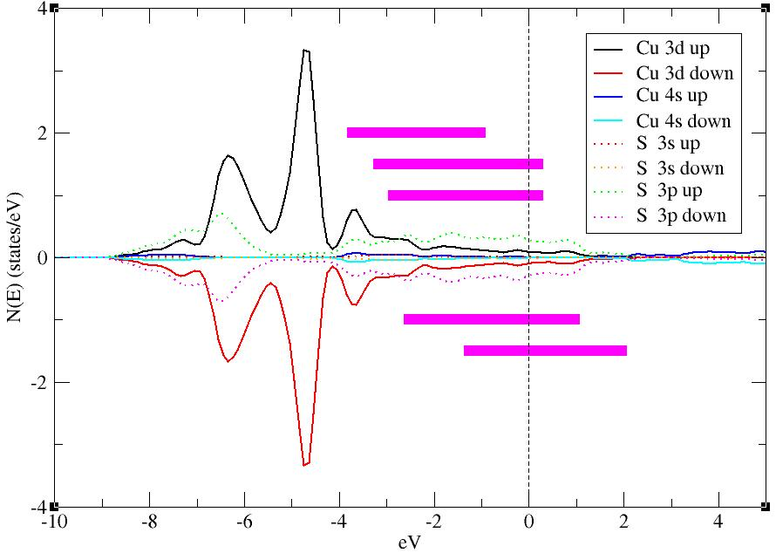
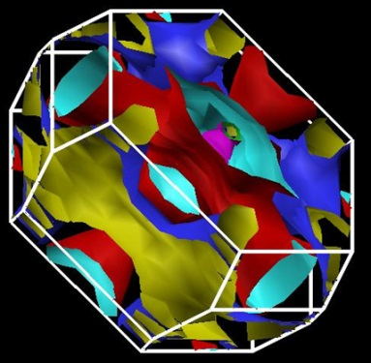
Tet-rs-CuS
Bandwidths, w_{i,j} (eV)
a = b = 4.5 Å
c/a = 1.1
S = 0.5
U = 6.0 eV
2.92
(1)
3.58
(2)
3.27
(3)
°K
(1) 1030
(2) 1551
(3) 1292
1659
1436
3.70
(4)
3.45
(5)
Such high values of T_{N} most
likely reflect a breakdown of
the simple tight-binding VVAH model when “X” > “O” in CuX

Slide 20
Superconductivity(?) Phonons(?)
Eliashberg-McMillan
Need to compute
!

Slide 21
e-p Interaction in the DFT/LDA Formalism

Slide 22
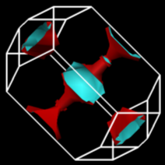
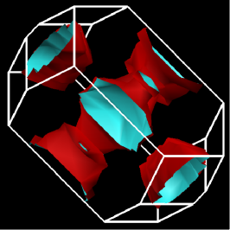
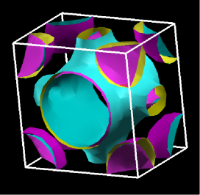

The Colossal Quantum Conundrum
T
U~U₀ {1 - (g/g*)²}^{1/2}
U = 3
“Real Metal”
“Fermi Liquid”
“Funny Metal”
“Pseudogap”
“Fond AF Memories”
“SDW”
“NEEL”
“A-F”
“Funny Metal”
“Pseudogap”
“Fond AF Memories”
U = 6
U = 0
Superconductivity
“Insulator”
g*
“Conductor”
g
Somewhere in here there has to be “BCS-like” pairing!
Perhaps phonon-mediated?

Slide 23
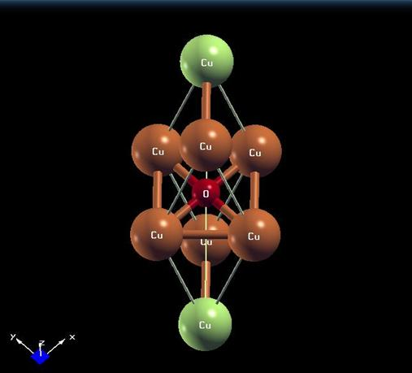
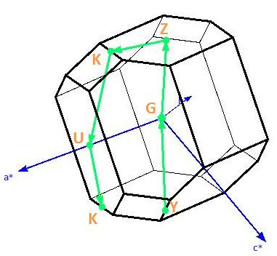
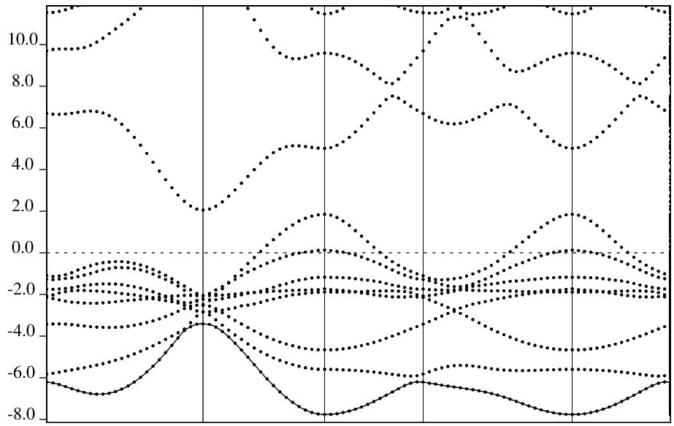
Well, how about the “U = 0, Fermi Liquid” limit
for doped proxy tet-CuO?
eV
G
Z
K
U
K
Y

Slide 24
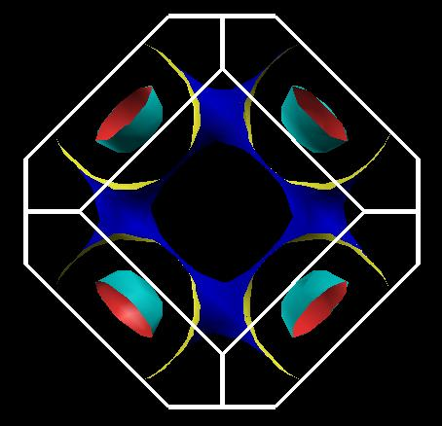
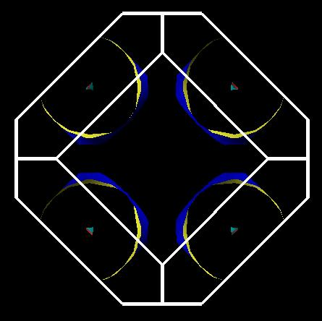
So let’s do it and “compute” what happens!
q = 0.15 |e|/CuO (holes)
q = -0.15 |e|/CuO (electrons)
≈ 43 °K
≈ 25 °K
Apply DFT to obtain between electrons and phonons, followed by application of the Eliashberg-McMillan-Allen-Dynes formalism to find Tc:

Slide 25


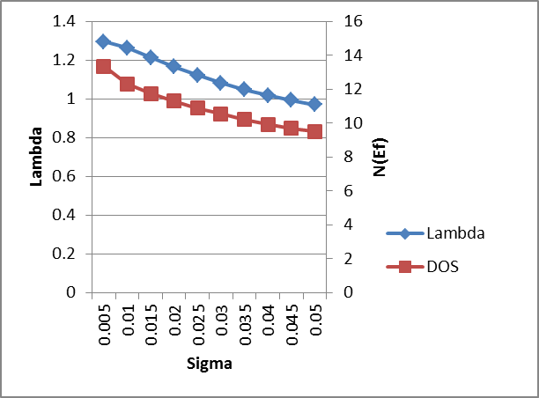

Whither Superconductivity in the TM Mono-VI’s?
CuO (Tet a=3.9 Å, c/a=1.3, U=0, q=0.15 |e|/CuO)
CuS (Cub a=4.7 Å, c/a=1.0, U=0, Undoped)
Note:
λ, N(Ef) ~ 0.5 that for CuO. Tc = ?

Slide 26
Can We Really Make Any of This Stuff?
Forced-epitaxial thin film growth is obvious choice (as it was with tet-CuO. Substrate selection likely limited, but here are possible choices:
  CuS (4.7 Å) Rocksalt ZnO (4.580 Å, ~3% compression)
  Rutile TiO₂ (4.591 Å, ~2.5% compression)
  CuSe (5.0 Å) Hex Al₂O₃ (4.748 Å, ~5% compression)
  CuTe (5 .3 Å) Cubic ZrO₂ (5.147 Å, ~5.3% compression)
  YSZ (5.13 – 5.23 Å, ~3.5% compression max)
  CaF (5.46 Å, ~3% expansion)
Methodologies
MBE - PLD:
  Use appropriate sintered sample source.
  Empirically determine optimum substrate temperature and argon pressure.
  Characterize growth and structure via in-situ “high pressure compatible” RHEED, XPS, UPS, LEED.
External characterization, depending on stability in air:
  4-probe transport.
  UV-Vis optical transmission and reflectivity.

Slide 27

“An Ideal Lab”

Slide 28
The Bottom Line(s)
For X = S, Se and Te, neither a finite U or a “5% basal” tetragonal distortion has much effect on their respective CuX Fermiologies, and likely transport/magnetic properties dependent thereon.
However, the respective Fermi surfaces ...may...may... contain nesting topologies promoting itinerant antiferromagnetism a la Cr, but, unlike Cr, here for X = S, Se, Te, the DOS at Ef is dominated by p-like chalcogenide overlap.
Future homework for proxy structure modelling, suggested by preliminary results on “doped” tet-CuO: Let’s look for electron-phonon mediated superconductivity!
But ...most importantly... experiment always rules. Our fundamental computational finding is that equilibrium rocksalt CuS, CuSe and CuTe structures can in principle exist ...so let’s try to make and dope them and henceforth measure their properties!
Finally, there is something quite special about the Cu-O bond in square-planar symmetry!
...but we knew that already... in 1986 B & M told us so!

Slide 29
Addenda Forward
-- What’s the Path to Higher Tc? --
All known HTSCs are “strong coupled BCS” systems...exclusive of “whatever boson” may be involved.
  Beasley/Gurevich have shown strong coupling yielding Tc’s ~ 190 K will lead to ξ’s < atomic radius.
  Not likely!
  So what’s the escape route?
Weak BCS coupling employing higher energy bosonic glue...e.g., “excitons,” aka Bill Little’s model.

Slide 30

Phononic, Plasmonic, or...Excitonic,?
“Organic Perovskites”
Mitzi (1999)

Slide 31


Back to the Future...PRB 1976
Kirshnitz, Maximov & Khomskii (KMK)
This dispersion relation is at the heart of the “Little Model”
Assume for a given model we compute the ground state eigenstates via DFT...we then need to code KMK and apply to estimate Tc...
Let’s do it, People!

Slide 32

A Fibonacci “Dislocation Line”
“Scratch” along the 100 surface of single crystal, say Si, and then “decorate” with a line of, say Al atoms. Then use DFT + KMK to test “Bill’s idea.”
tan θ = 1/τ ; τ = (1 + √5)/2 = 1.618… ; θ = 31.717…°

Slide 33

The Future?
Physics Today, November 1998
700 K !
NB! The plot of this story is fiction...
May, 2028
But the Science is not!

