Slide 1
Setup

Slide 2



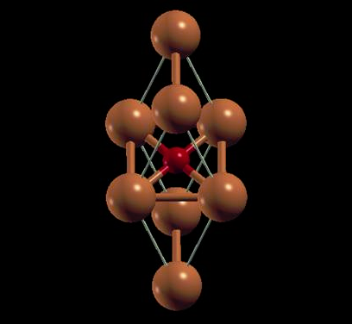
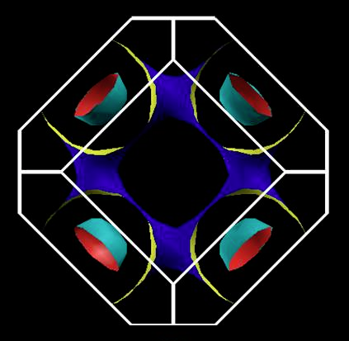
A DFT Study of Electron-Phonon Coupling in
Proxy CuX (X = S, Se, Te) Structures and Its Relationship
to Possible Manifestation of Superconductivity
Paul M. Grant
W2AGZ Technologies
Robert H. Hammond
Stanford University
Session Q11
Chalcogenide Superconductors
2:30 PM – 4:54 PM, Wednesday, 4 March
Paper 11
4:06 PM – 4:18 PM
Room 007B

Slide 3

– Our Computational Tool Box –
DFT + Hubbard U
Quantum Espresso
Fermiologies, States (DOS), Phonons, e-p “Lambda”
Graphics
Xcrysden, XMGRACE
Fermi Surfaces, Projected DOS
Modeling
Debye Temperatures a la Gibbs2 Package
Thanks to Alberto Otero-de-la-Rosa, http://azufre.quimica.uniovi.es/src/gibbs2/gibbs2.pdf
Then Superconductivity via Eliashberg/McMillan!

Slide 4
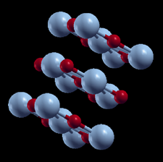
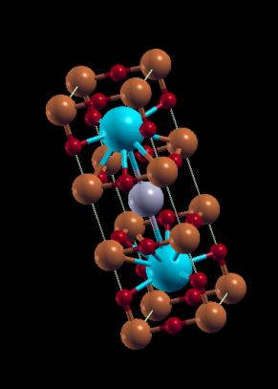
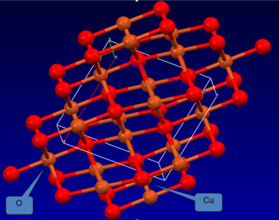
The Various Flavors of Copper “Monoxide”
Siemons, et al. (2009)
Grant (2008)
Franchini Group (2011)
Cococcioni Group (2011)
tet-rs-CuO
“1-2-3”
Relative Ground
State
Energies
Tennorite
Can we compute/synthesize
the S, Se, Te analogues
...and what would be their physical properties wrt magnetism and superconductivity?
Magnetic properties revealed at APS MM Denver 2014. Now superconductivity!
“Configuration/Coordination Space”

Slide 5
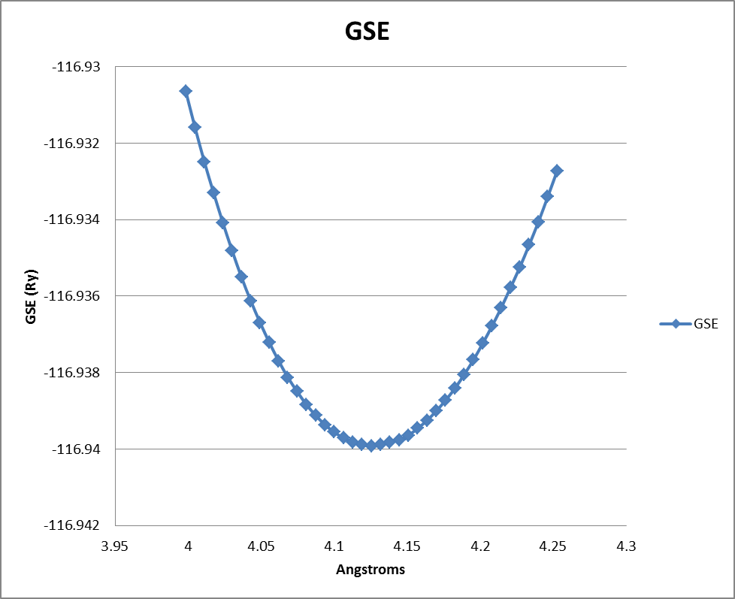
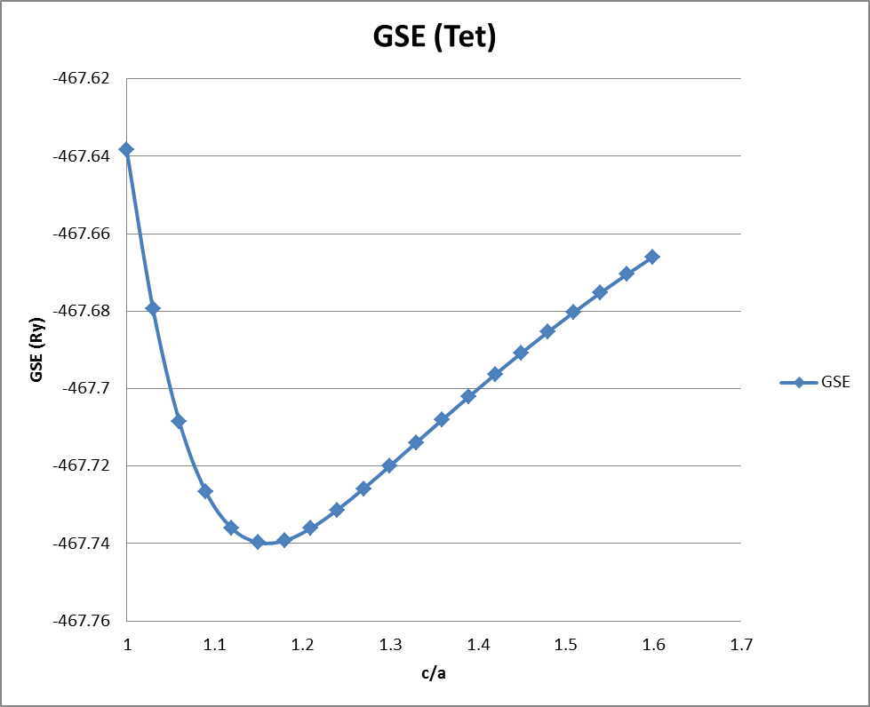
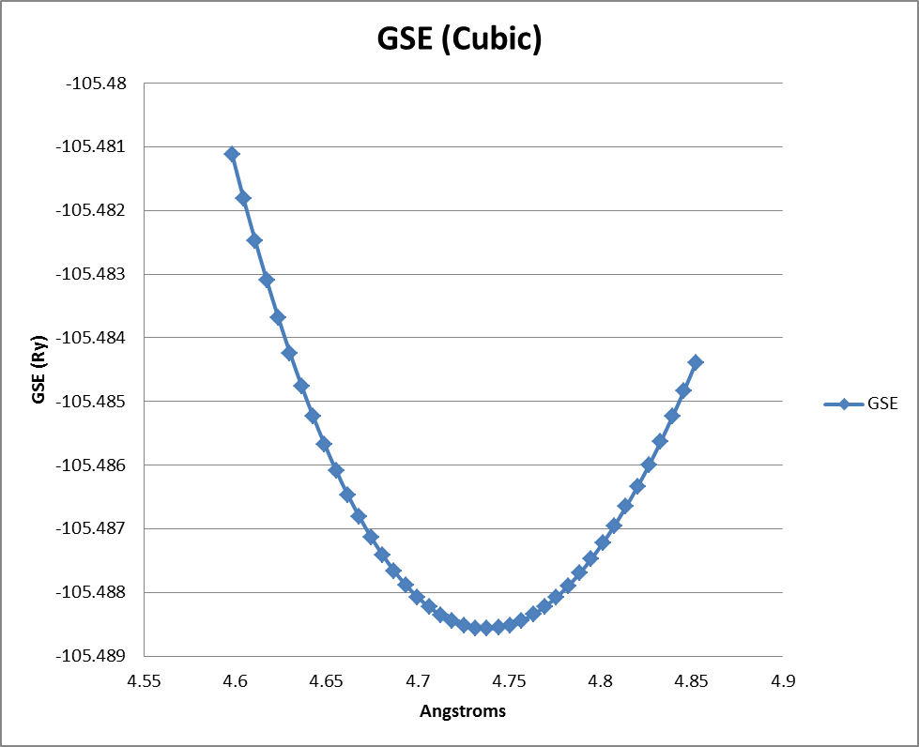
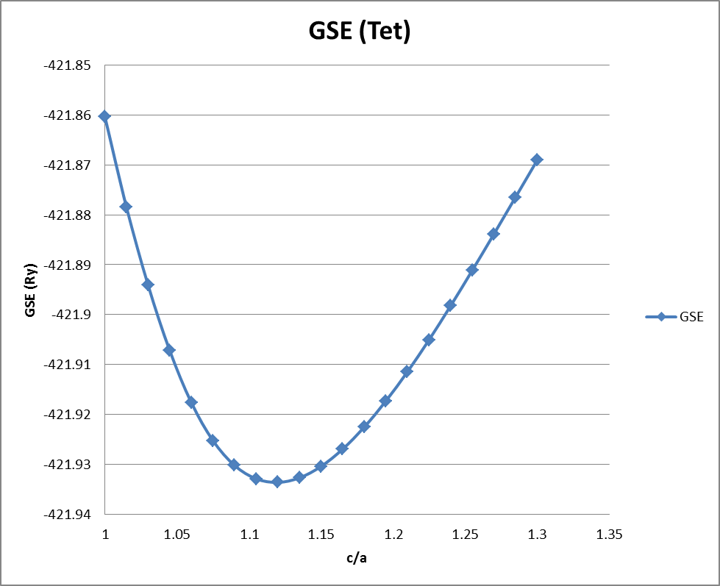
Ground State Energies via Gibbs2: CuO & CuS
Cubic
Tetragonal
(Cubic)
CuO (Cubic)
CuO
CuO (Tet)
Θ_{D} = 693 K
Θ_{D} = 733 K
Min GSE at a0 = 4.13 Å
Min GSE at a0 = 3.9 Å, c/a = 1.15
CuS (Cubic)
CuS(Tet)
CuS
Θ_{D} = 525 K
Θ_{D} = 780 K
Min GSE at a0 = 4.75 Å
Min GSE at a0 = 4.5 Å, c/a = 1.12

Slide 6
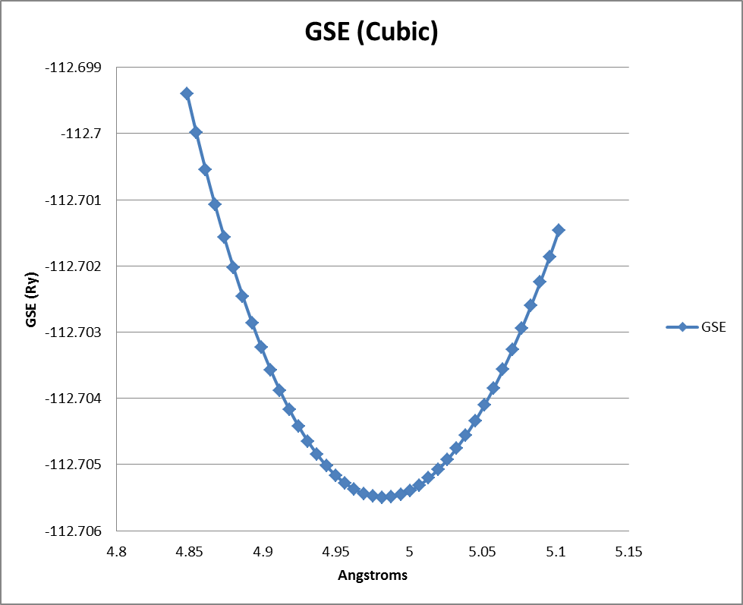
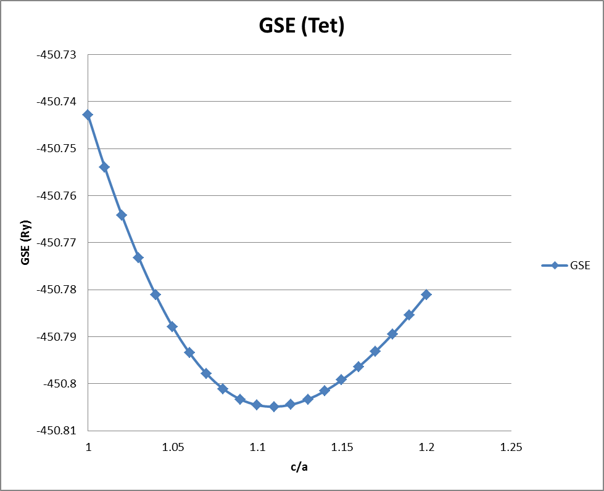
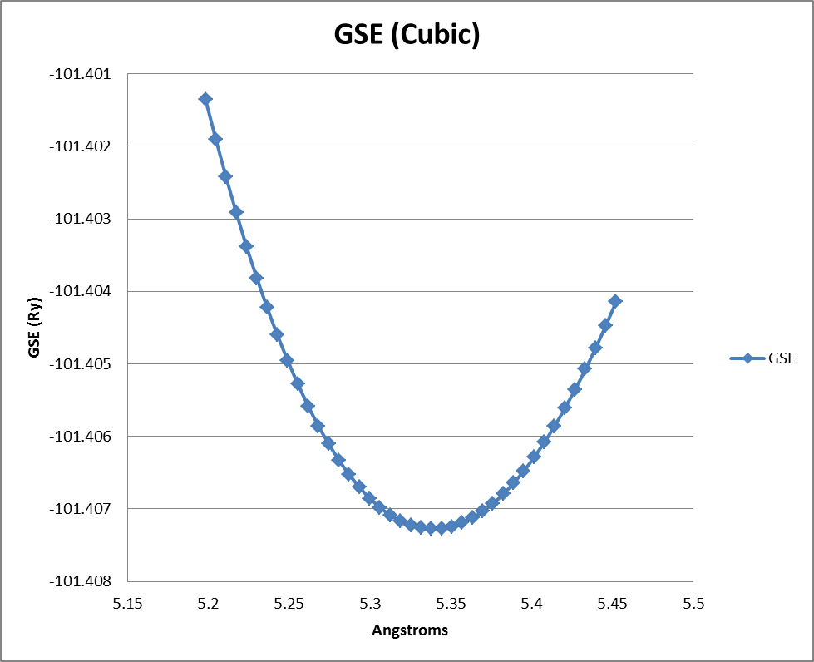
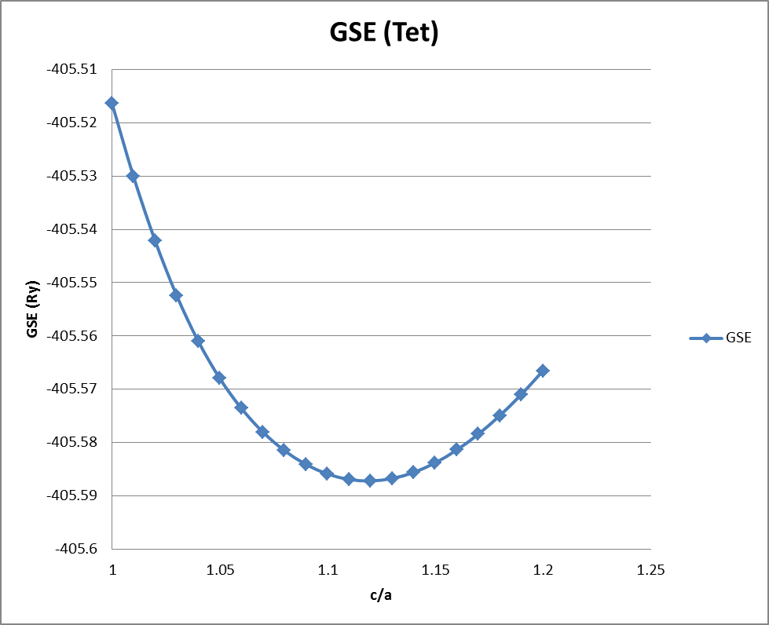
Ground State Energies via Gibbs2: CuSe & CuTe
Cubic
Tetragonal
CuSe
CuSe (Cubic)
CuTe (Tet)
Θ_{D} = 409 K
Θ_{D} = 622 K
Min GSE at a0 = 5.0 Å
Min GSE at a0 = 4.75 Å, c/a = 1.1
CuTe (Cubic)
CuTe
CuTe (Tet)
Θ_{D} = 327 K
Θ_{D} = 489 K
Min GSE at a0 = 5.34 Å
Min GSE at a0 = 5.05 Å, c/a = 1.1

Slide 7
Superconductivity and Phonons BCS via Eliashberg-McMillan
NB! The “double deltas” will be approximated by two Gaussians of width “sigma (σ)” whose numerical convergence is governed by imposed precision limits and basis set symmetry. Con Quidado!
To get λ, need to compute
!

Slide 8
Eliashberg-McMillan-Allen-Dynes
Let’s Go!

Slide 9
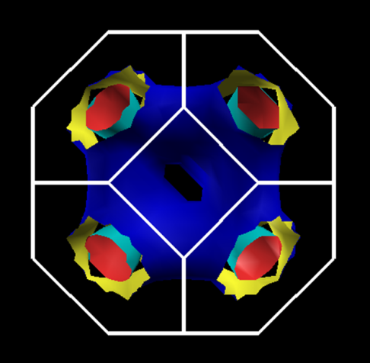
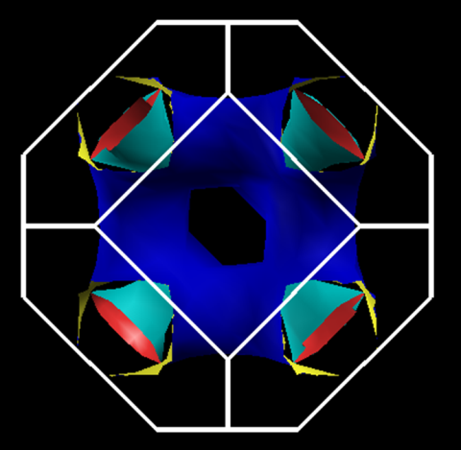
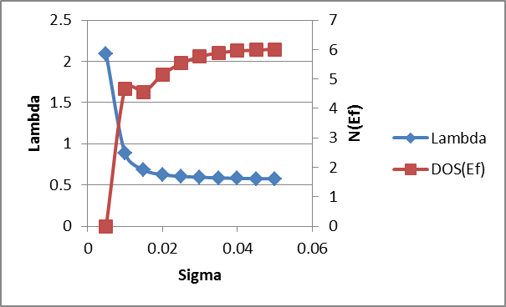
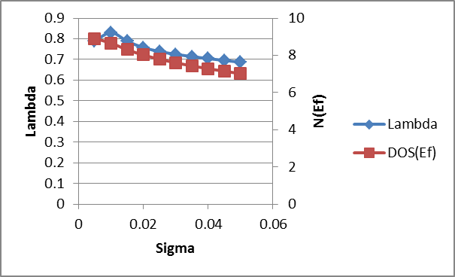
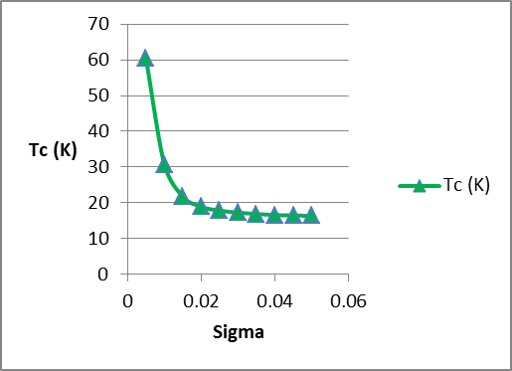
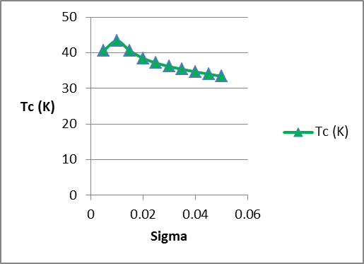
Cubic
CuSe
T_{C}
Tetragonal
Θ_{D} = 409 K; μ* = 0.0
Θ_{D} = 623 K; μ* = 0.0
T_{C}(max) ~ 17 K
T_{C}(max) ~ 36 K

Slide 10
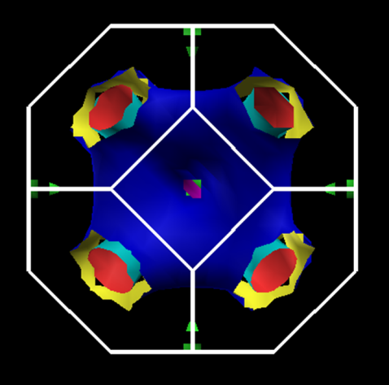
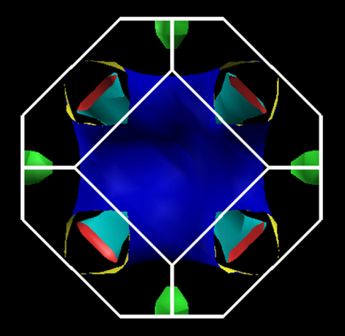
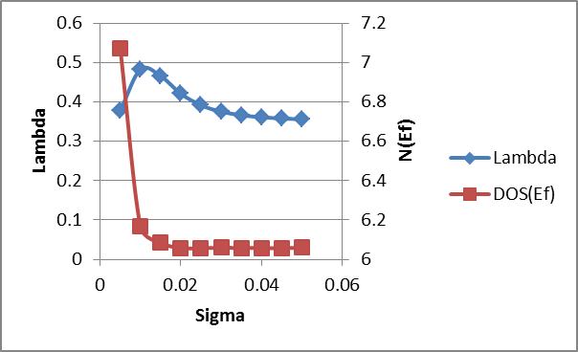
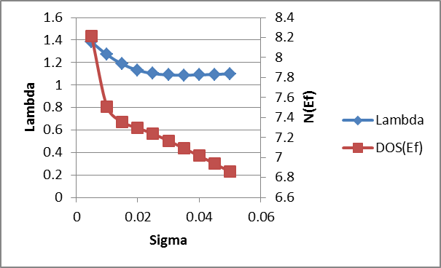
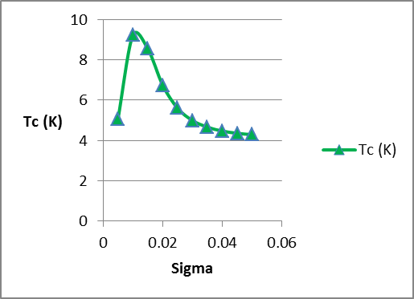
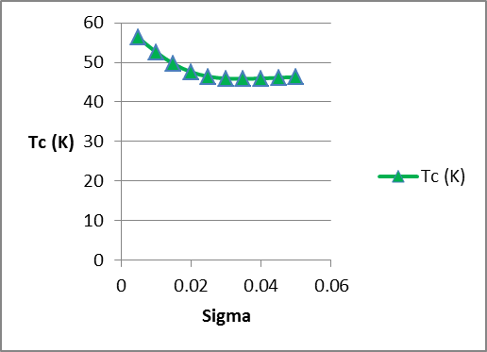
Cubic
CuTe
T_{C}
Tetragonal
Θ_{D} = 327 K; μ* = 0.0
Θ_{D} = 490 K; μ* = 0.0
T_{C}(max) ~ 4.2 K
T_{C}(max) ~ 45 K

Slide 11
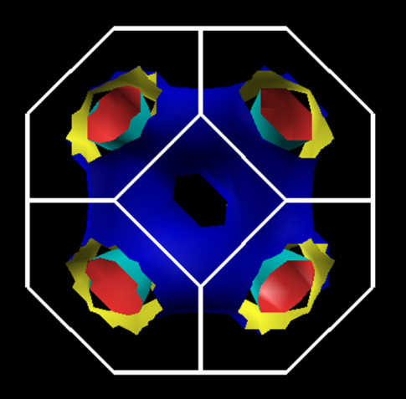
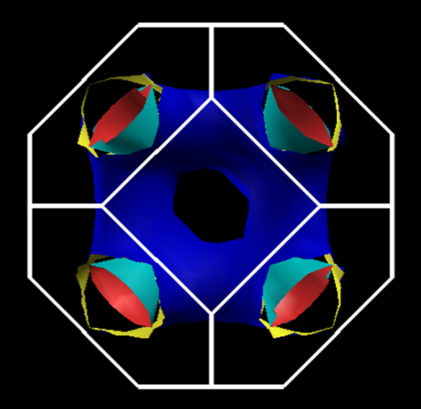
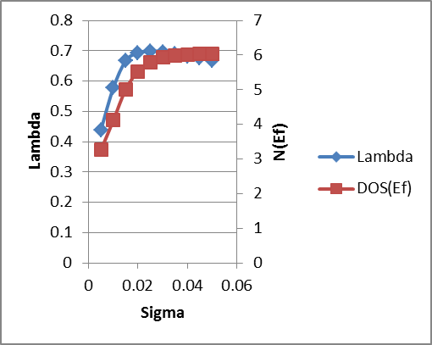
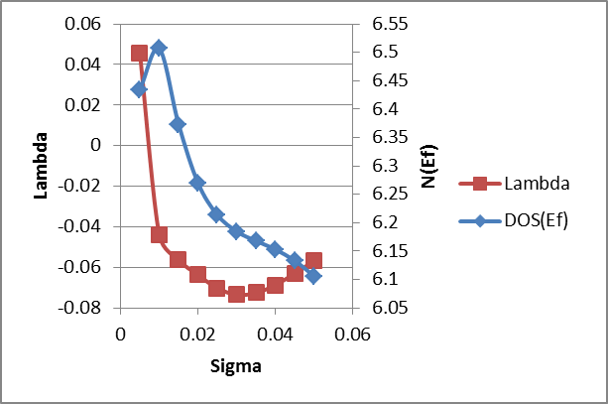
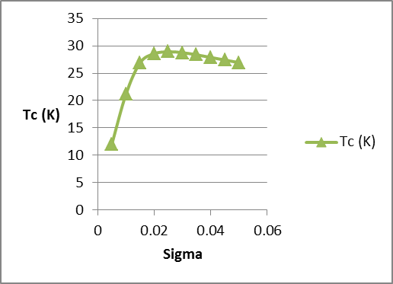
Cubic
CuS
T_{C}
Tetragonal
Θ_{D} = 525 K; μ* = 0.0
Θ_{D} = 780 K; μ* = 0.0
Whoops!
Unphysically “negative” λ !
Convergence issues?
Symmetry issues?
“Needs more work ;-)”
T_{C}(max) ~ 28 K

Slide 12
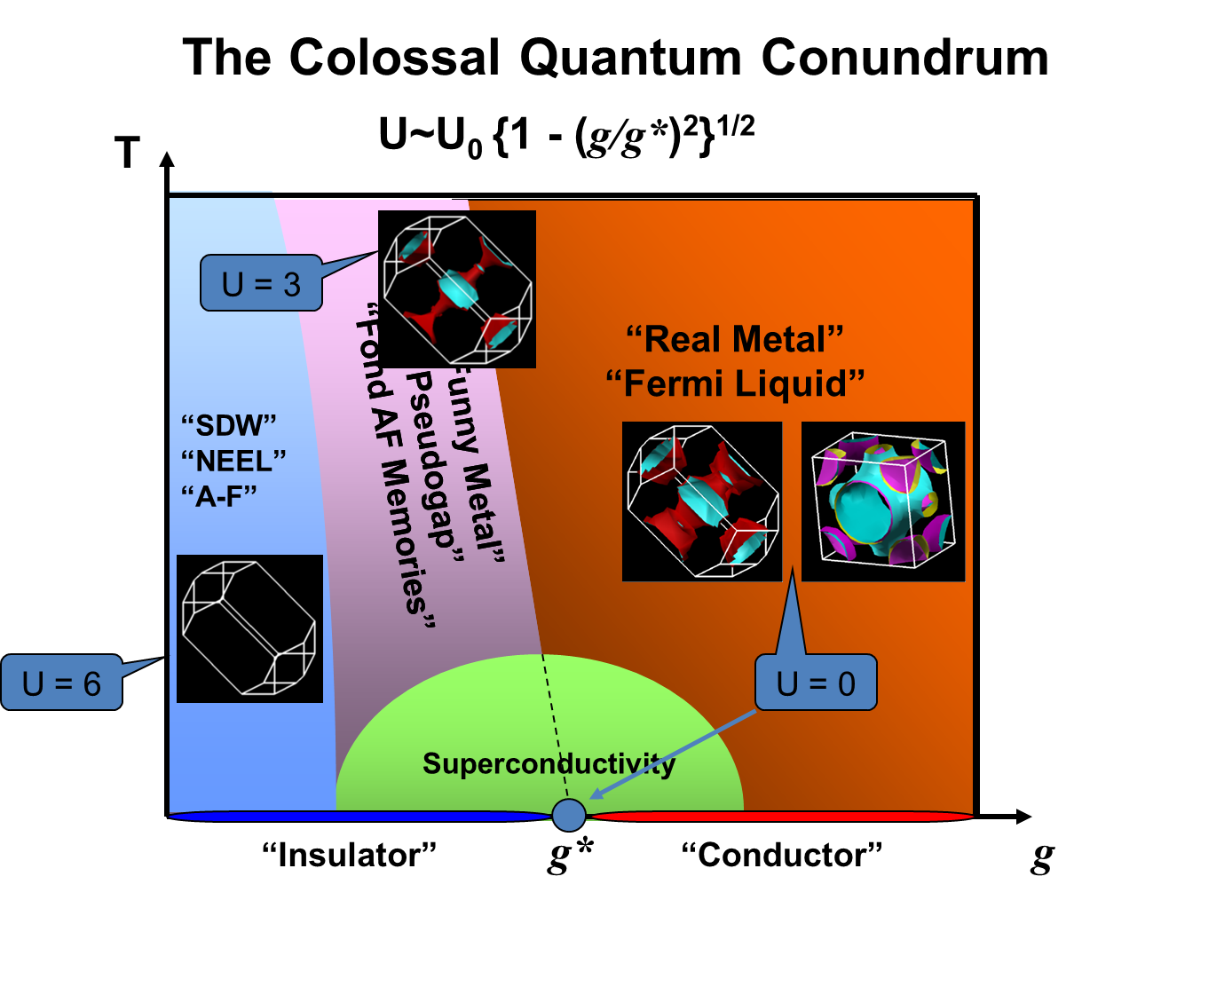
OK...Now What About CuO? Well?
Assume a doping density for“g = 0.15 holes/CuO” in this region for experimentally determined Tet-CuO that effectively screens “U” such that we have an “ideal” Fermi liquid.
Then what does Gibbs2 and Eliashberg-McMillan tell us about the possibility of electron-phonon mediated superconducting copper oxide perovskites?

Slide 13

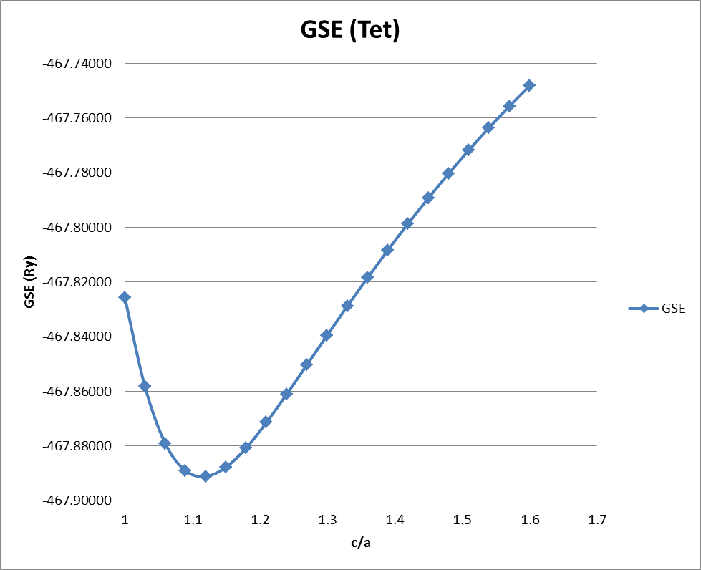


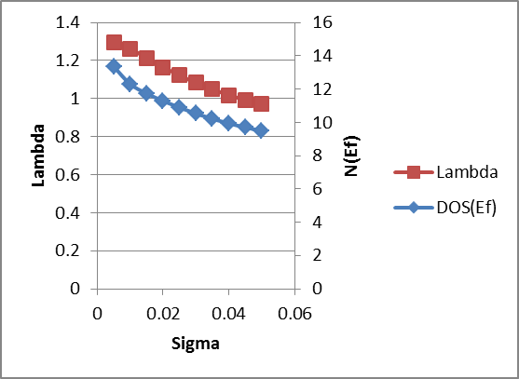

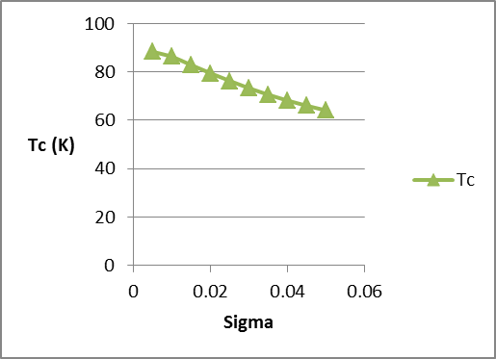
CuO
(tetragonal)
q = 0.15/CuO
T_{C}
Θ_{D} = 928 K
Ipso Facto...
At least at optimum doping...
the holes are paired by lattice shakes...
μ* = 0.05
with maybe a little help from their spins!
T_{C}(avg) ~ 75 K

Slide 14
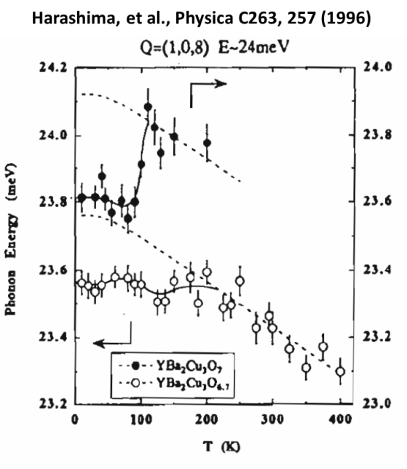
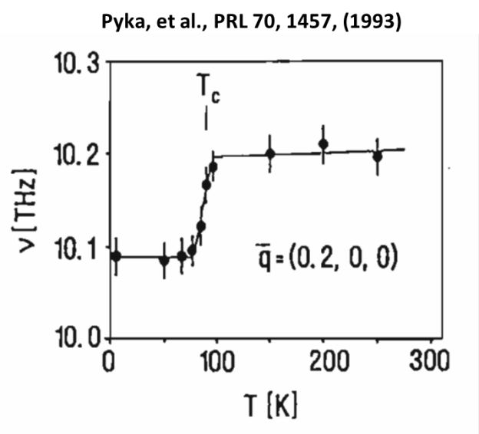
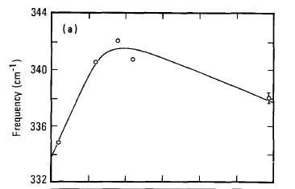

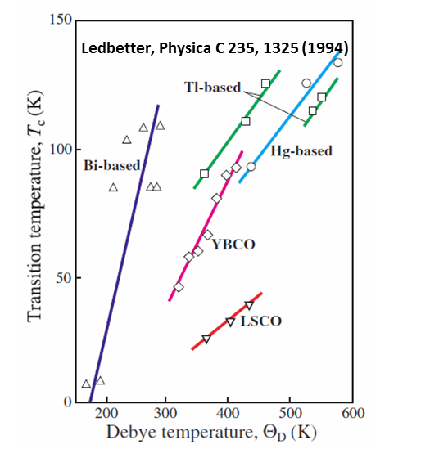
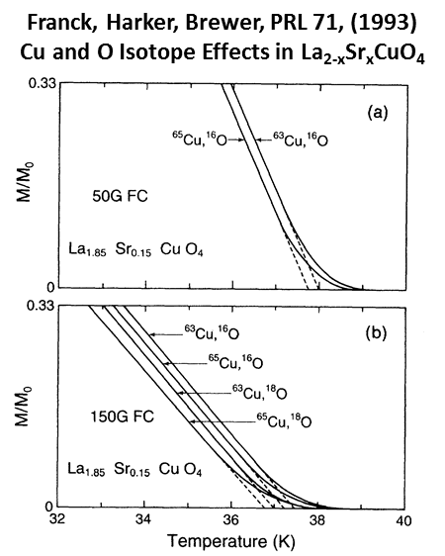
So What Else is New?
Macfarlane, Rosen, Seki, SSC 63, 831 (1987)
Raman Spectroscopy of YBCO
We can see Phonons have been there ever since the
Creation!

Slide 15
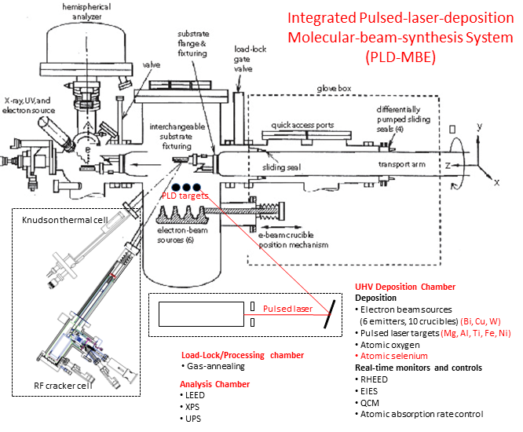
At the End of the Day... Can We Actually Make Any of this Stuff?

Slide 16
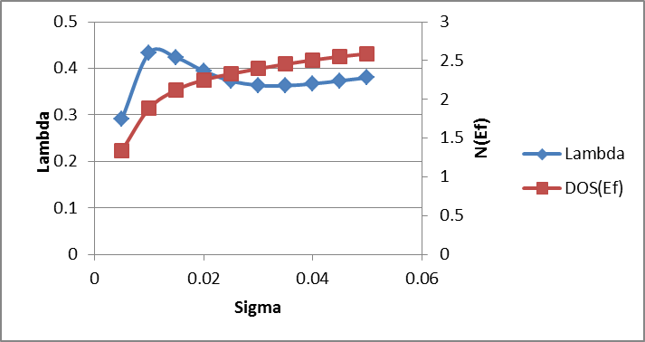
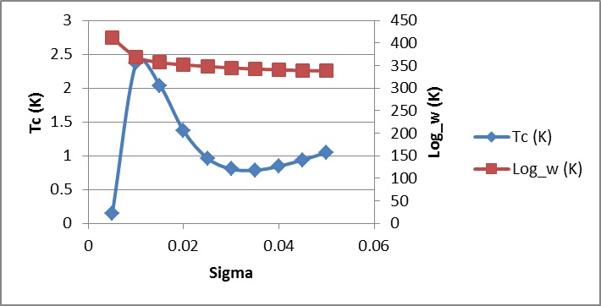
Aluminum (Quantum-ESPESSO Example)
μ* = 0.1
Log_w ~ Θ_{D}
T_{C}(exp) = 1.2 K
∗

