Slide 1
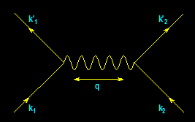
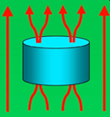
From Electrons Paired
To
Electric Power Delivered
…And… Back
Again
?
-- A Personal Journey in Applied Physics --
-- IBM, EPRI, and Beyond --
Paul M. Grant
IBM (1953-1993)
Joined 1953 (age 17)
SAGE/NORAD (MIT)
Clarkson/Harvard
Magneto-optics
Displays/Printers
Organic Conductors
DFT
Superconductivity
High-Tc
Sabbatical (UNAM)
EPRI (1993-2005)
High-Tc Power Apps
Wide Bandgap SCs
Power Electronics
“Hot” Fusion
“Smart Grid”
“SuperGrid”
Visionary Energy Societies
W2AGZ (2005-?)
Due Diligence
Tet-CuO (Stanford)
“Proxy” DFT
RTSC via DFT
IASS Potsdam
Dual Use of NG Pipeline ROWs for Co-transport of Electricity via HTSC Cables (e.g., Keystone)

Slide 2
The 2014 PMG DLAP Tour August - November
Applied Superconductivity Conference (Charlotte, Luncheon Speaker)
Clarkson University (Potsdam NY, Physics Colloquium & Lunch)*
NY APA Sectional (SUNY Plattsburg, Plenary & Lunches)
Mid-Hudson Valley (Meetings with Physics faculty, Marist and Vassar Colleges)
Mid-Atlantic Sectional (Penn State, Panel Discussion)
St. Mary’s Honors College (St. Marys MD., Invited Lecture & Lunch)*
Four Corners Sectional (UVU, Orem UT, Plenary & Lunches)*
Far West Sectional (UN Reno, Invited Talk & Lunches)
San Jose State University (San Jose, Monthly Science Seminar & Lunch-Student Discussions)*
Ohlone College (Fremont CA, Discussions with Science Students & Faculty)
*The most fun. Buiochas, Alainn Garnion Crystal!

Slide 3
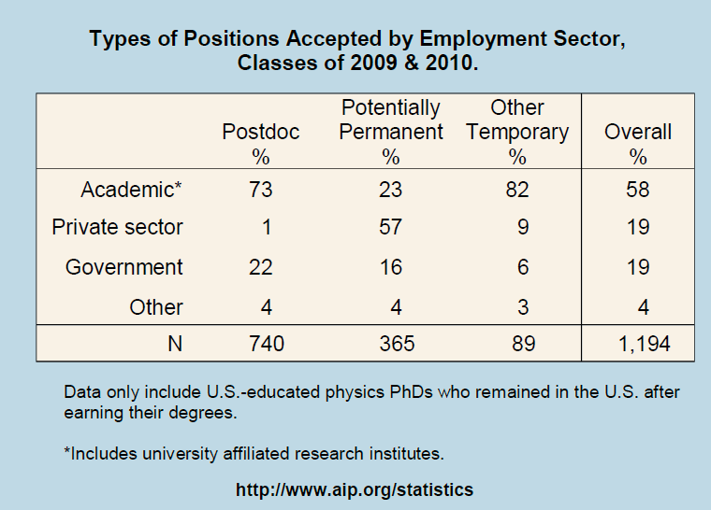
What are PhDs doing with their degrees?
Data courtesy of Crystal Bailey, bailey@aps.org
The largest percentage of Physics PhDs found initial employment in Postdoctoral and other temporary positions…
…but a significant number of graduates went straight into potentially permanent employment in the private sector.

Slide 4
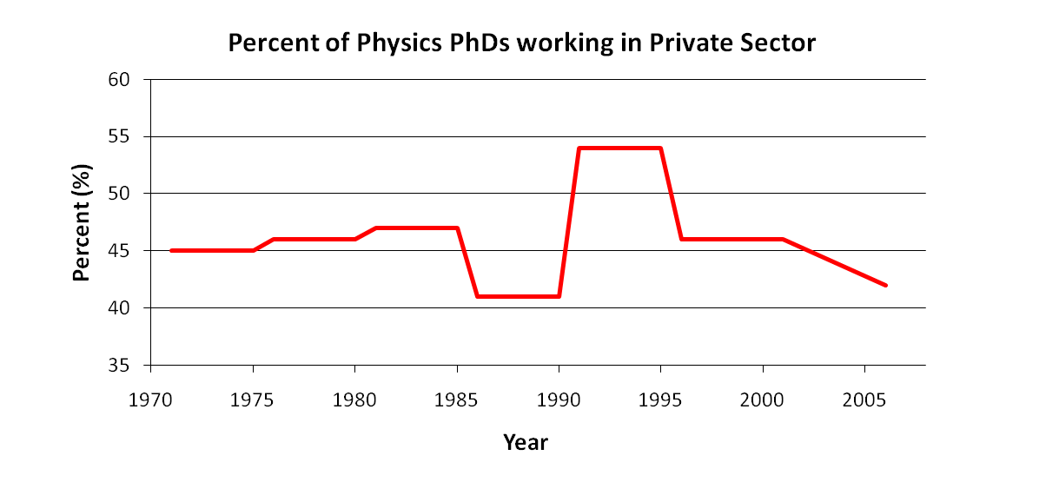
PhD Employment in the Private Sector
Recall that the majority (57%) of graduates who initially went into permanent employment positions were in the private sector.
According to the NSF Survey of Doctoral Recipients, in 2010 the private sector was the largest single employment base of Physics PhDs: about 47% (the next highest was 4 year colleges, at 38%).
This was also true in 2001, when the private sector employed 46% of Physics PhDs¹…
…and was also true in 1993, when the private sector again employed 46% of Physics PhDs².
In fact, the same data has shown consistent support for Physics PhDs in the private sector since 1971.
¹NSF Survey of Doctoral Recipients, 2001
²NSF Integrated Survey Data, 1993
Industry has been the largest employment base for Physics PhDs for decades.

Slide 5
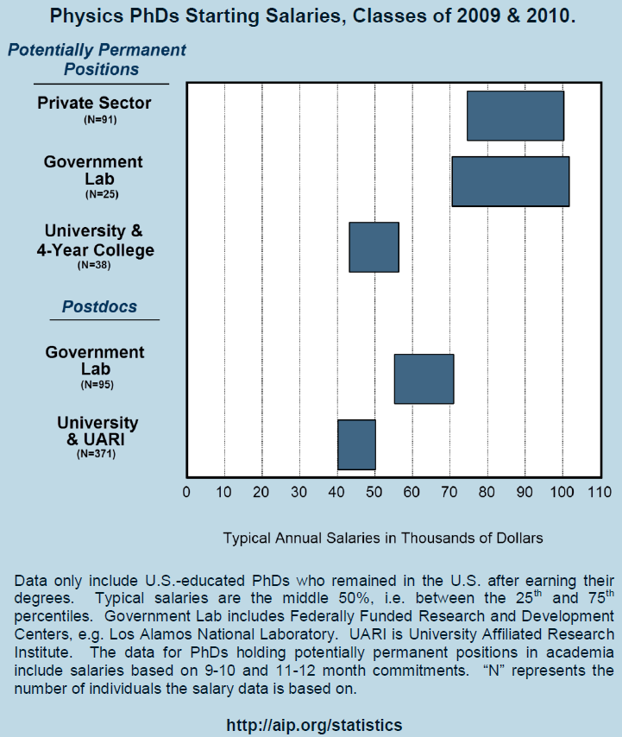
Not only does the private sector provide the largest number of jobs for physics PhDs, it also provides the highest-paying jobs, with a starting salary of $90K
By comparison, average typical starting salaries at Universities and 4-year colleges is around $50K…
…and a University postdoc position typically offers between $40K and $50K.
So, the private sector also offers well-paying employment to Physics PhDs.

Slide 6
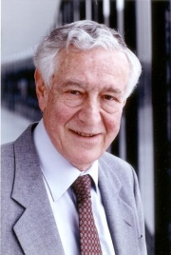
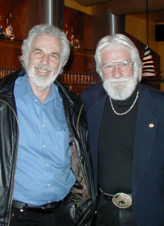
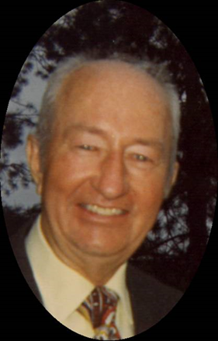
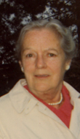
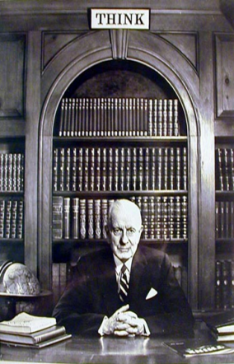


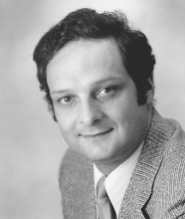


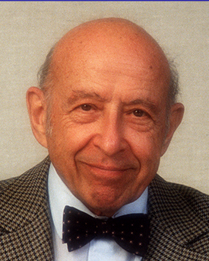

Heroes, Mentors and Buddies

Slide 7
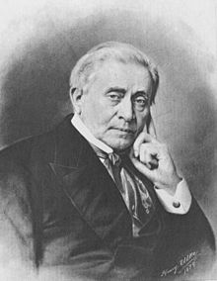
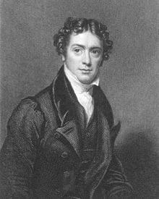
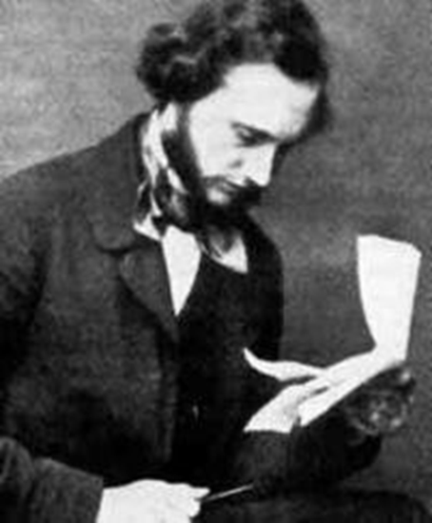
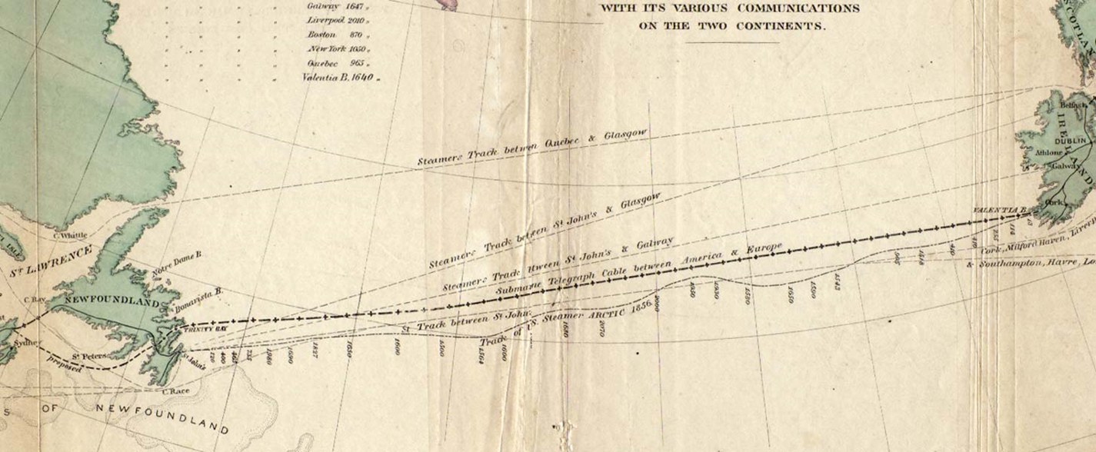
Three Famous Applied Physicists
Joseph Henry
Scottish-American
English
William Thomson
Michael Faraday
Irish-born
The Transatlantic Cable (1854 – 1866)
The First Thread in the World Wide Web!
“A Thread Across The Ocean”
John Steele Gordon (2002)

Slide 8
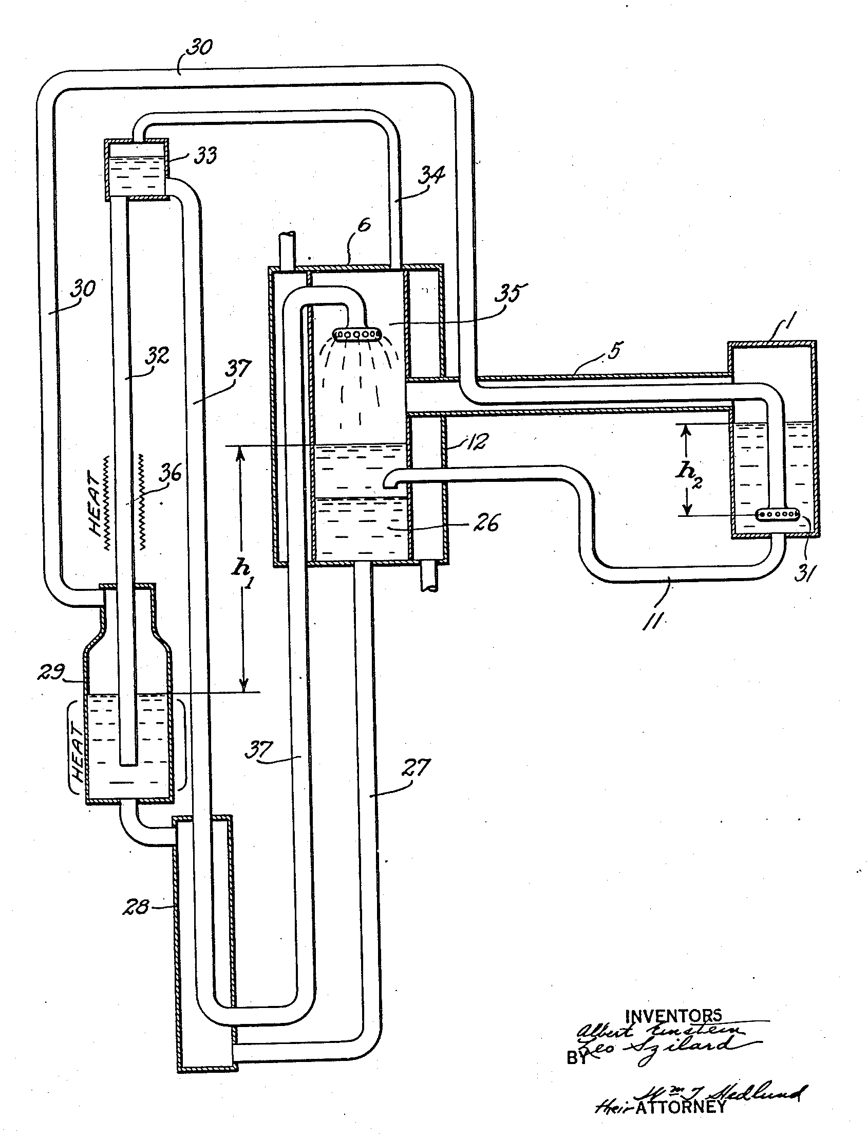
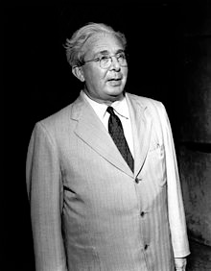
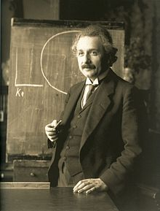
Two Other Famous Applied Physicists
A Simple Household Refrigerator!
Leo Szilard
In your career in Industrial Physics, you can have both PRLs and Patents!

Slide 9

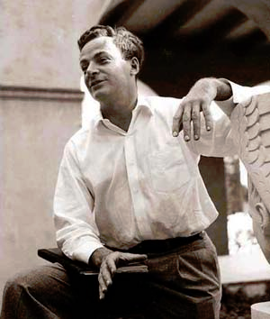
...and Finally One More...
Feynman was “inspired” by the classic 1959 British film, “Room at the Top,” wherein an ambitious young worker colludes with the daughter of a factory magnate as part of a plot to take over the company.
Richard P. Feynman...The Spiritual Father of Nanotechnology (1959)
“There’s Plenty of Room at the Bottom!”

Slide 10
The Take-Home...
Wisdom gained (so far!) from a lifetime career in
Industrial and Applied Physics...

Slide 11

“You can’t always get what you want…”
Notes:
11

Slide 12

“…you get what you need!”
Notes:
12

