Slide 1
Career Panel – Alternative Energies
Paul M. Grant, W2AGZ Technologies
Panel Discussion with local university physics students on career opportunities, based
largely on personal career experience and 2014-15 APS Distinguished Lectureship
Award on Industrial Physics.

Slide 2
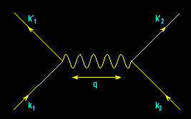
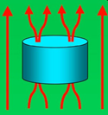
From
Electrons
Paired
To
Electric
Power Delivered
…And…
Back
Again
?
-- A Personal Journey in Applied Physics --
-- IBM, EPRI, and Beyond --
Relevant to All Alternative Energy Discussions
Paul M. Grant
IBM (1953-1993)
Joined 1953 (age 17)
SAGE/NORAD (MIT)
Clarkson/Harvard
Magneto-optics
Displays/Printers
Organic Conductors
DFT
Superconductivity
High-Tc
Sabbatical (UNAM)
EPRI (1993-2005)
High-Tc Power Apps
Wide Bandgap SCs
Power Electronics
“Safe” Fission
“Smart Grid”
“SuperGrid”
Visionary Energy Societies
W2AGZ (2005-?)
Due Diligence
Tet-CuO (Stanford)
“Proxy” DFT
RTSC via DFT
IASS Potsdam
Dual Use of Energy Delivery ROWs

Slide 3
Alternative Energies
(PMG Definitions! Con Quidado!)
“Non-Hydrocarbon-aceous”
  CH₄ + 2O₂ → CO₂ + 2H₂O
Must be Minimally Eco-invasive
  Wind Farms x
  Solar Farms x
  Solar Roofs √
  Nukes √
  Hydro ?
  Biomass ?
  Energy Transport ROWs ?
Fuels/Storage
  Electrochemistry (aka “batteries”) √
  Pumped Hydro ?
  Hydrogen ?

Slide 4
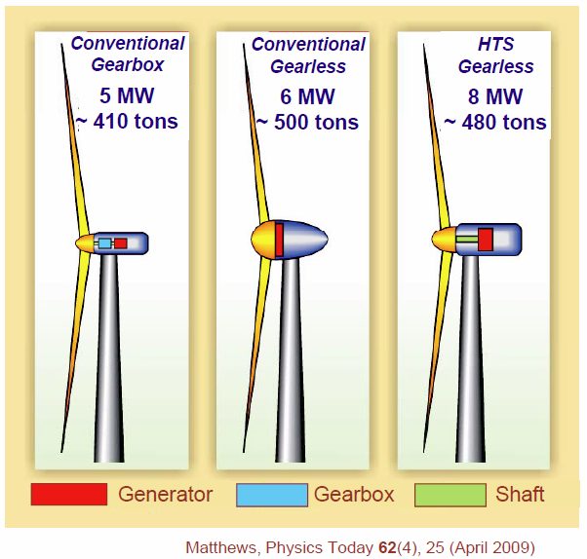
Rotating Machinery - Wind Generators

Slide 5
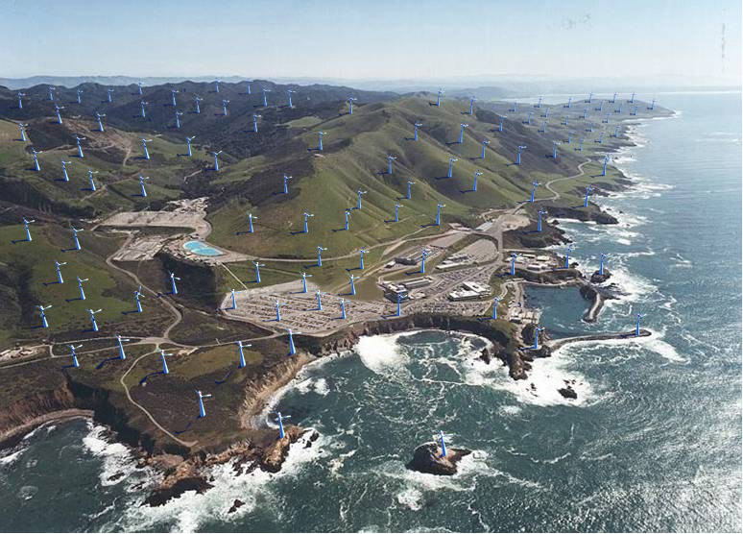
Diablo Canyon
Notes:
5

Slide 6
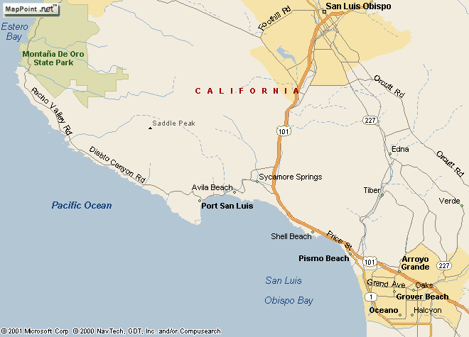
California Coast Power
Diablo Canyon
2200 MW
Power Plant
Wind Farm
Equivalent

Slide 7
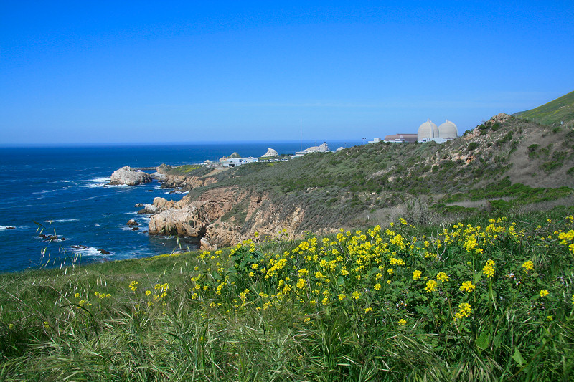
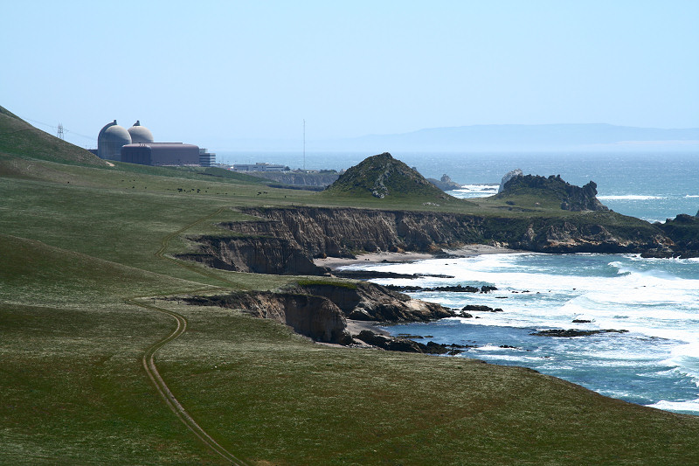

Slide 8
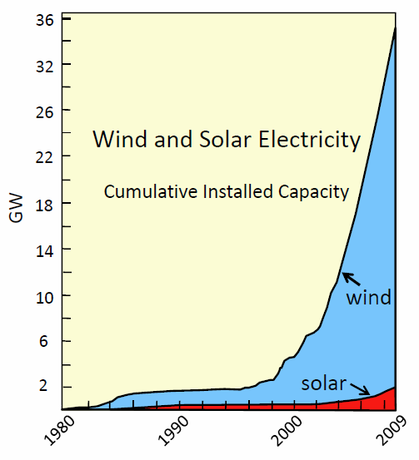

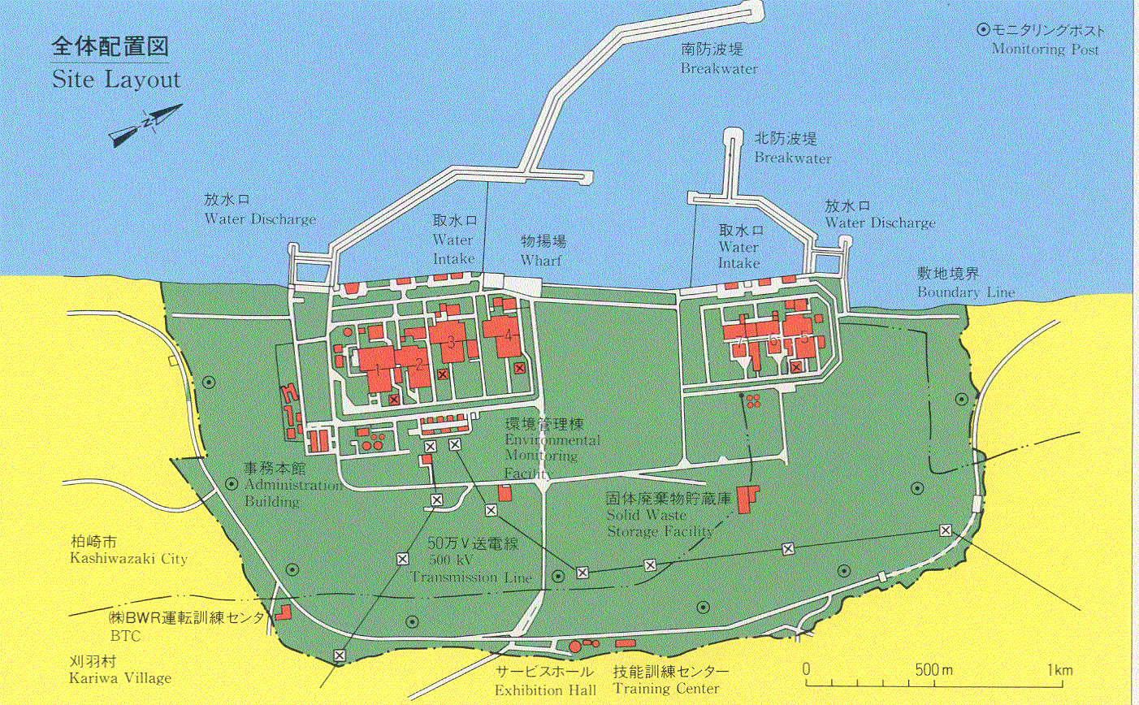
Wind Power Factoids
KK Wind Equivalent (8 GW)
Power per Tower 8 MW
Number of Towers 1000
Inter-tower Distance 1000 ft
Total Area (miles x miles) 43.5 x 43.5
1 mile
Kashiwazaki Kariwa: 8 GW !

Slide 9
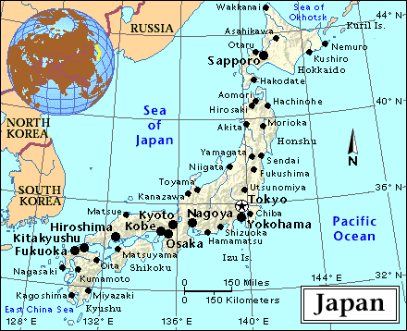
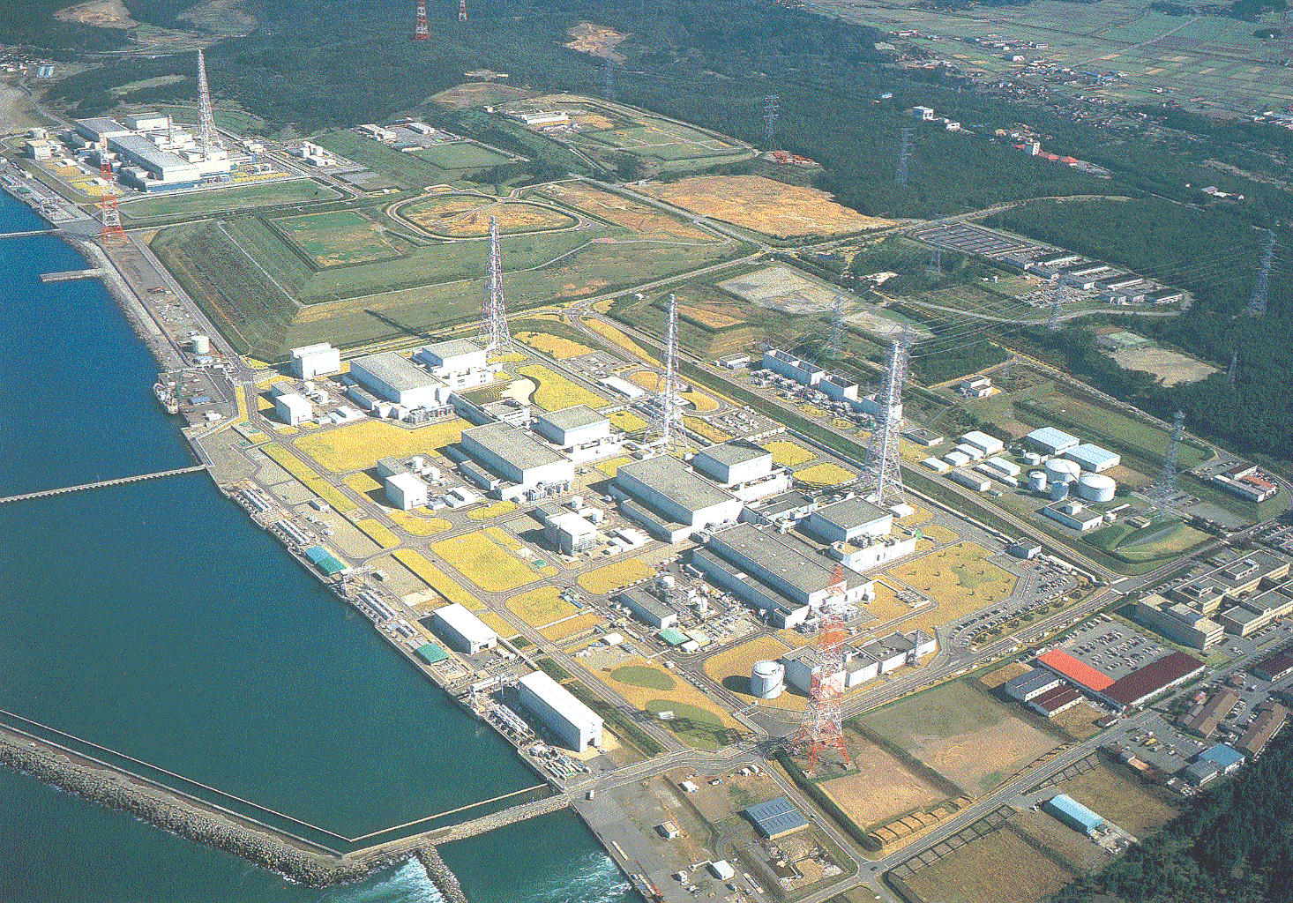
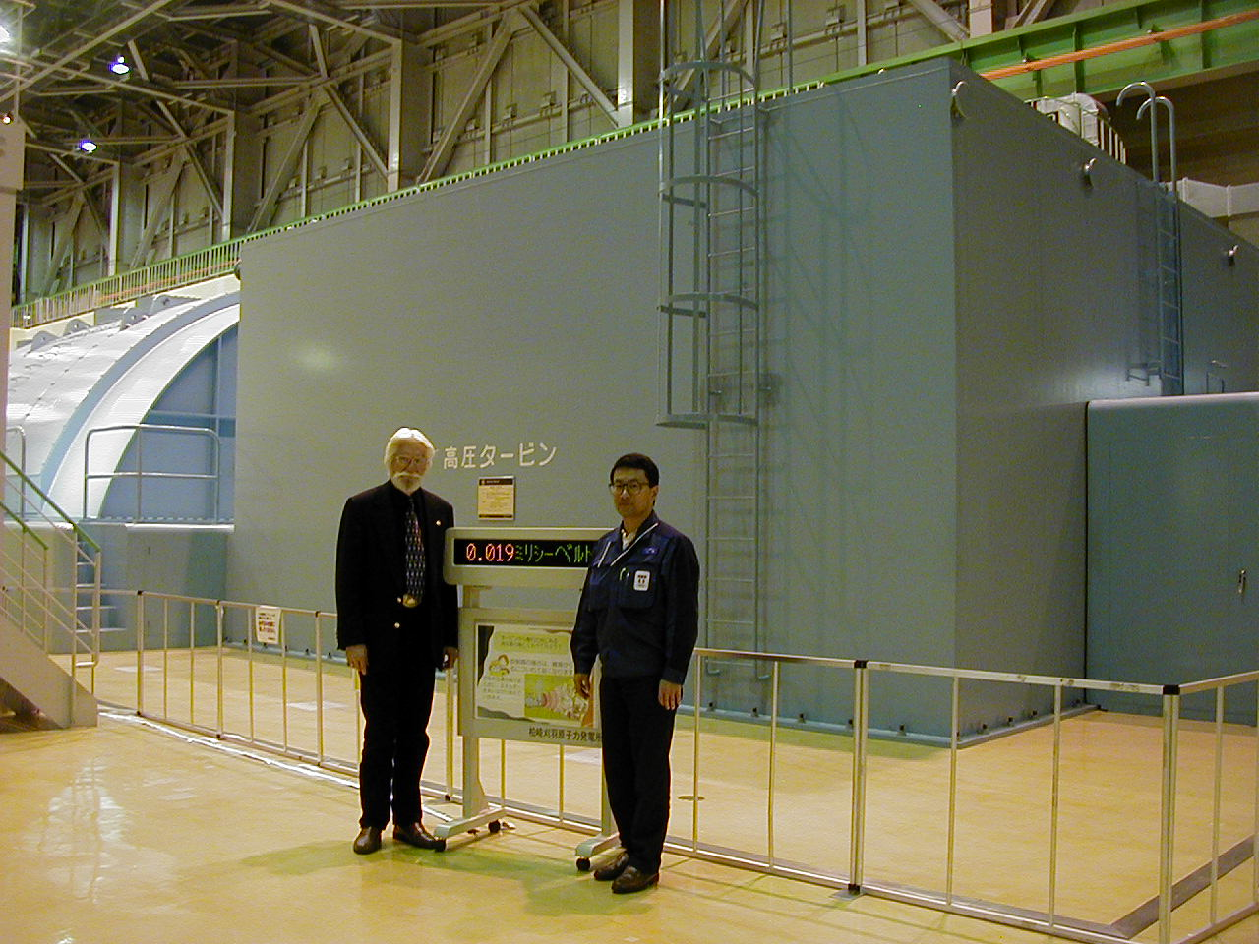
Kashiwazaki Kariwa: 8000 MW
KK
Unit 7: 1320 MW ABWR
1 mile

Slide 10
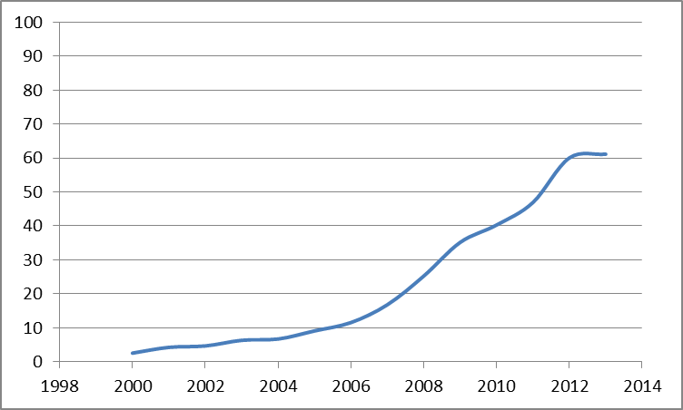
US Wind/Nuke Comparison
US Nukes (100 GW)
US Wind Capacity (GW)
KK (8 GW)
Year

Slide 11
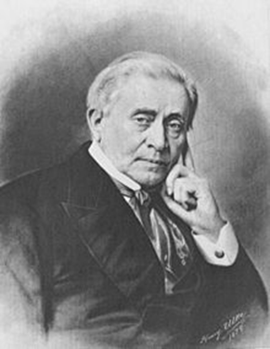
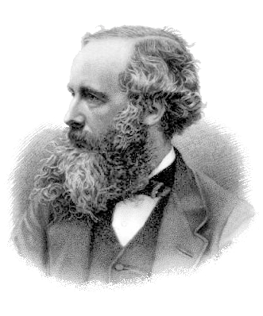
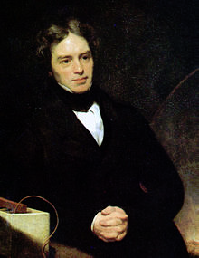
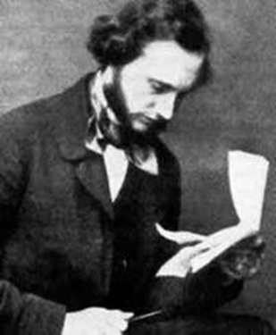
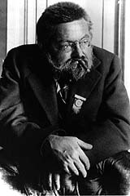
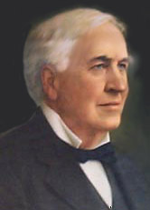
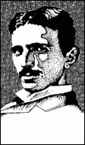
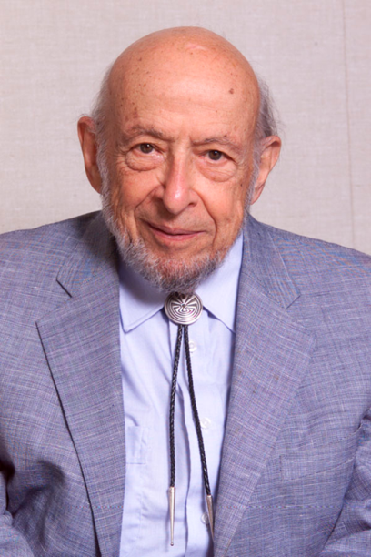
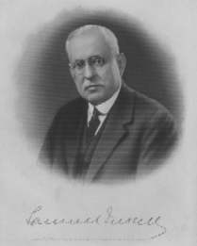
Fathers of Electric Power
Notes:
Faraday Henry Maxwell Thomson (Kelvin)
Edison Tesla Steinmetz Insull Starr

Slide 12
What They Didn’t Teach Their Kids (Us)
How to store lots of electrons for us to Recycle!

Slide 13
World Population: 1850 - 2100

Slide 14
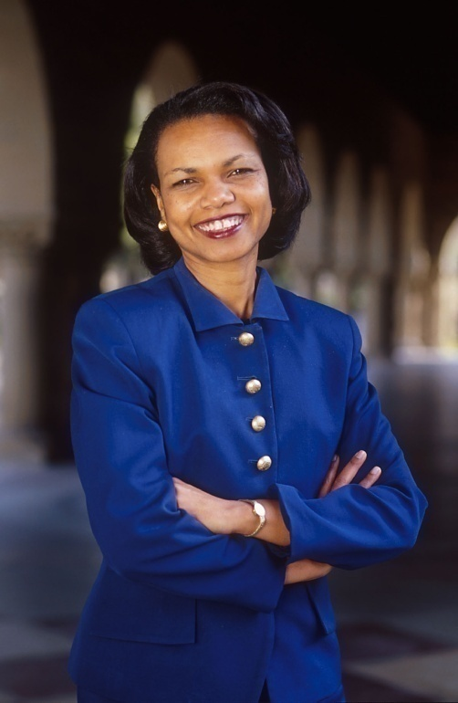
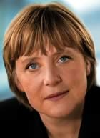

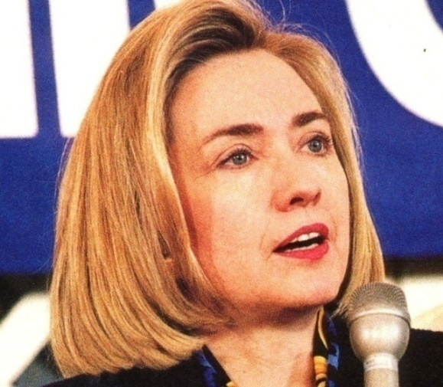
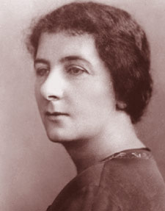
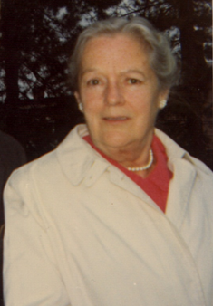
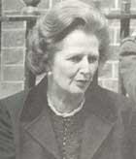
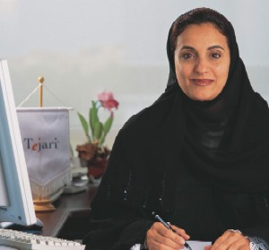
Enfranchisement of Women
Oops! Gotta be Politically Correct...Double-X Genotypes!
Notes:
Condi Rice Angela Merkel Tzipi Livni Hillary Clinton
Margaret Thatcher Golda Meir Mary Grant Lubna Qasimi

Slide 15
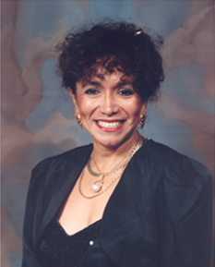
La Profa. Dra. Maria Eugenia Lopez-Morales de Grant
Chemistry Dept., Ohlone College, Fremont, California
> 50% Her Students -> UC, CSU 4 Year Degrees, 3 MDs from UC Davis

Slide 16
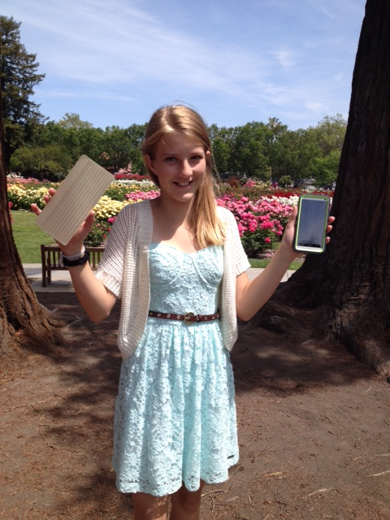
12-Year Old Devin Grant’s
“ Big Data” Homework Assignment
How many of GrandPa’s really silly 1953 IBM Punched Cards does it take...
...to fill up a 32 gig iPhone?
Well?
A stack about 30 miles high!
> 3000 miles in a 4 TB home cloud!
Wow!* That’s really “Big Data! ”
So What’s Next?
Putting Your 1’s & 0’s in a Black Hole?
*Assumptions:
120 bytes/card
Thickness = 0.007 inches

