Slide 1
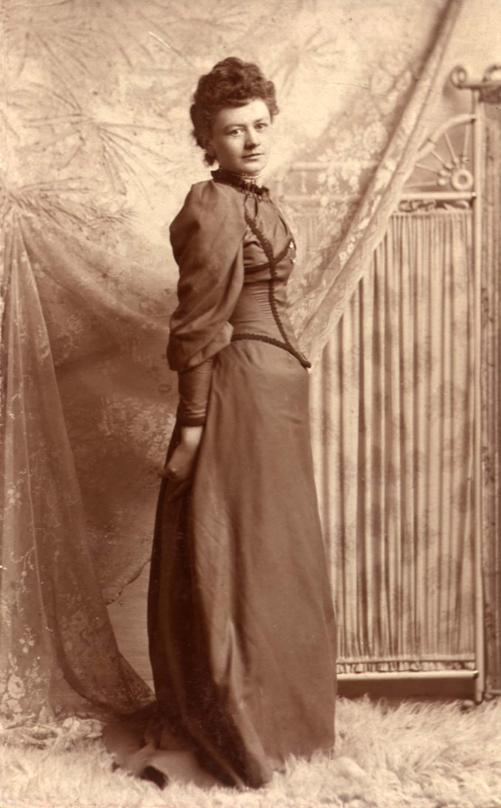


St. Patrick’s Day - 2016
Paul Michael Patrick Grant
-2014-
Grandson of
Two Proud Lands
PMPG Accepted as a Dual National by the Republic of Ireland
Bridget Ann Mullen-Whalen

Slide 2
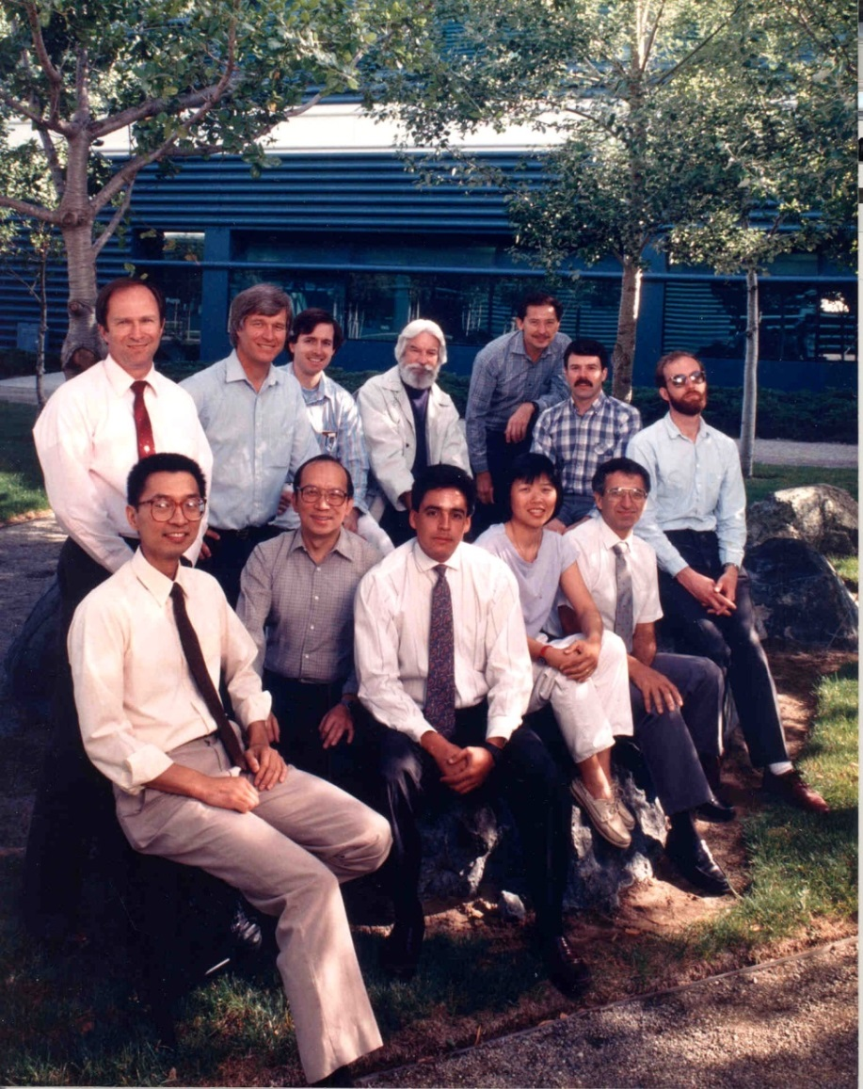
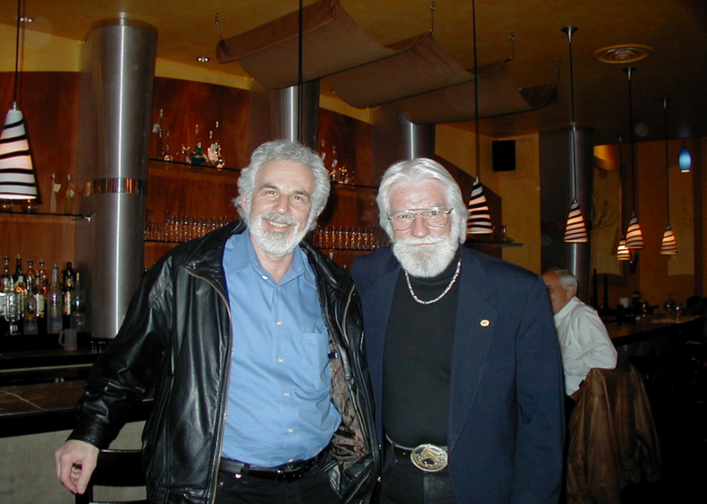
“Woodstock” (#30 Upcoming)
“Infamous Irish-Jewish
Catskill Borscht-Belt Comedy Team”
“Band of Brothers (and a Sister!)”
- IBM Almaden, March 1987 -

Slide 3
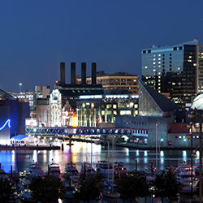

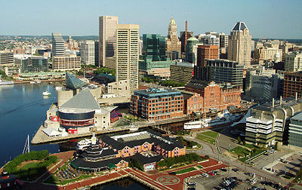
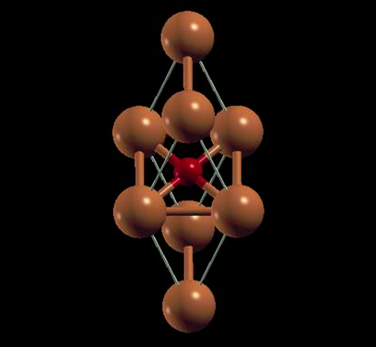
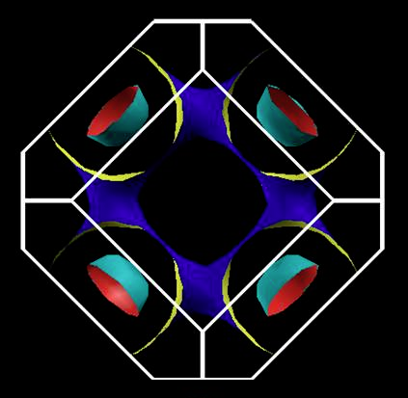
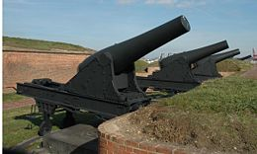


A DFT Study of Electron-Phonon Mediated Superconductivity in Doped Mott-Hubbard Proxy Cubic-Tetragonal Copper Monoxide
Paul M. Grant
W2AGZ Technologies
Aging IBM Pensioner
Research supported under the IBM retirement fund
1812
Session R25
Superconductivity: Less Common Materials I
8:50 AM – 10:48 AM, Thursday, 17 March
Paper 8
9:24 AM – 9:36 AM
Room 324

Slide 4
– Our Computational Tool Box –
DFT
  − Quantum Espresso
    Fermiologies, States (DOS), Phonons, e-p “Lambda”
  Gibbs2
    Debye Statistics
  ELK
    LDA + U
Graphics
  Xcrysden, XMGRACE
    Fermi Surfaces, Projected DOS
Modeling
  Then e-p Superconductivity via Eliashberg/McMillan!

Slide 5
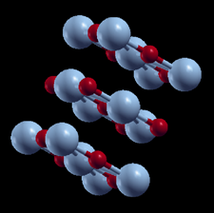
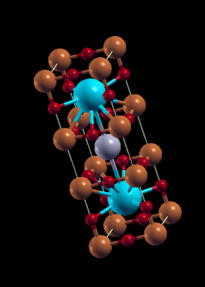
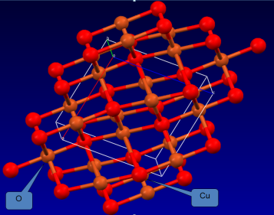
The Various Flavors of Copper “Monoxide”
Siemons, et al. (2009)
Grant (2008)
Franchini Group (2011)
Cococcioni Group (2011)
tet-rs-CuO
“1-2-3”
Relative Ground
State
Energies
What Nature (she) gives us! (triclinic)
Tennorite
Can we compute/synthesize
its physical properties wrt magnetism and superconductivity?
NB: All show attributes of Mott-Hubbard behavior
“Configuration/Coordination Space”

Slide 6
Interesting...
Lowest symmetry yields lowest ground state energy.
Higher...at least in a computer...gives greater (localized around given “optimal lattice” constants).
Why? Jahn-Teller “degeneracies”! Nature abhors them (Aristole).
Were Bednorz-Mueller (Chakravarty & Hoecht) on the right path in 1986 after all?

Slide 7
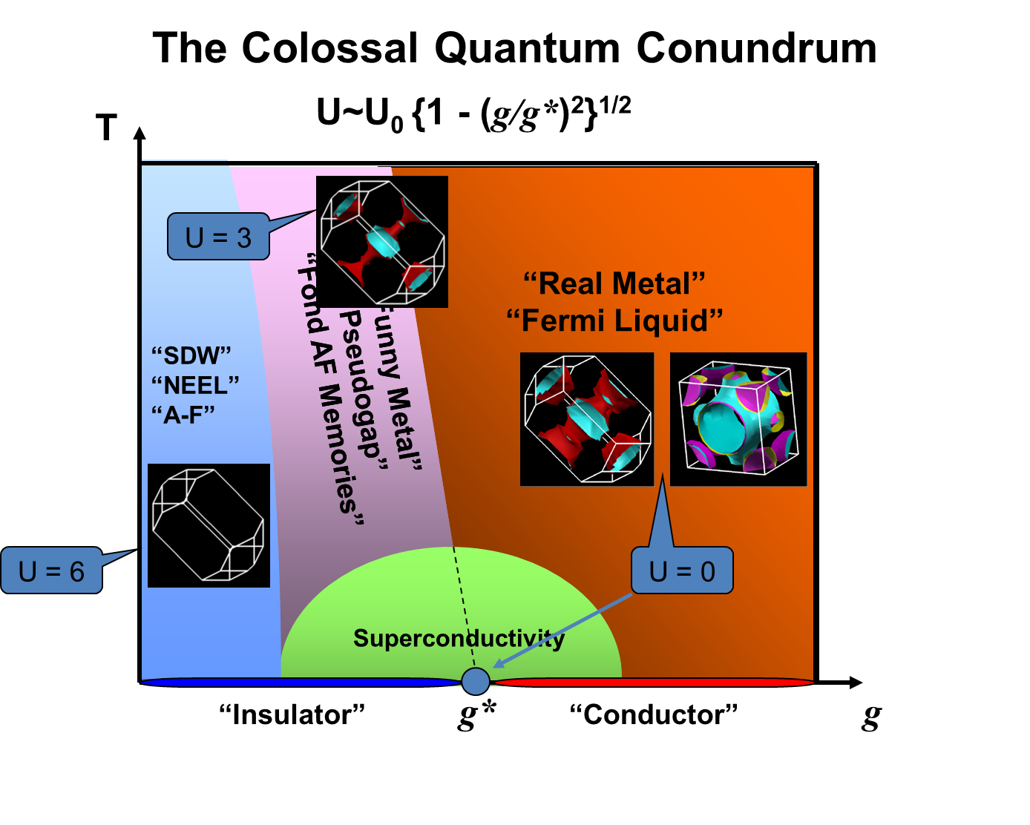

Slide 8
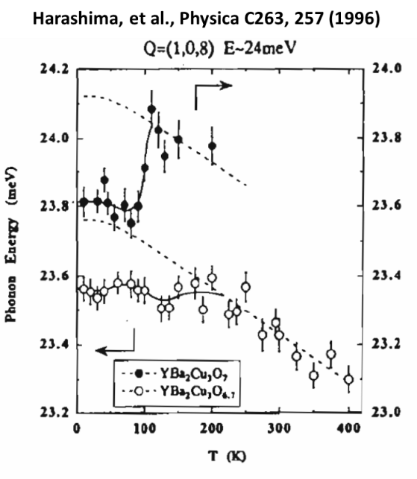
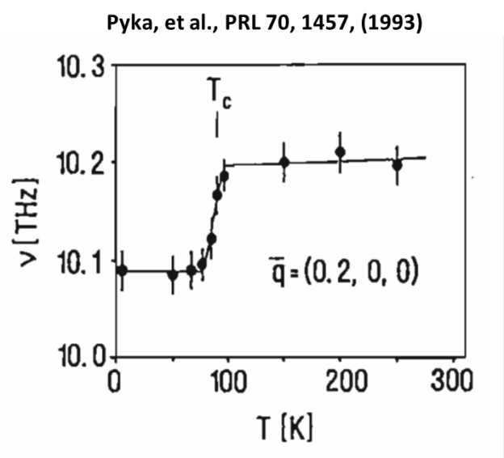
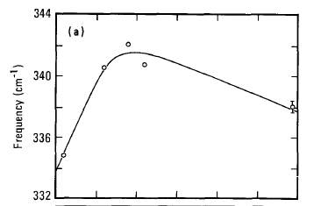

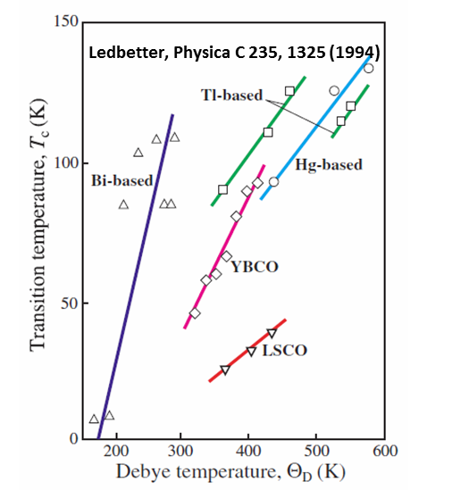
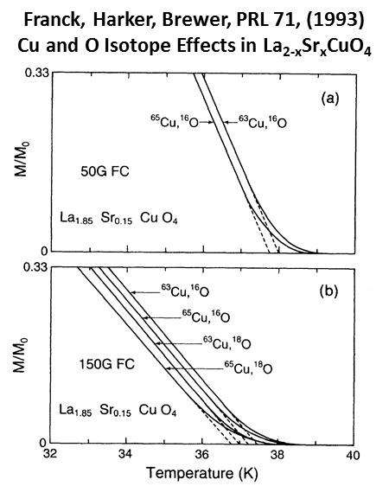
Phonons are there!
Macfarlane, Rosen, Seki, SSC 63, 831 (1987)
Raman Spectroscopy of YBCO
But maybe spins too?

Slide 9
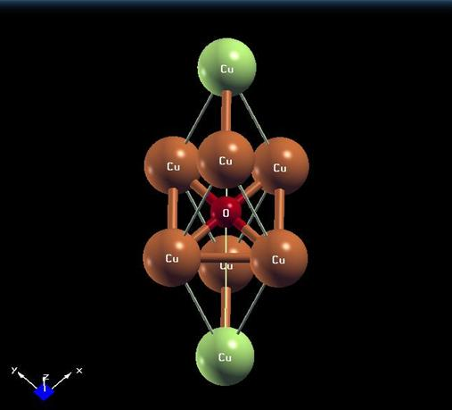
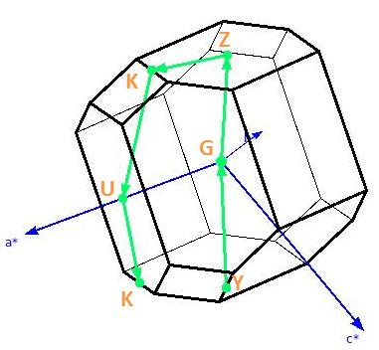
E
lectronic properties of rocksalt copper monoxide:
Let’s look at the “U = 0, Fermi Liquid” limit
for doped proxy tet-CuO!
Electronic properties of rocksalt copper monoxide:
A proxy structure for high temperature superconductivity
The International Conference on Theoretical Physics ‘Dubna-Nano2008’
IOP Journal of Physics: Conference Series 129 (2008) 012042
doi:10.1088/1742-6596/129/1/012042
A
proxy structure for high temperature superconductivity

Slide 10
Superconductivity and Phonons
BCS via Eliashberg-McMillan
NB! The “double deltas” will be approximated by two Gaussians of width “sigma (σ)” whose numerical convergence is governed by imposed precision limits and basis set symmetry. Con Quidado!
To get λ, need to compute
!

Slide 11
e-p Interaction in the DFT/LDA Formalism

Slide 12

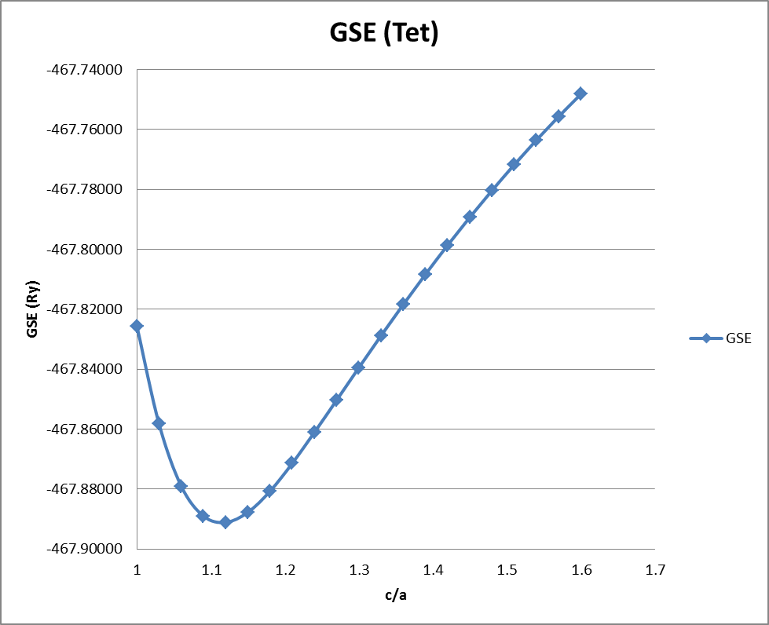


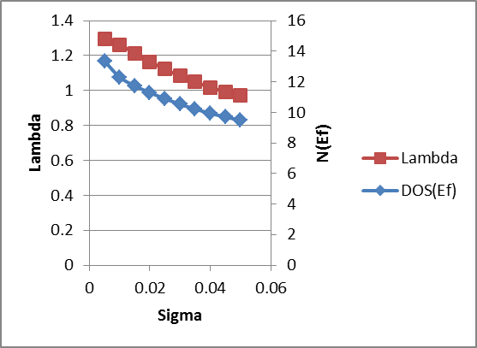

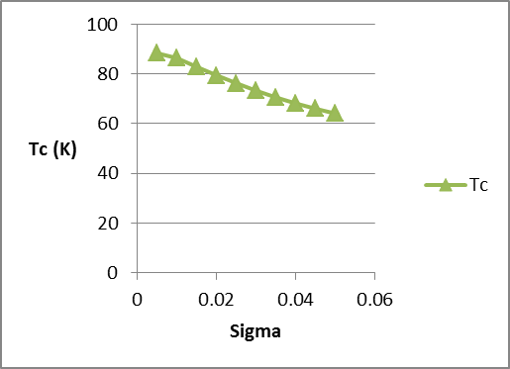
CuO
(tetragonal)
q = 0.15/CuO
T_{C}
Θ_{D} = 928 K
Ipso Facto...
At least at optimum doping...
the holes are paired by lattice shakes...
μ* = 0.05
with maybe a little help from their spins?
T_{C}(avg) ~ 75 K

Slide 13
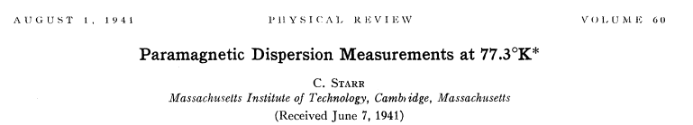
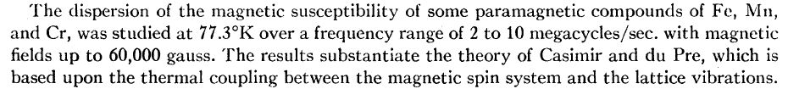
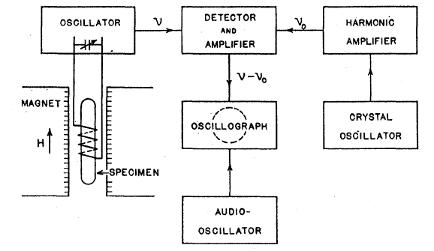
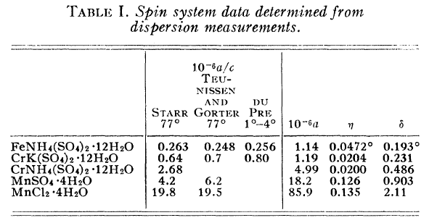
Voice from the Past!
Why not repeat this experiment on the CuO perovskites?

Slide 14

So is it Shakes and/or Spins?
Maybe it takes two to Tango!

Slide 15
Stay Tuned!

Slide 16
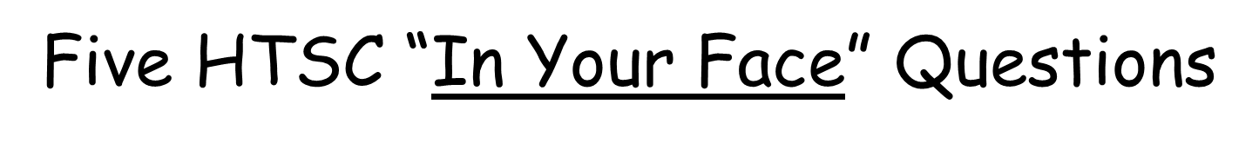
T
What about RTSC?
U = 3
Is it “shakes or spins”...or both?
U = 0
“Funny Metal”
“Pseudogap”
“Fond AF Memories”
“SDW”
“NEEL”
“A-F”
“Funny Metal”
“Pseudogap”
“Fond AF Memories”
“Real Metal”
“Fermi Liquid”
U = 6
Where is Pr-123 ?
Is “bulk SC” a function of g* ?
Superconductivity
“Insulator”
g*
“Conductor”
g
When and where can we use HTSC/RTSC in the
Electricity Enterprise?

