Slide 1




UC Merced
Praeseodymium-123
30 Years Later...Why Isn’t It Superconducting...or Even Conducting?
Maria Eugenia Lopez-Morales
Professor of Chemistry, Ohlone College
mgrant@ohlone.edu
Paul Michael Grant
Aging IBM Pensioner
w2agz@w2agz.com

Slide 2
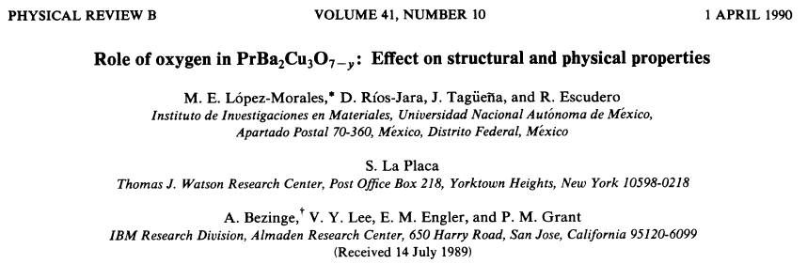


The Most Cited Mexico – USA HTSC
Collaboration of the 20th Century
Diego Patrick Grant Lopez-Morales
“An Unique Irish-Purechepan Genotype”

Slide 3
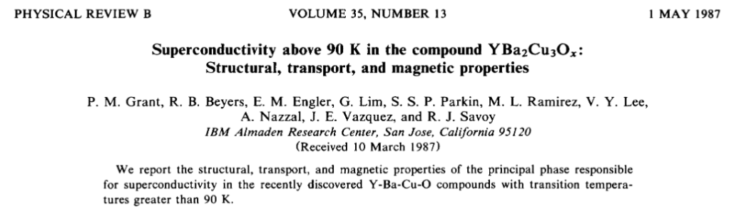
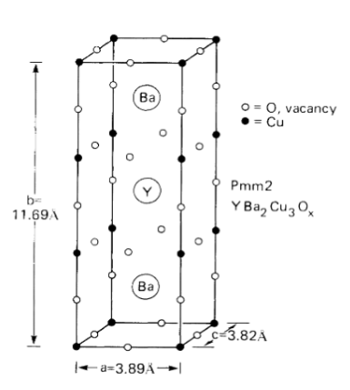
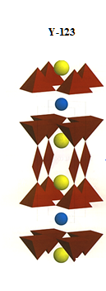
Woodstock of Physics, 1987
NB!

Slide 4
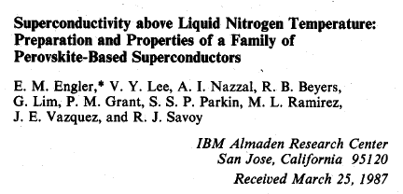
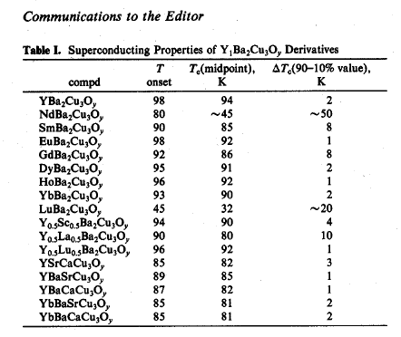
Woodstock of Physics, 1987, Cont’d
Where is Pr-123?

Slide 5
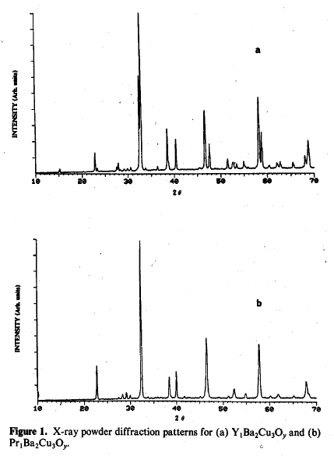
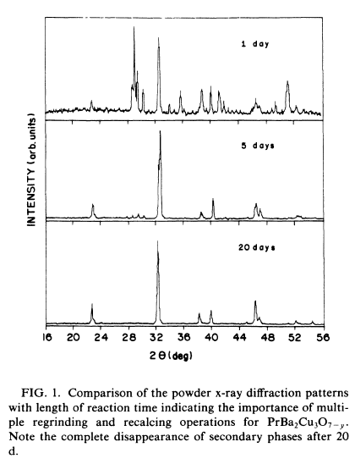
Lopez-Morales, et al., 1989
Ya gotta clean it up!
20 Days!
Engler, et al., Previous Slide Publication

Slide 6
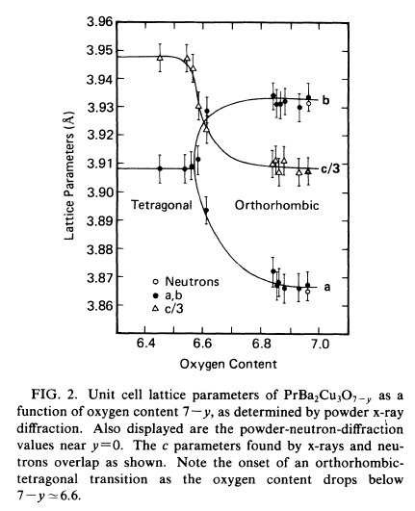
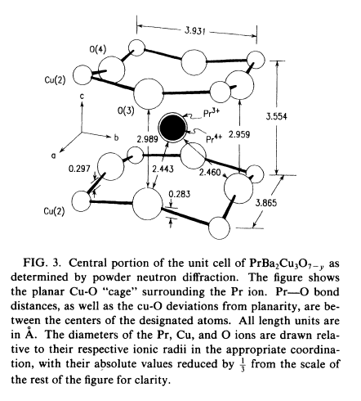
Lopez-Morales, et al., 1989 (Cont’d)
Note smaller ionic radius for Pr⁴⁺

Slide 7
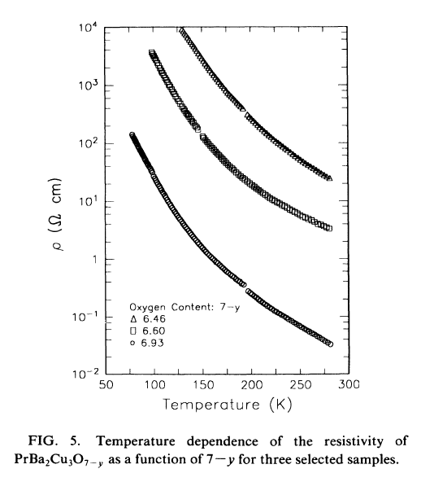
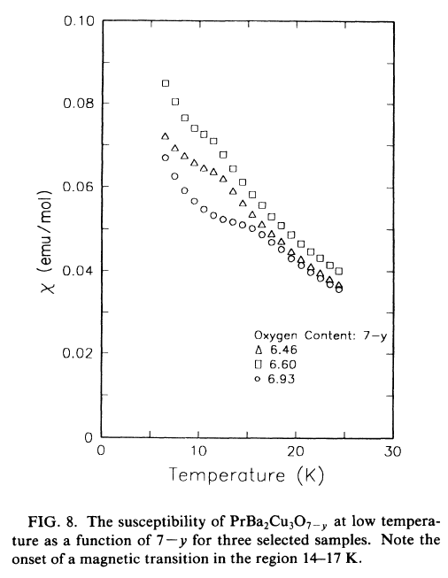
Lopez-Morales, et al., 1989 (Cont’d)
Pr-123 Resistivity & Susceptibility
No Tendency Toward Metallic Behaviour
No Tendency Toward Diamagnetic Shielding

Slide 8
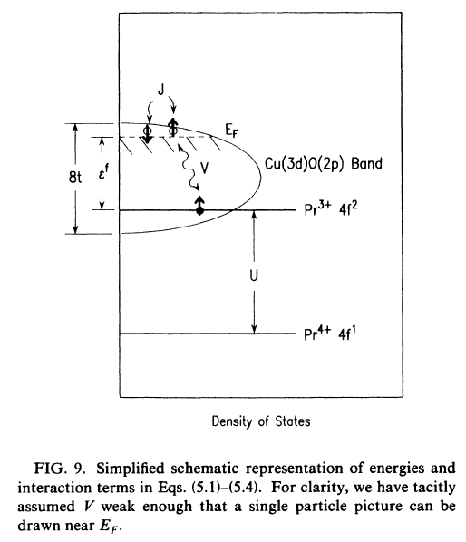
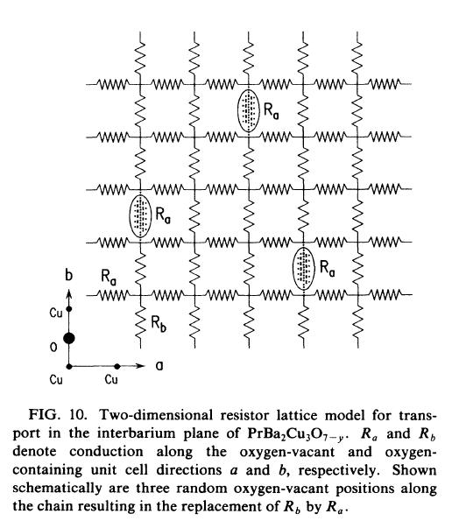
Pr-123: An Anderson Lattice?
See L-M, et al., for detailed description of model. In brief, a variable range hopping model that “defeats” a coherent metallic electronic structure.

Slide 9





The Ultimate QMC Homework Problem
Actually, a PhD thesis that could win the
APS Computational Physics Student Prize ☺

Slide 10
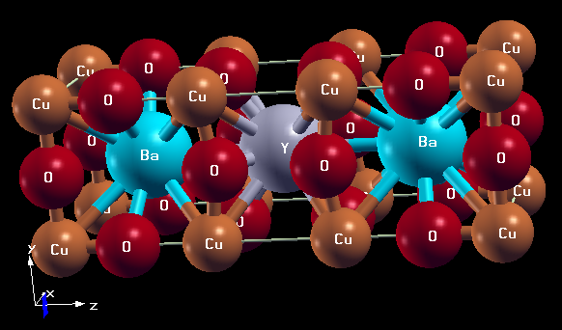
Are There Any Practical Applications for RE-123?

Slide 11
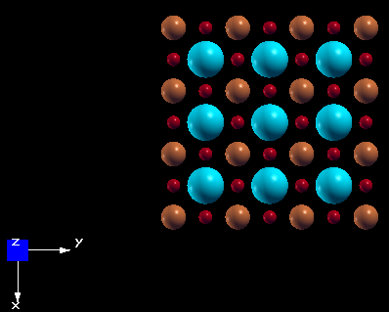
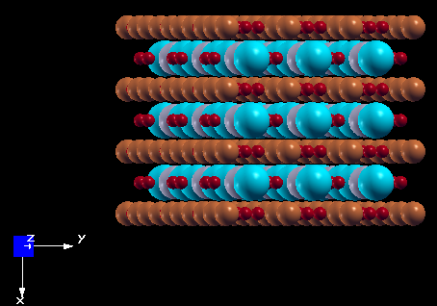
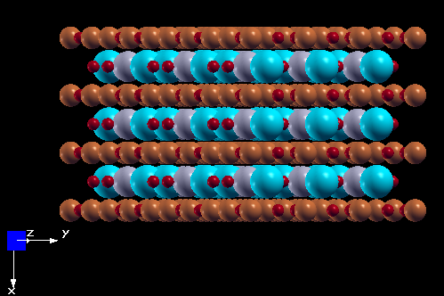
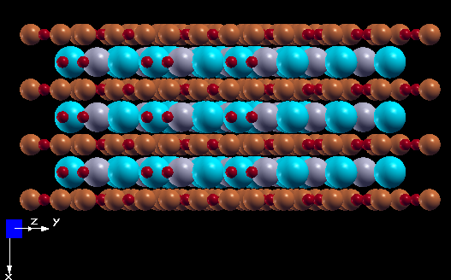
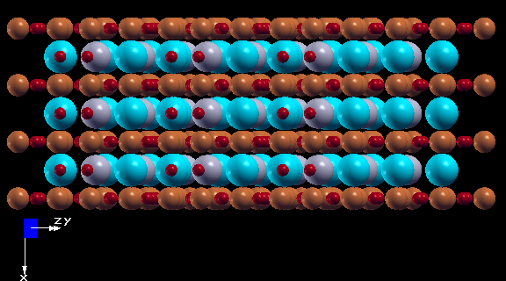
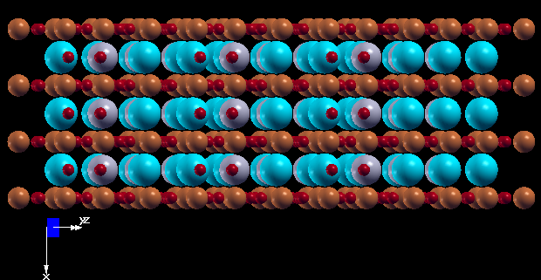
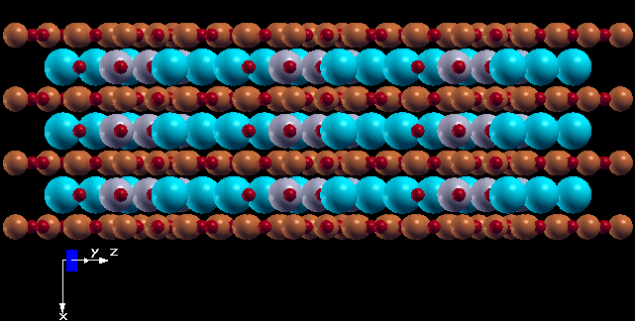
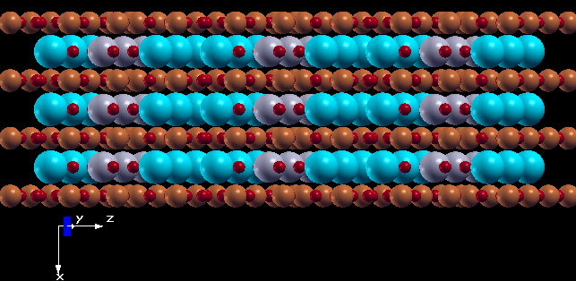
“The abc’s (xyz’s) of RE-123”
Cu
O
Ba

Slide 12
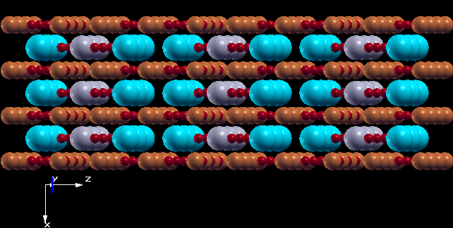
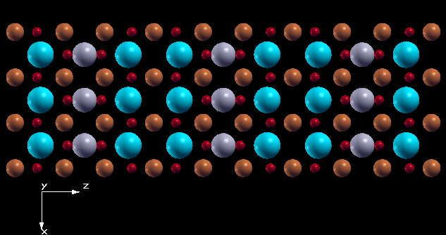
“...and Finally...”
“RE Channel”
“Ba Channel”

Slide 13
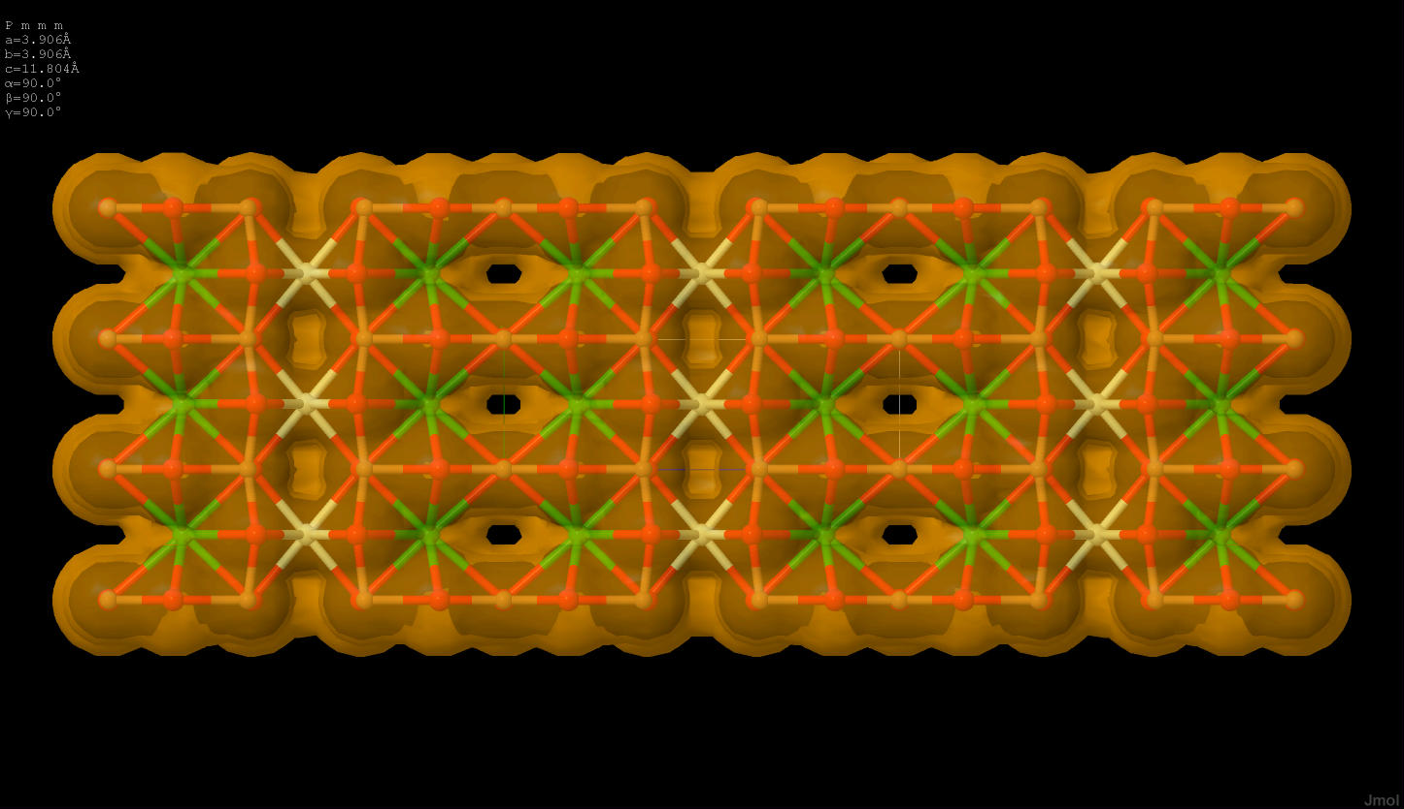
Van der Waals Surface for RE-123
a
b
c
Wow !

Slide 14
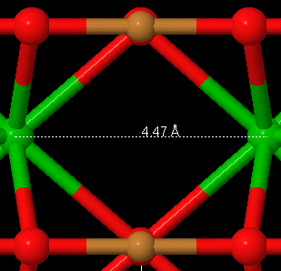
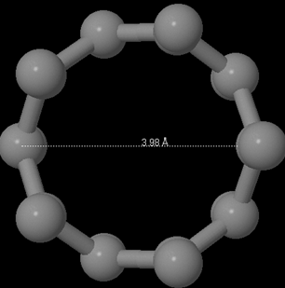
Channel Structure Comparisons
PBCO
CNT-5,0
NB: Relative Dimensions Approximate

Slide 15
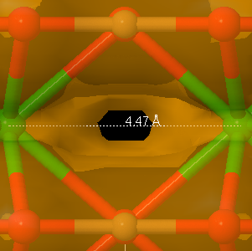
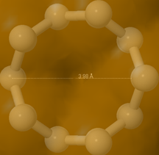
Van der Waals Surfaces
PBCO
CNT-5,0
NB: Relative Dimensions Approximate

Slide 16
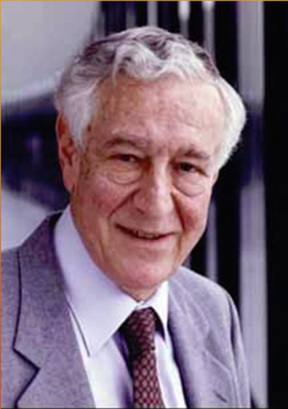

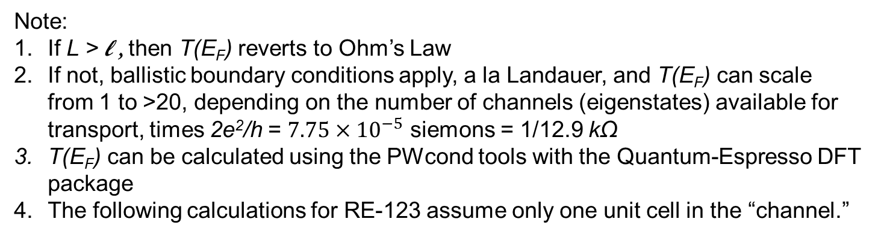
Landauer-Buettiker Formalism
W
k_{z}
L
“Channel”
R
L < l
l ≡ Electron Inelastic Mean Free Path
V
Note:
If L > l , then T(E_{F}) reverts to Ohm’s Law
If not, ballistic boundary conditions apply, a la Landauer, and T(E_{F}) can scale
from 1 to >20, depending on the number of channels (eigenstates) available for transport, times 2e²/h = $7.75×{10}^{−5}$ siemons = 1/12.9 kΩ
T(E_{F}) can be calculated using the PWcond tools with the Quantum-Espresso DFT package
The following calculations for RE-123 assume only one unit cell in the “channel.”

Slide 17
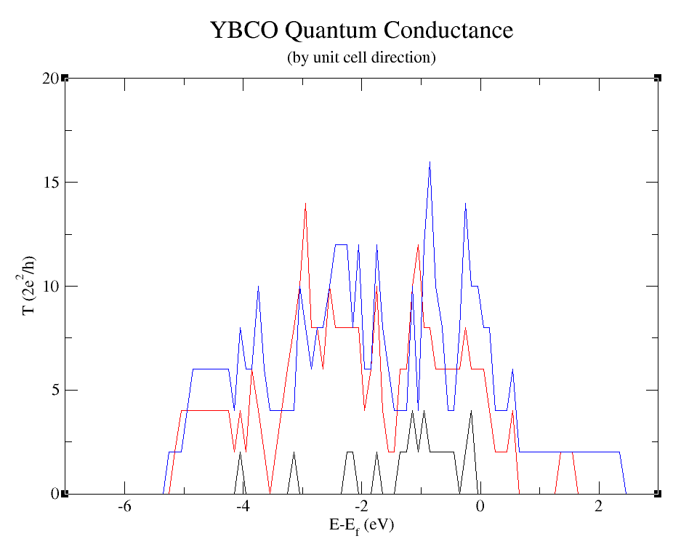
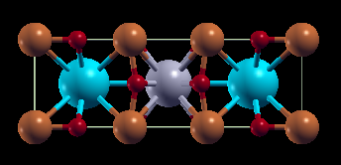
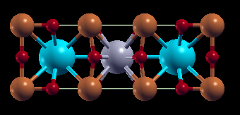

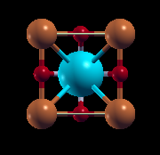
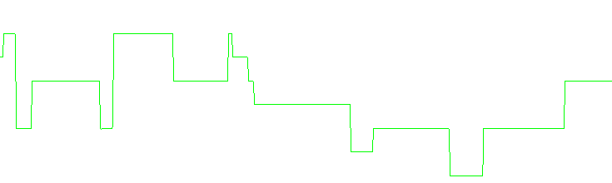
“b”
“a”
T_{max} = 16, <T> = 4.5
σ(T) = 3.3
T_{max} = 14, <T> = 3.3
σ(T) = 3.0
“CNT 5,0”
“c”
T_{max} = 4
<T> = 0.4
σ(T) = 0.7

Slide 18

“Need to Test by Experiment”
Y-123 Conducting
Pr-123 Insulating (10 monolayers, ~ 50 Å)
Can be made by MBE
  But b-axis growth not easy, might be best to try a-axis first
I
Y-123
Pr-123
V
Y-123
b-axis

Slide 19
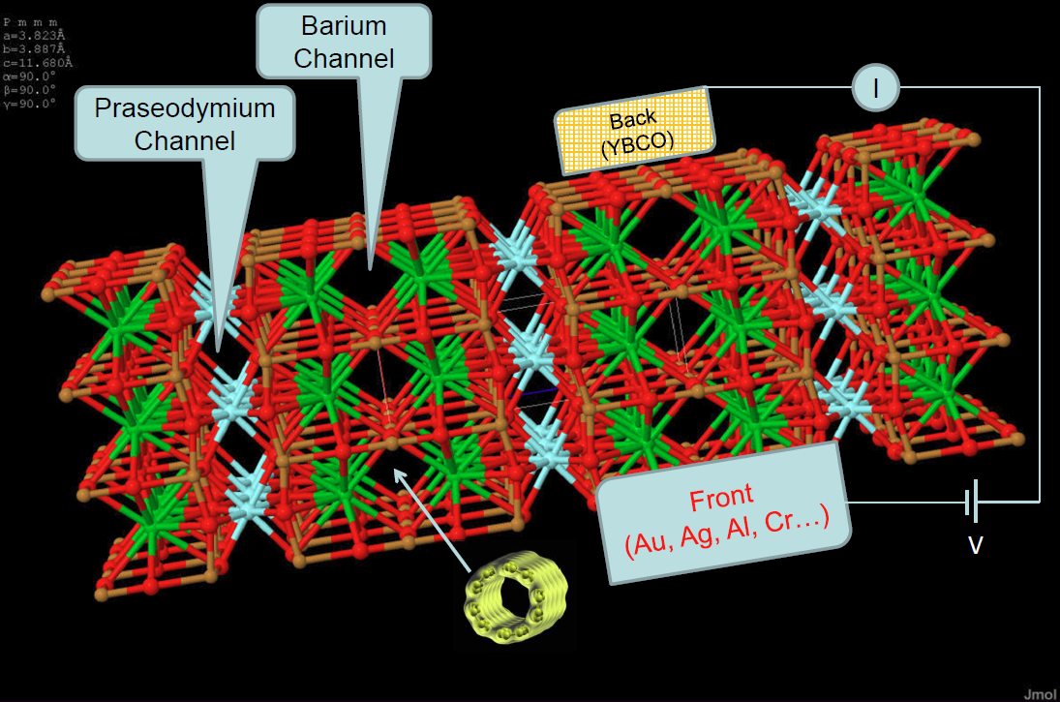
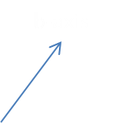
Embodiment as FET Gate

Slide 20
“The Last Word(s)”
Quantum Conductance in the a, and especially b, directions of RE-123 appears plausible.
Coulomb correlation (aka “Hubbard U”) needs to be taken into account.
Experimental verification is required.
Can the effect be exploited for FET gate applications? Or maybe something completely new?
“That’s All for Now, Folks...But Stay Tuned!”

