Slide 2
Setup

Slide 3
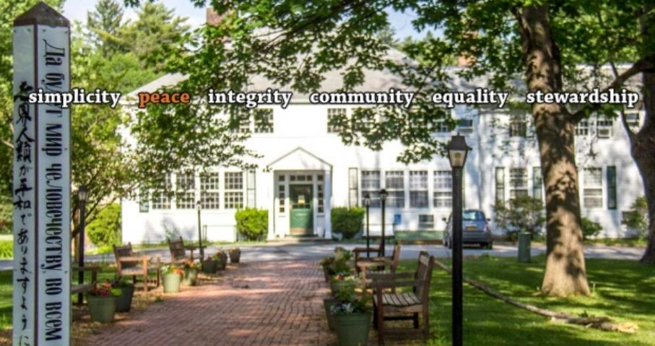


2018 Oakwood Herzog Lecture
“A Life Journey in Physics and Beyond”
Paul Michael Grant, ’53
www.w2agz.com
Off the Streets of Poughkeepsie to the Halls of Oakwood,
Then to the Labs of IBM,
Followed by the Study of Physics at Clarkson and Harvard Universities,
Back to IBM Research in San Jose,
Then Appointed Science Fellow at EPRI, Palo Alto,
Now an Aging IBM Pensioner☺
“Before Silicon Valley, There Was The Hudson Valley!”

Slide 4
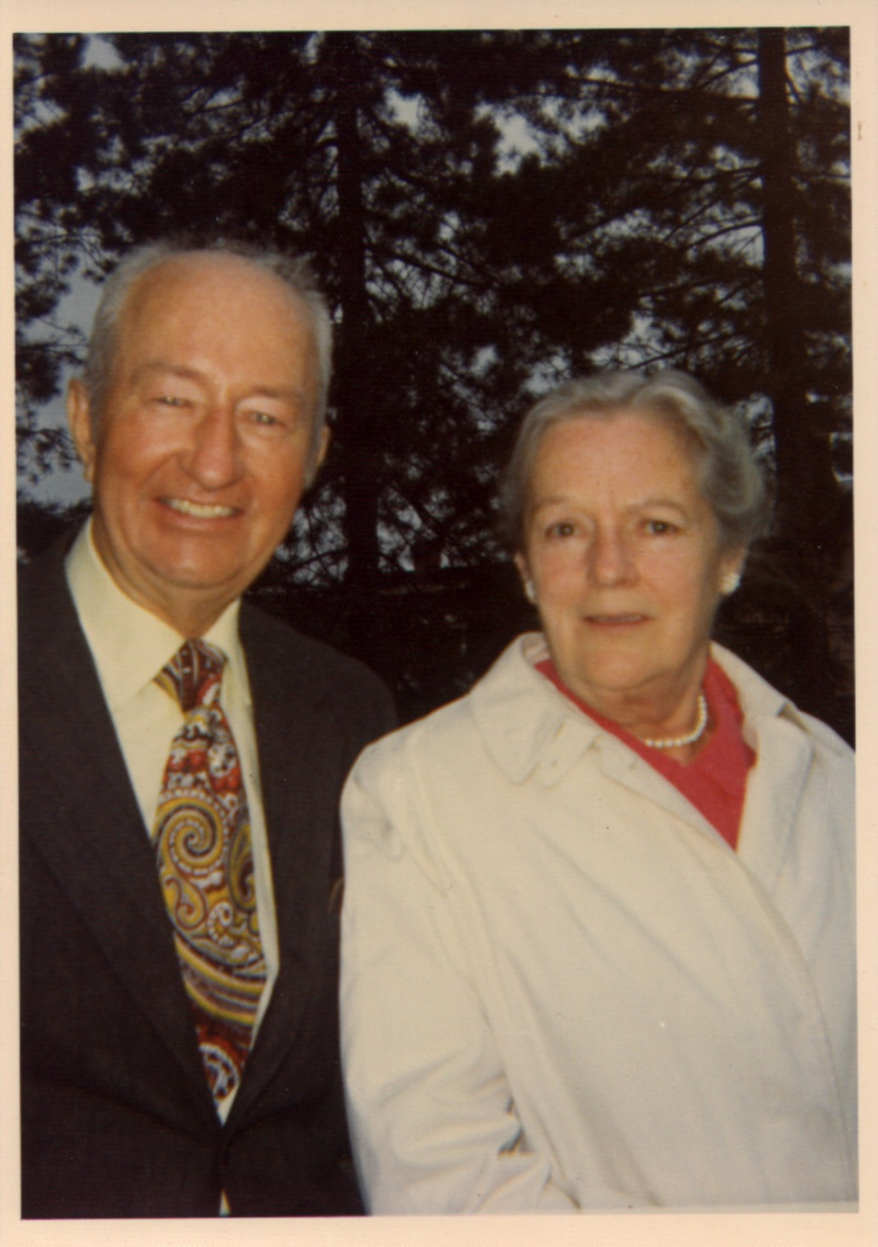
Born May 9th, 1935 in Poughkeepsie
…and then followed life in their shoes…
Paul Archibald Grant
  W2AGZ
  US Navy, WWII
  IBM, 1948-1974
  Ski Patrol, 1948-1970
Mary Ann Whalen Grant
  CYO BB Champ, 1921
  NYS Bowling Champ, 1939
  Women’s Baseball, ‘33-’47
  Eastman School, ’21-’22
  CHG&E, 1923-1965

Slide 5
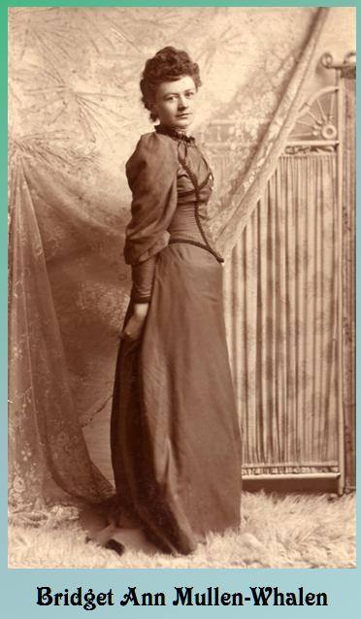
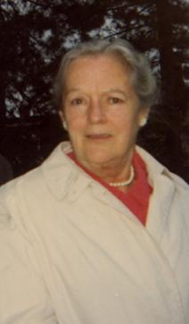
“Heaven’s “ XX Board Members
Mary Ann Whalen Grant

Slide 6
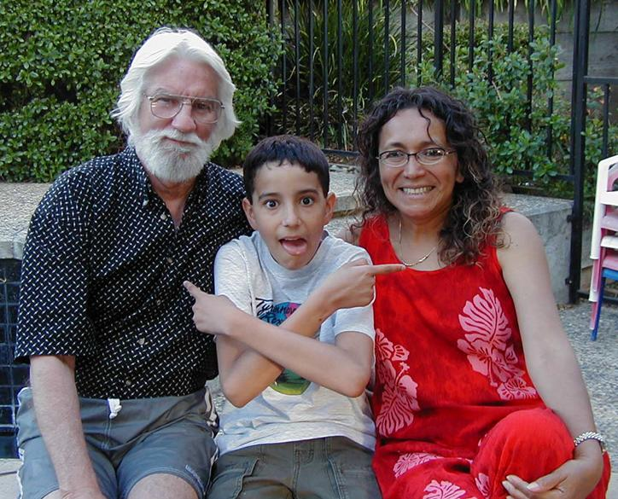
21st Centrury
“Mexican-American Alliance”

Slide 7
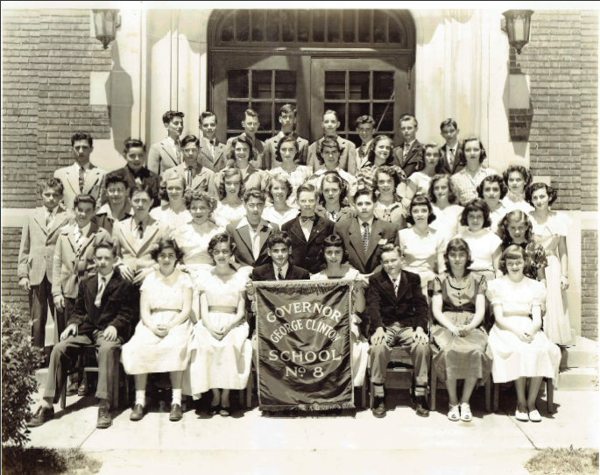
It’s 1949

Slide 8
PMG Path Forward
Clinton (1949)
Oakwood (1949-53)
IBM (1953-56)
Clarkson (1956-60) (Summers at IBM P-K)
Harvard (1960-65) (Sample Prep at IBM Kingston)
IBM Research SJ (1965-93)
EPRI PA (1993-2005)
W2AGZ Tech (2005-Present)

Slide 9
PMG@Oakwood: 1949-53
Oakwood Interlude and Memories

Slide 10
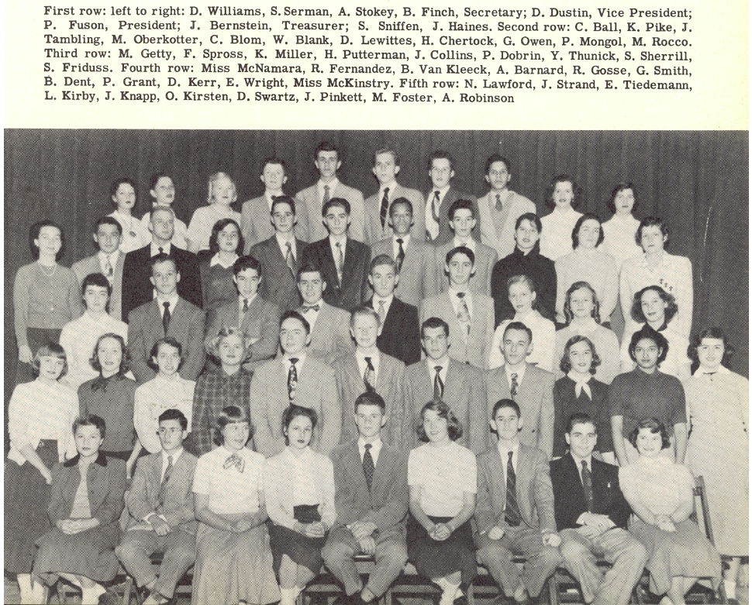

Slide 11
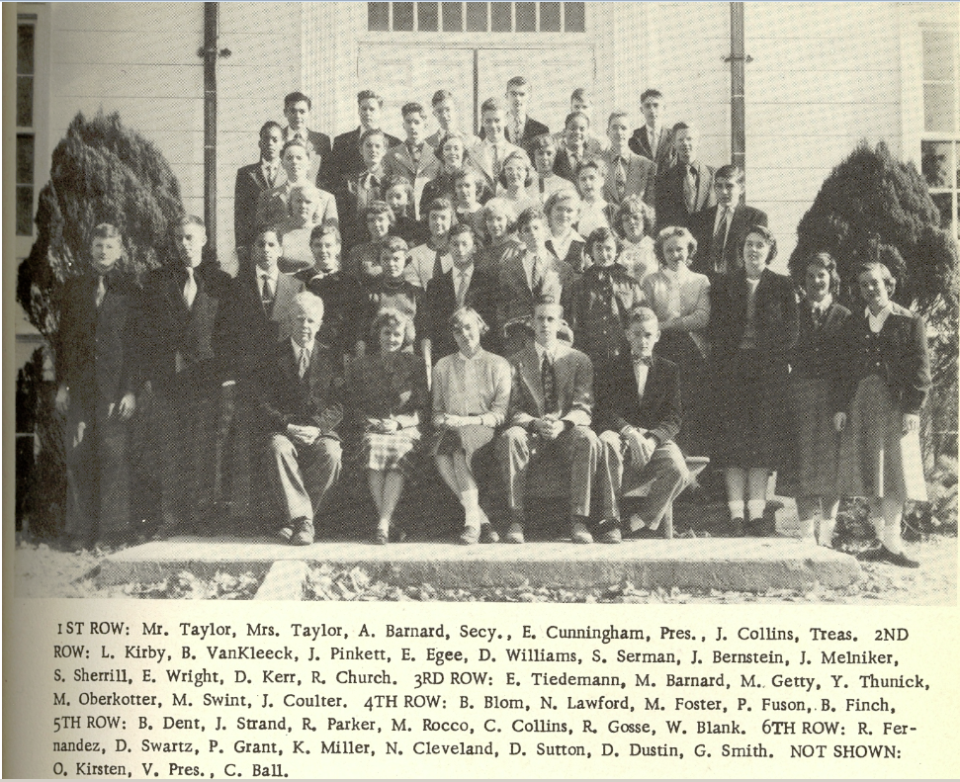

Slide 12
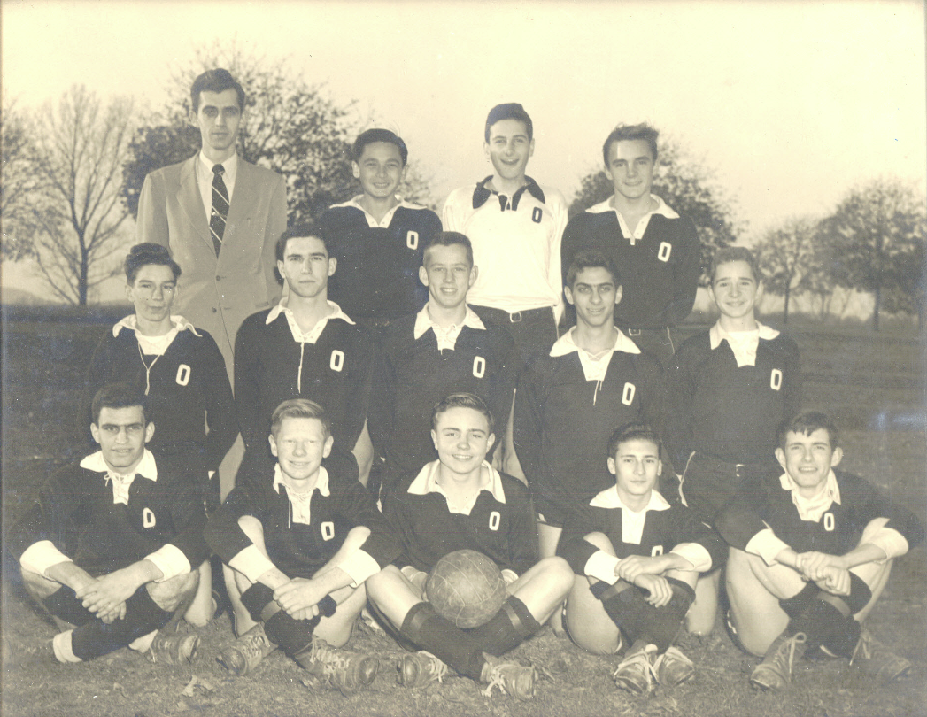
1951

Slide 13
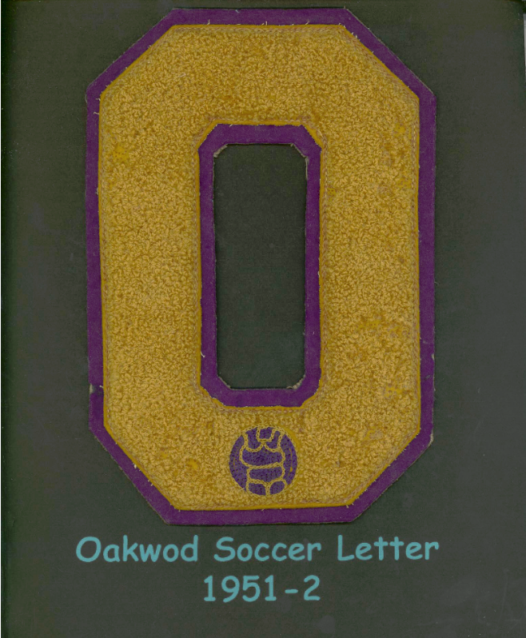
Oops!!
That’s “Oakwood,”
and I did get A’s in English...sigh...

Slide 14
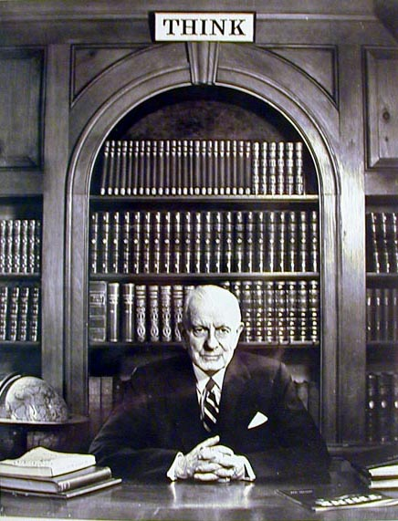
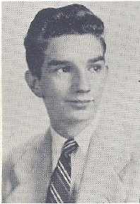
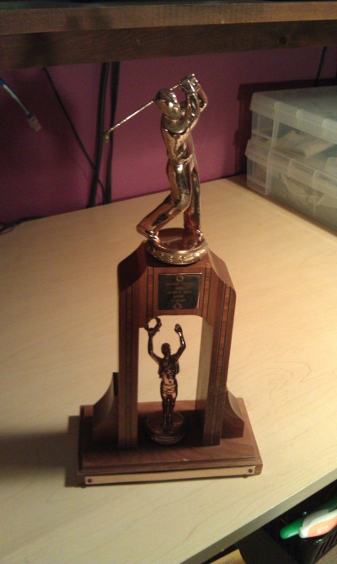
While At Oakwood...Watson Golf Trophy
-1952-

Slide 15
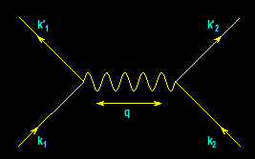
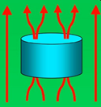
Life After Oakwood
-- IBM, EPRI, and Beyond --
From
Electrons
Paired
To
Electric
Power Delivered
…And…
Back
Again
?
IBM (1953-1993)
Joined 1953 (age 17)
SAGE/NORAD (MIT)
Clarkson/Harvard
Magneto-optics
Displays/Printers
Organic Conductors
DFT
Superconductivity
High-Tc
Sabbatical (UNAM)
EPRI (1993-2005)
High-Tc Power Apps
Wide Bandgap SCs
Power Electronics
“Hot” Fusion
“Smart Grid”
“SuperGrid”
“Climate Change”
Visionary Energy Societies
W2AGZ (2005-?)
Due Diligence
Tet-CuO (Stanford)
“Proxy” DFT
RTSC via DFT
IASS Potsdam
Dual Use of NG Pipeline ROWs for Co-transport of Electricity via HTSC Cables (e.g., Keystone)

Slide 16
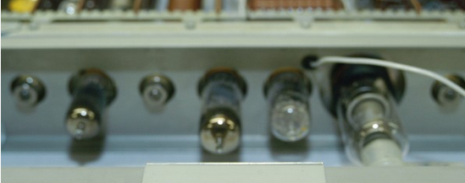
PMG@IBM: 1953-56
July, 1953: At age 18, hired as mail boy, Project High laboratory, Poughkeepsie
November, 1953: Promoted to bench technician...
  Helped build pluggable unit and core memory test equipment for XD-1 assembly line.
  Worked on assembly line of XD-2, Poughkeepsie Manufacturing.
Summer, 1954: Attended first SAGE support programming class, IBM Poughkeepsie, taught by Art Samuel, pioneer of “Checkers AI” gaming.
  With a TvN machine instruction set of only three operations (store, subtract, branch on minus), you can compute anything!
Spring, 1955: Posted to MIT Lincoln Lab as member of XD-1 service team.
August, 1956: Now 21, began pursuit of undergraduate degrees in EE and physics at Clarkson as IBM employee on educational leave.

Slide 17
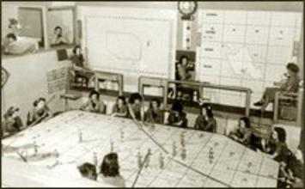
Prologue: 1949-50
It’s 1949: The USSR has developed nuclear weapons.
Deliverable via supersonic bombers and elementary ballistic missiles.
Here was our defense at the time!
Obviously, we needed a new technological approach...
(and not just by substituting XXs with XYs)!

Slide 18
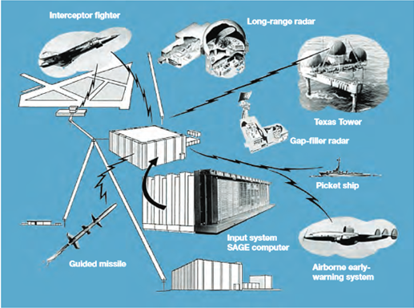
Proposal: 1951-53
George Valley and Jay Forrester of MIT propose:
  A net of radars and other data sources, along with computers,
  That receive radar and additional information to detect and track aircraft,
  Process such data to depict the total challenge to confront militarily,
  Then guide weapons to destroy incoming enemy munitions.
Wow! Ambitious! Their vision became SAGE (Semi-Automatic Ground Environment), first prototyped as XD-1 at MIT Lincoln Labs in 1954.
Hmmm...seems like a lot of “things” “netted” together. That’s why “t=0” of the IoT began back then!

Slide 19
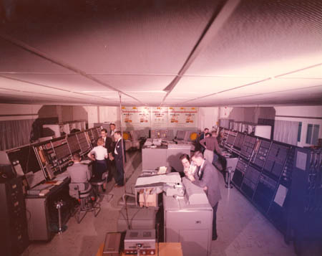
1953
Project Sage – IBM/MIT

Slide 20
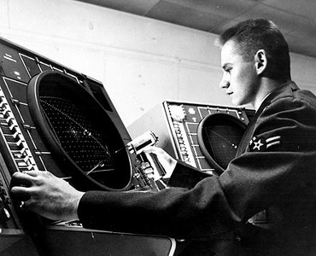
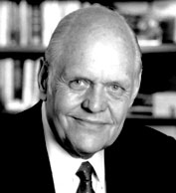
SAGE Console (1954)
Ken Olsen

Slide 21
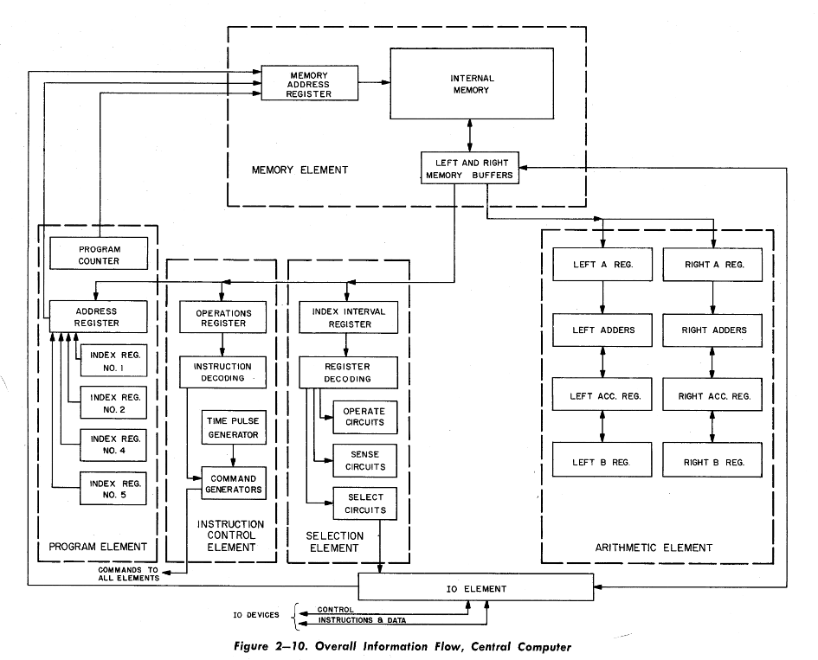
AN/FSQ-7 Architecture
The World’s First
Parallel Computer!
x = ρ cos Θ
y = ρ sin Θ

Slide 22
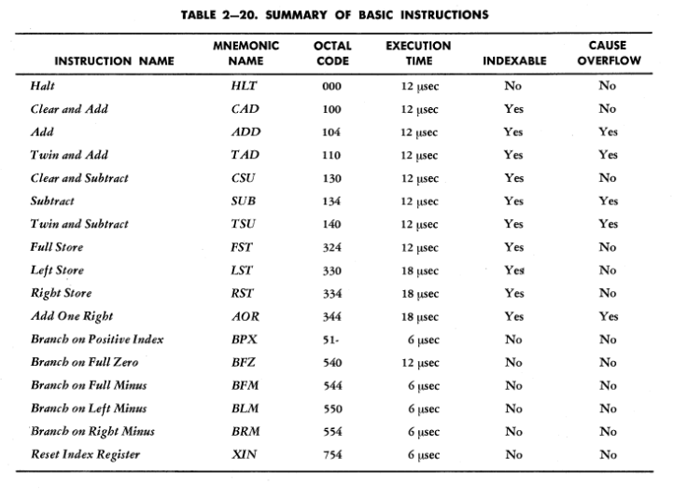
SAGE XD1 AN/FSQ-7 Instruction Set
In 1955, I was able to use the above parallel instruction set to calculate pi(π) to ~1500 decimal places, but...

Slide 23
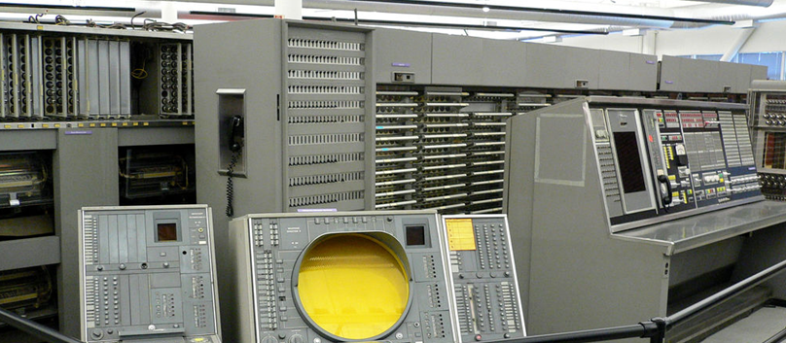
It’s 2018 = SAGE + 65 Years
Is the IoT of today any different from the IoT of SAGE?
I.E., Does Ecclesiastes 1:9 Hold? Depends...
SAGE
AN/FSQ-7
Weighed 250 tons
Consumed 3 MW
60,000 vacuum tubes
75,000 instructions per second (6 µsec/memory cycle)
3rd class phone linkage: (400-3400 Hz)
IBM card reader, card punch, line printer, magnetic tape units
70,000 15-bit words of magnetic core RAM
100,000 15-bit words of magnetic drum SATA storage
> 50 CRT display consoles, keyboards, light guns
Total Cost of NORAD: 10x10^9 USD
wow!

Slide 24
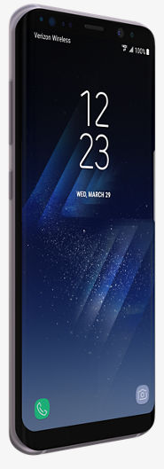
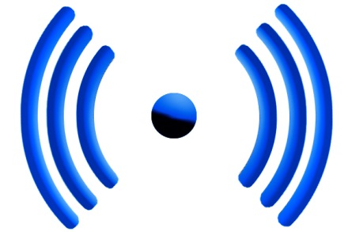

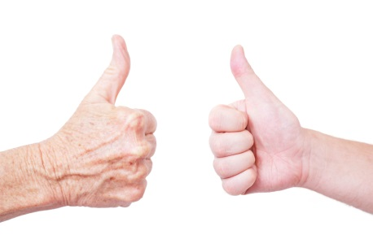
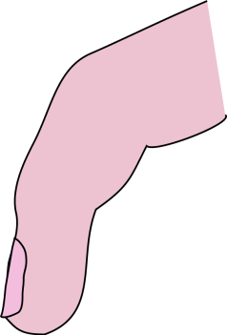
Now We Have!
Our iToys + Wireless + The Cloud
...and...oh, yeah...APPS!

Slide 25
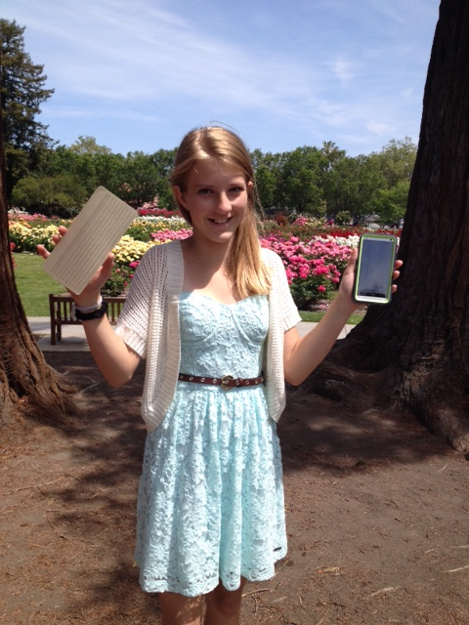
12-Year Old Devin Grant’s
“ Big Data” Homework Assignment
How many of GrandPa’s really silly 1953 IBM Punched Cards does it take...
...to fill up a 32 gig iPhone?
Well?
A stack about 30 miles high!
> 3000 miles in a 4 TB home CLOUD!
Wow!* That’s really “Big Data! ”
So What’s Next?
Putting Your 1’s & 0’s in a Black Hole?
*Assumptions:
120 bytes/card
Thickness = 0.007 inches

Slide 26
Herzog Homework Problem
So, based on what you just saw Devin do...
How many SAGE computers could you stuff into your:
  Apple idiotPhone?
  Android dumbPhone?
Send me the numbers when you have the answer.

Slide 27
PMG@Clarkson: 1956-60
During the summer of 1956, my IBM management in the Hudson Valley offered to send me to college ( only in New York State) as an employee under a special “leave of absence” for “townies” that underwrote my tuition, books, and incidental expenses, and guaranteed me promotion and increased salary on return each summer to IBM in the Hudson Valley.
I accepted the IBM offer, but had difficulty getting admitted, because of my “advanced age (I was now 21)” and marginal high school grades. I applied to, and was rejected by RPI, Union and Clarkson.
At the last minute, Clarkson admitted me “under the bar” within an exemption for Korean War Vets, inasmuch I was about “the same age.”
Based on my summer work at IBM, I undertook a Senior Thesis, unusual for that time.
I majored in both Electrical Engineering and Physics. Under Clarkson’s present Honors Program, I would have received two diplomas, however, at IBM’s insistence, I chose a BSEE degree.

Slide 28
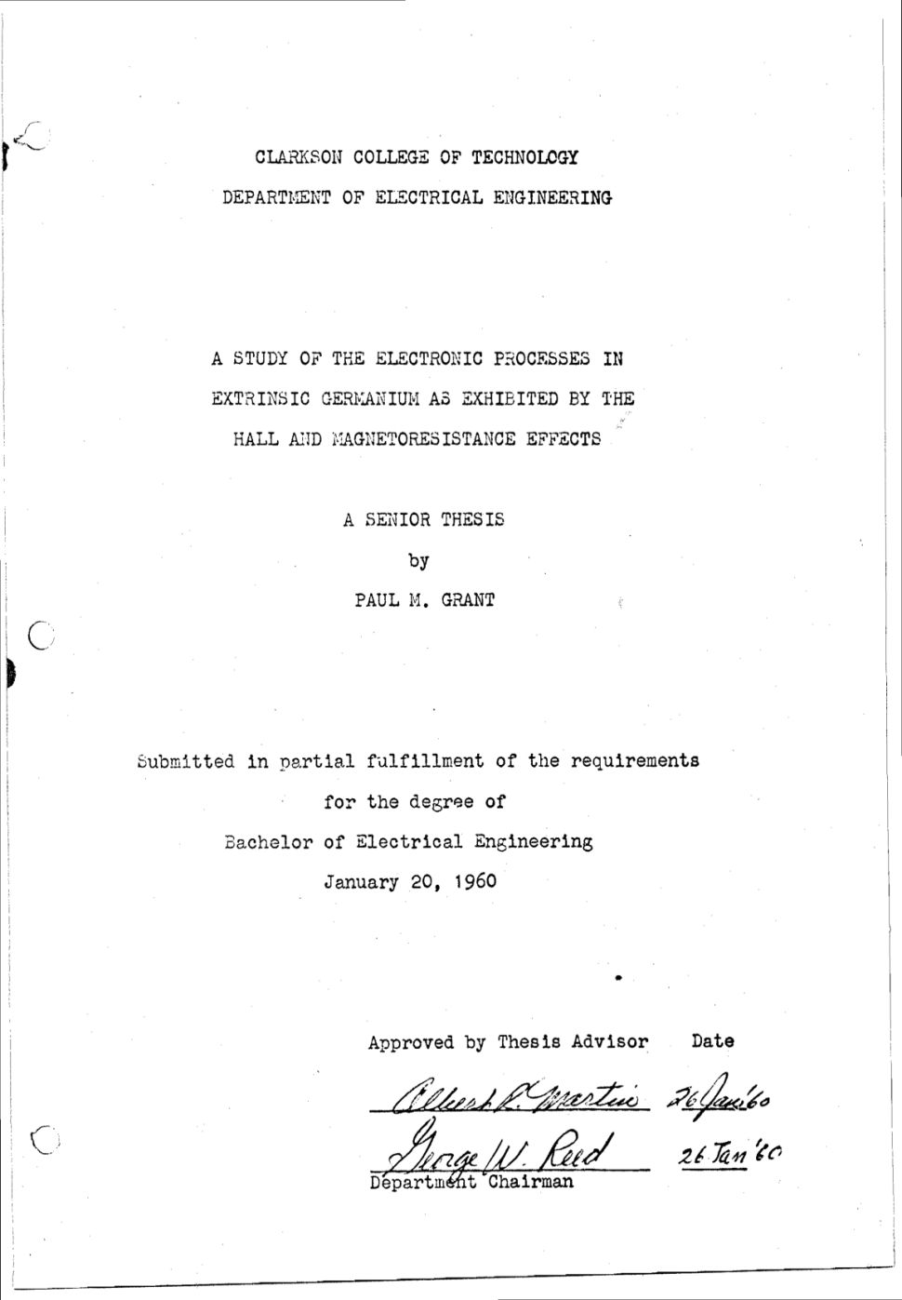
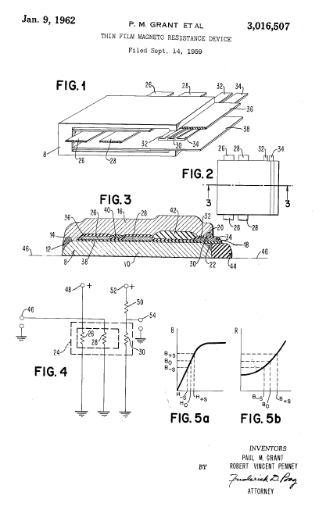
Clarkson Senior Thesis
My Senior Thesis Morphed
Into the GMR Read Head
Employed in Hard Drives Today!

Slide 29
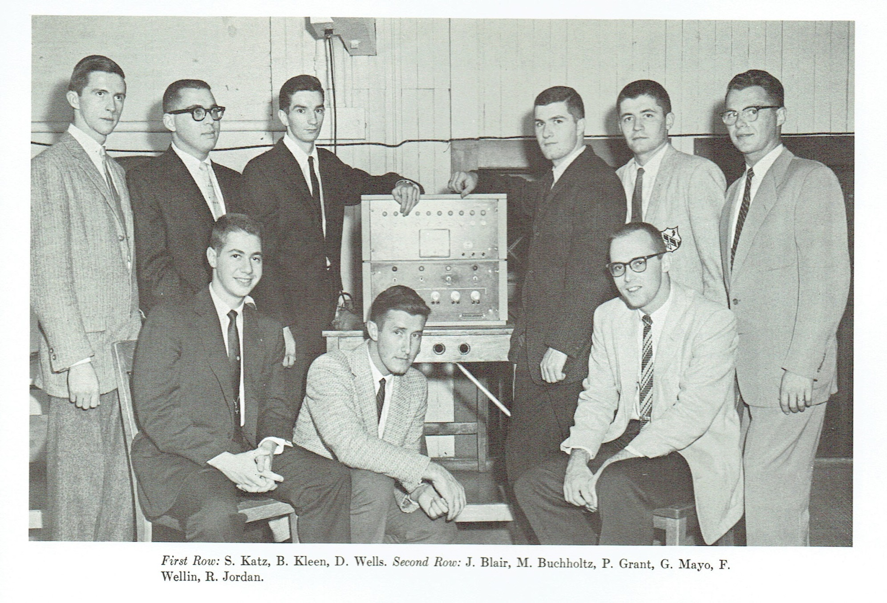
Eta Kappa Nu, ‘60
Graduated Valedictorian Class of 1960
GPA: 3.93/4.00

Slide 30
PMG@Harvard: 1960-65
I applied successfully for admission into the physics graduate programs at RPI and
and MIT, with a national defense fellowship. I was going to leave IBM.
However, IBM offered to underwrite my attendance as an employee, if could get
accepted at Harvard, which had an outstanding program in semiconductor physics, a
field of vital importance to IBM at the time. I applied and was immediately accepted.
My Thesis research involved the epitaxial deposition of semiconductor thin films, which
innaugurated the effort on topological physics for which the Harvard Gordon McKay
Center is now world renown.
Historical Events while at Harvard:
  Cuban Missile Crisis, 27 October 1962 (the end of the world was at hand).
  Assassination of JFK, November 22, 1963.

Slide 31
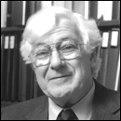
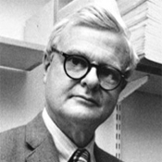
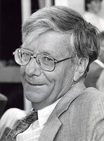

Harvard Thesis Advisors (1962-65)
William “Bill” Paul
High Pressure Physics
Topological Structures
Harvey Brooks
Nuclear Power Pioneer
Science Advisor to JFK
“Niko” Bloembergen
Nobel Laurate NMR
Great Squash Player
Paul Michael Grant
PhD Thesis
“The Optical Properties of Thin Germanium Films”

Slide 32
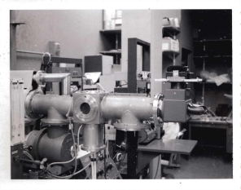
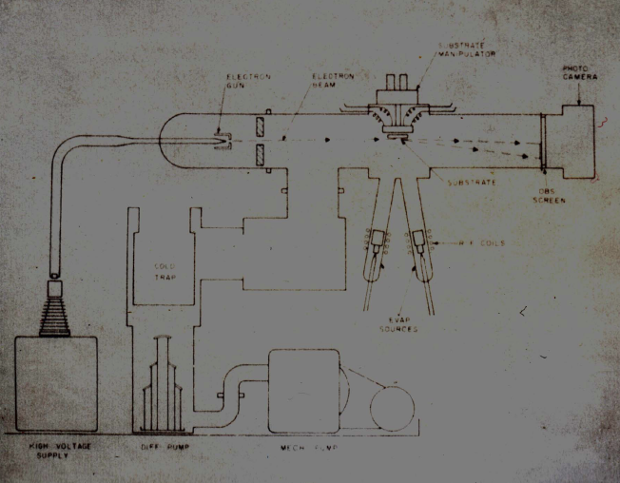
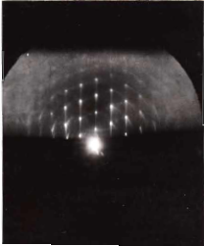
IBM Kingston MBE Tools

Slide 33
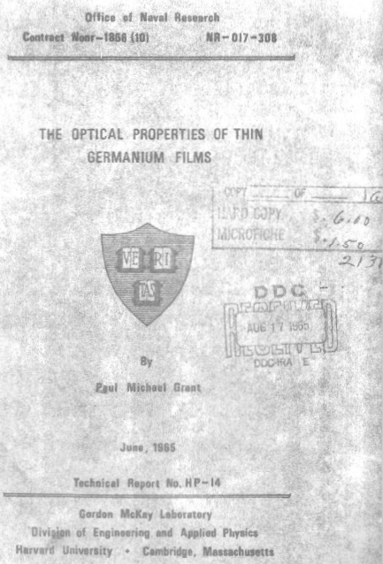

Slide 34
PMG@IBM#2: 1960-93
All Work Performed at IBM Research San Jose/Almaden Valley, California
Laboratory Automation
Organic Conductors & Superconductors
Polymer Field Effect Transistor
High Temperature Superconductivity
Explore novel materials/mechanisms for magnetic storage

Slide 35


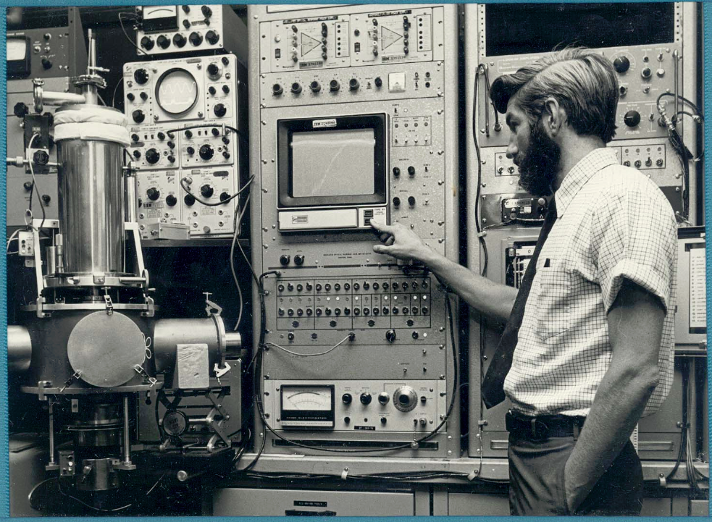


Semi-Anthology of 1800 Lab DAC Papers from IBM San Jose Research published in IBM J. Res. Devel., 1968 Special Issue
Authors: Grant, Schechtman, Ramondi, Winters, Clarke, Gladney...
... and many others

Slide 36
Superconductivity 101

Slide 37
Models of
Electrical Conductivity
The Most Popular:
R
e⁻
Freezes Out!
T

Slide 38
Models of
Electrical Conductivity
Reality:
R
Limited by
Impurities!
•

e⁻
T

Slide 39
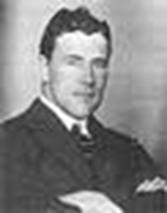
1911
A Big Surprise!
Thus the mercury at 4.2 K has entered a new state, which, owing to its particular electrical properties, can be called the state of superconductivity
Gilles Holst, H. Kamerlingh-Onnes (1911)

Slide 40
Physics of Superconductivity
(1957 – 2006)
Electrons Pair Off!
BCS Equation
•
+
+
e⁻
+
+
•
e⁻

Slide 41
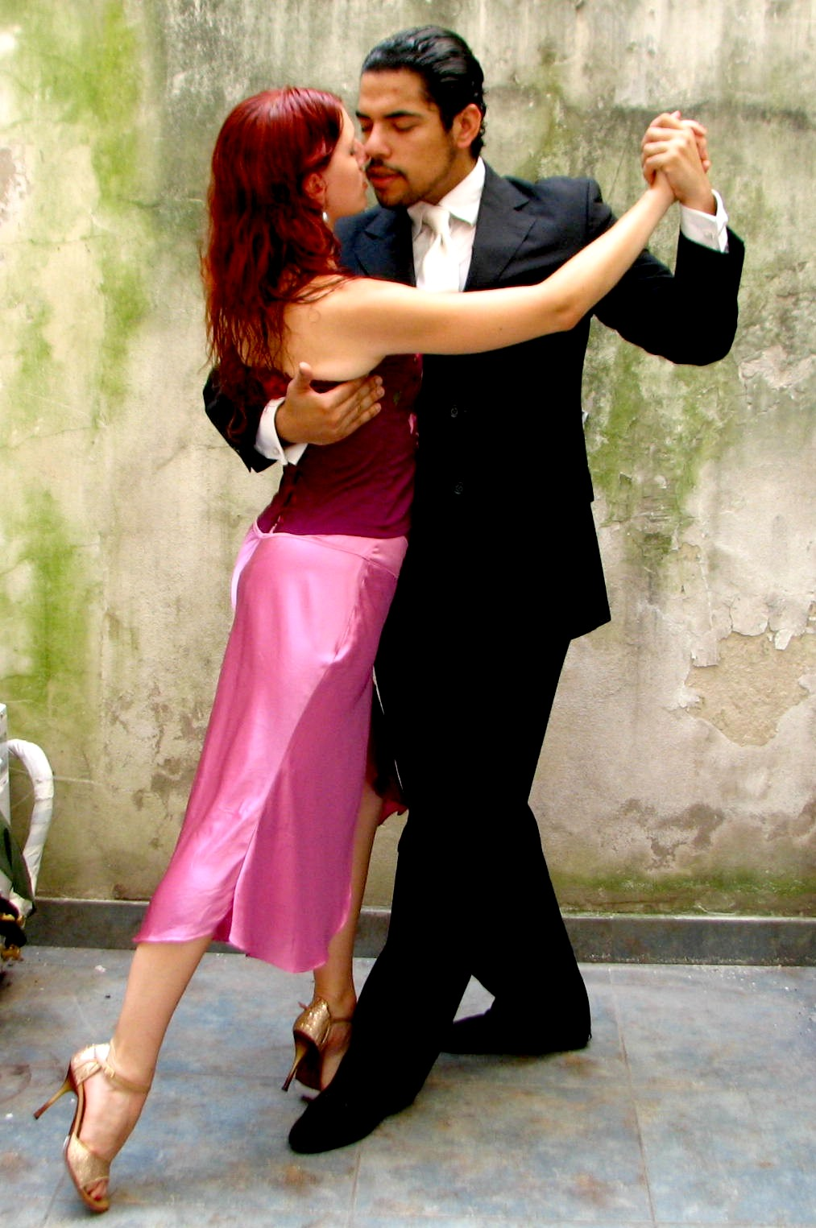
It takes two to Tango
Notes:
Ney Mello, 9/11 survivor decided to leave his career as investment banker and turn to tango

Slide 42

conductor

Slide 43

Semiconductor

Slide 44

SUPERCONDUCTOR

Slide 45
Important Numbers in Superconductivity
Transition Temperature, T_{C} Way below 300 K
Critical Current Density, J_{C} 10⁻² - 10⁶ A/cm²
Critical Magnetic Field, H_{C} 10⁻⁴ - 10 T
London Penetration Depth,  10 - >1000 Å
Pippard Coherence Length, ξ 10 - >1000 Å
G-L Parameter,  = /ξ 0.01 - 100
NB! All these numbers depend on each
other. E.g., H_{C} ~  ξ

Slide 46
T_{C} vs. Year:
1911 - 1980
25
Nb₃Ge
20
Nb₃Sn
NbN
V₃Si
15
Temperature (K)
10
Pb
5
Hg
0
Cubic Metals
1900
1910
1920
1930
1940
1950
1960
1970
1980
Year

Slide 47
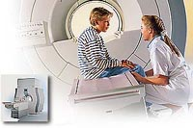
MRI & “Big Physics”
Magnetic Resonance Imaging
Philips
Tevatron
Fermi National Laboratory

Slide 48
1986
Another Big Surprise!
Onset T_{C} = 40 K !
Bednorz and Mueller
IBM Zuerich, 1986

Slide 49
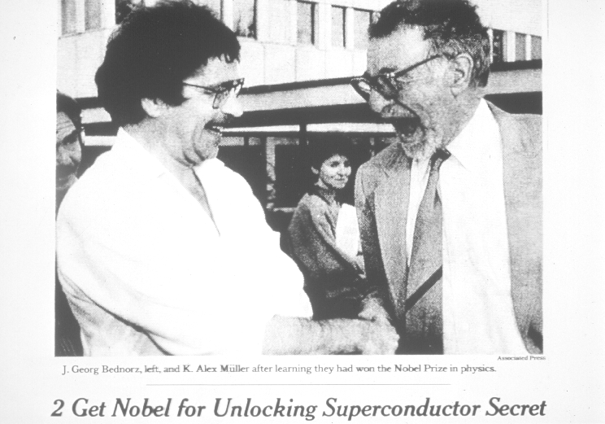
1987
“The Prize!”

Slide 50
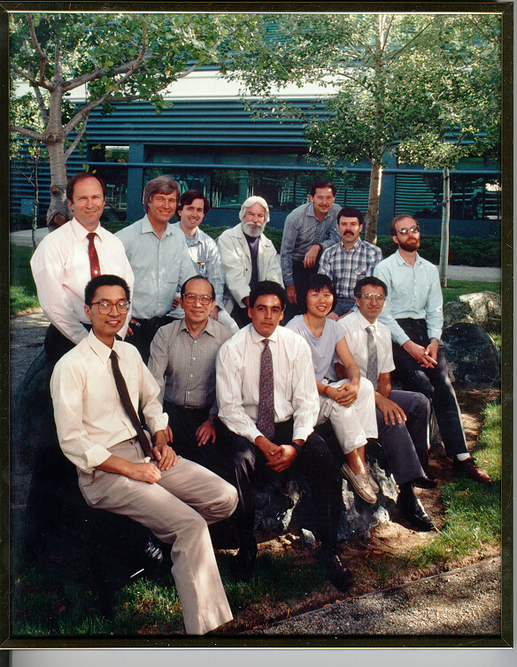
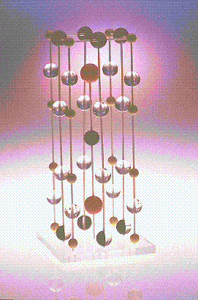
March 3, 1987
“123” Discovered

Slide 51
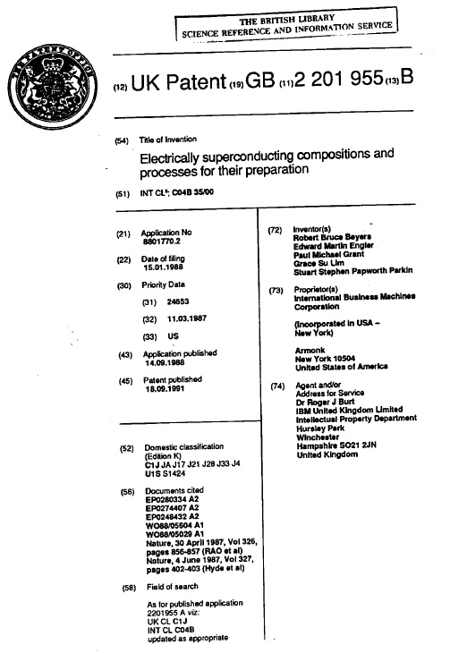
1991 IBM International Patent on
High Temperature Superconductivity

Slide 52
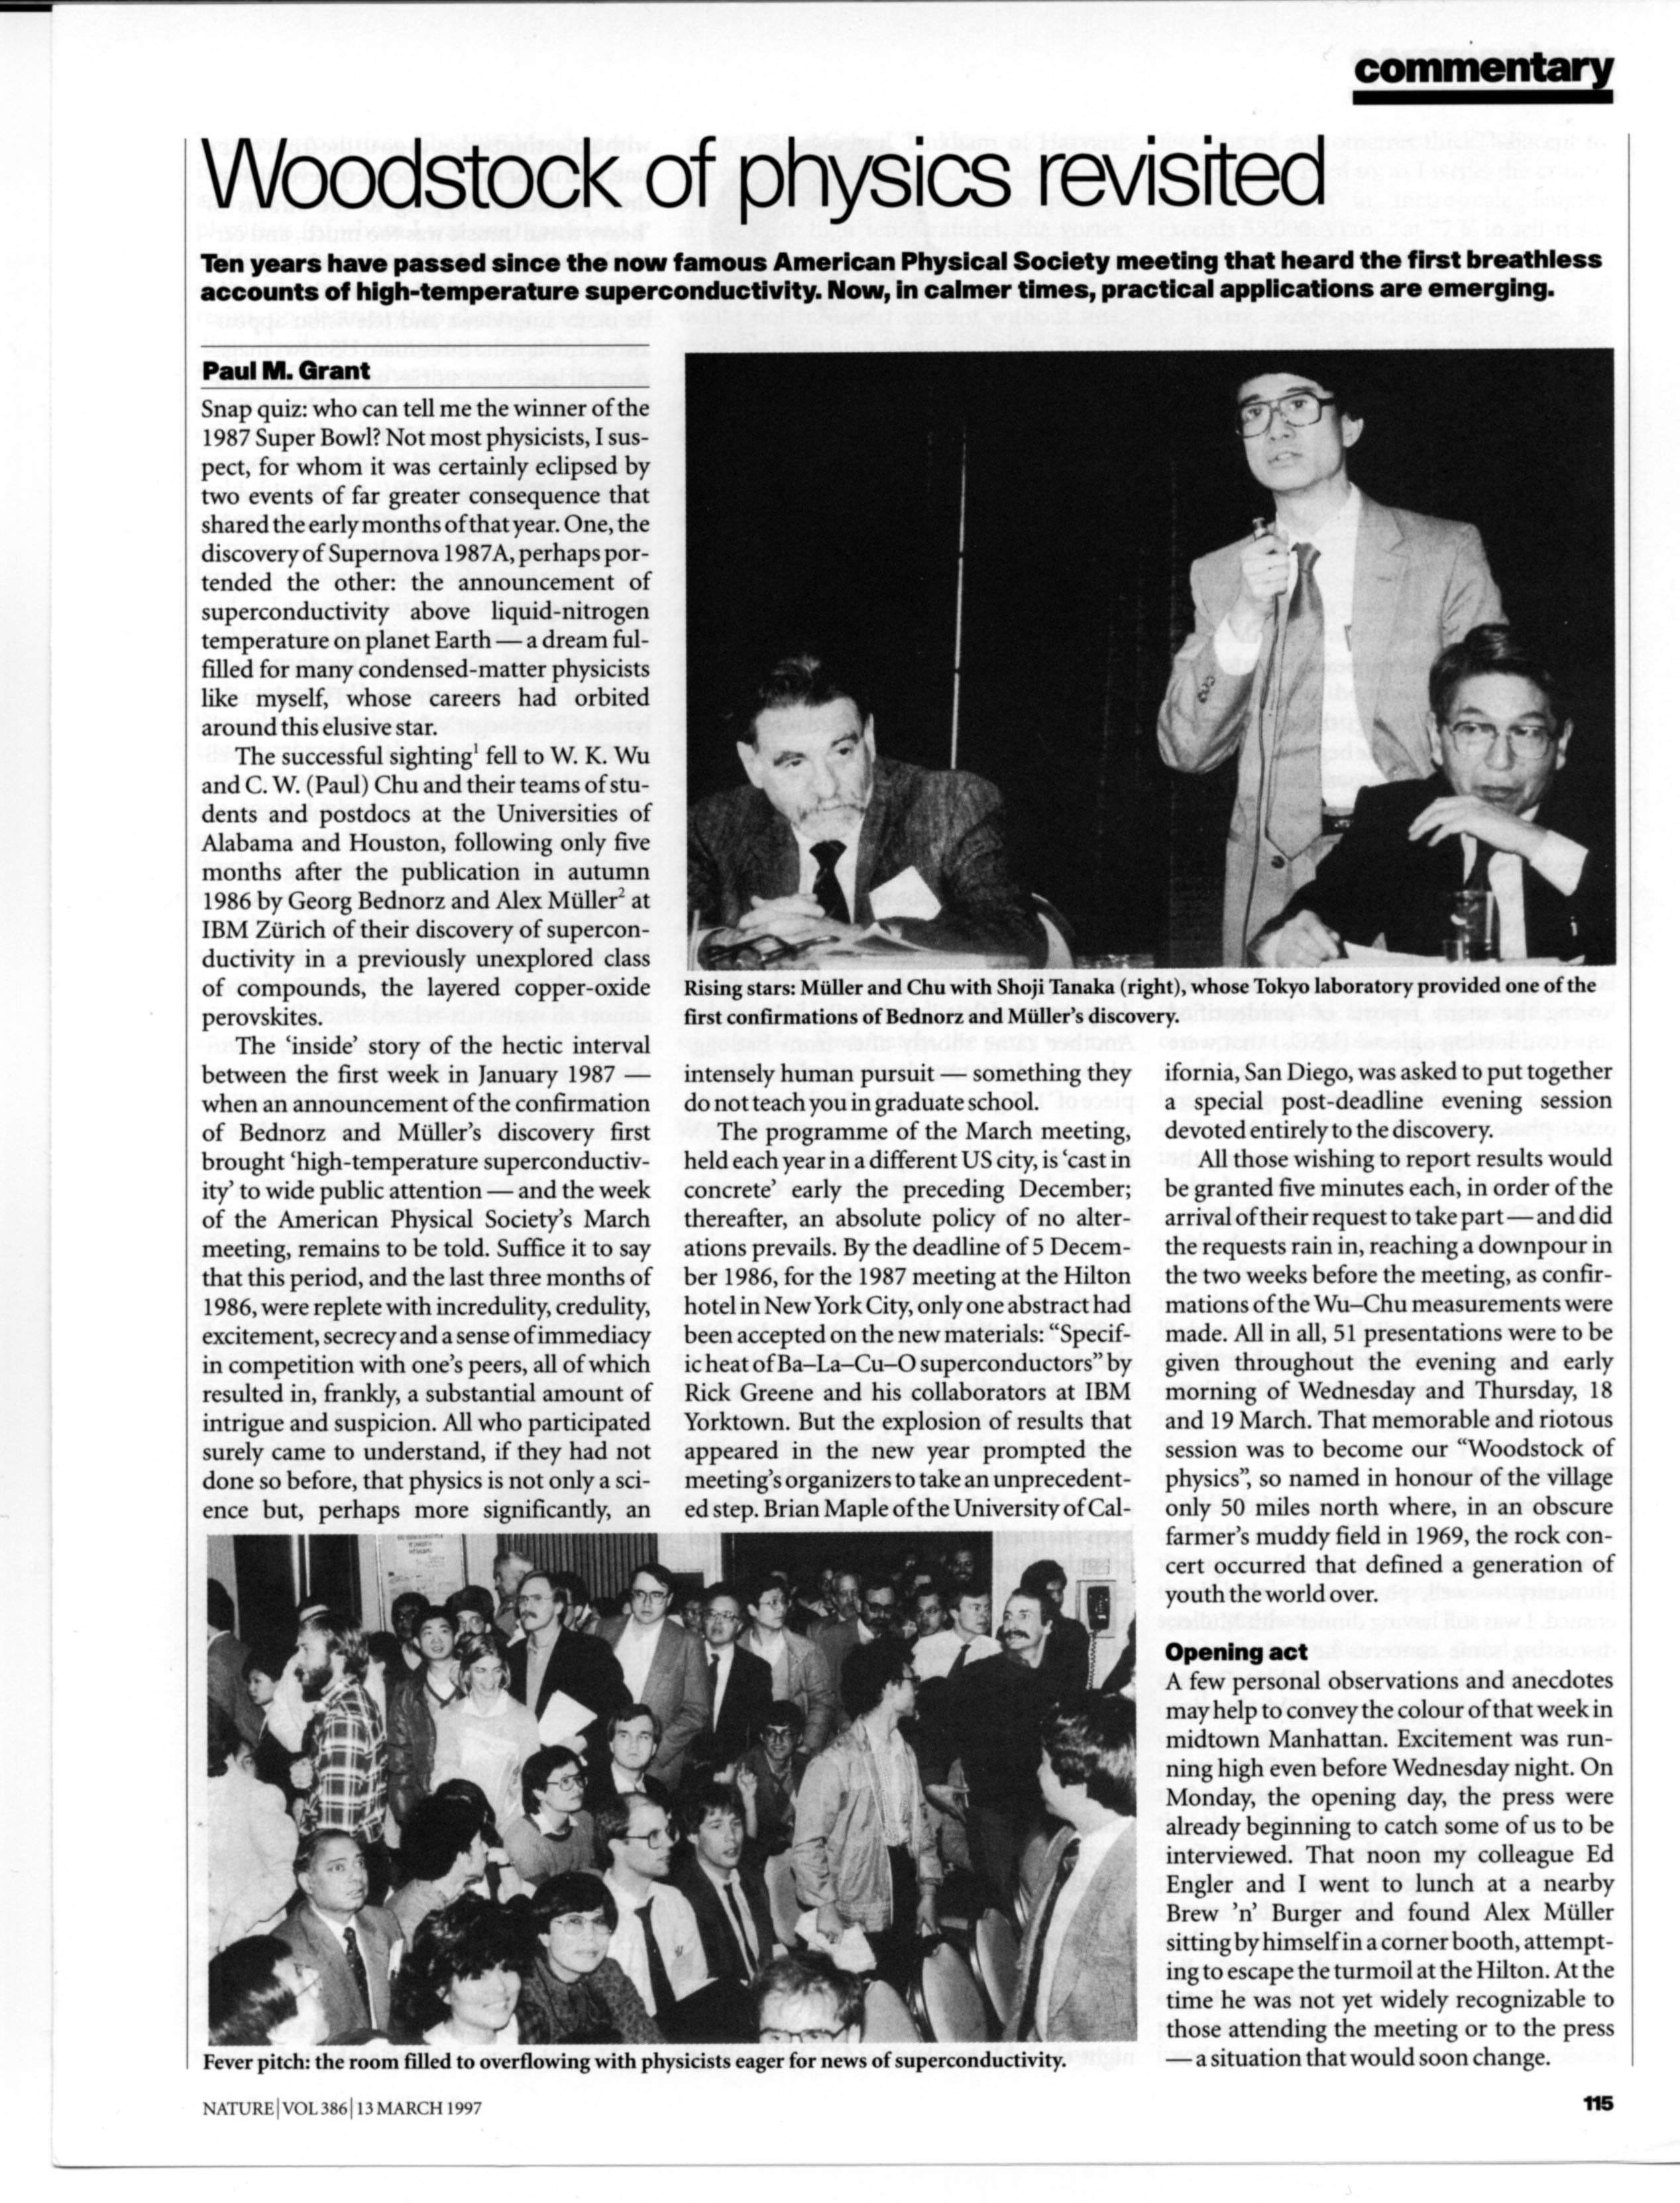
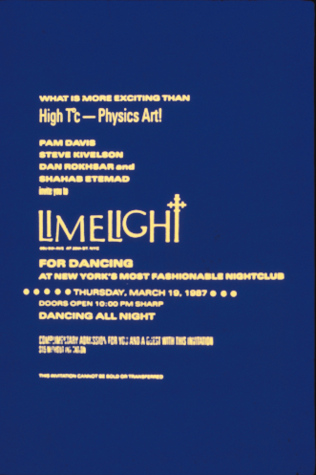
Woodstock of Physics
NYC, 1987
Physicists’ Night Out!

Slide 53
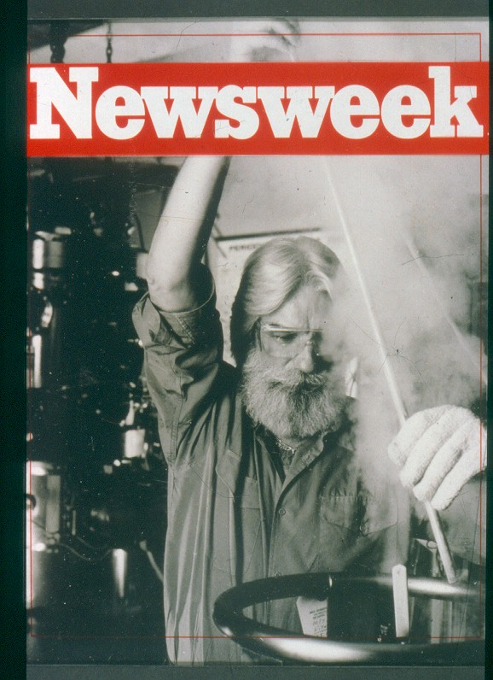





“The Hype”

Slide 54

HTSC Symposium, MRS Spring Meeting, Anaheim, 23-24 April 1987
“The Altamont of Materials”

Slide 55

“The Great Communicator”
Notes:
55

Slide 56

Today
Tc (K)
Year

Slide 57
PMG@EPRI: 1993-2005

Slide 58


My Virtual Grandfather (@ 94)

Slide 59

NYC circa 1890s

Slide 60





The US Electrical System

Slide 61

The US Transmission Grid(s)
300,000 km
500 companies
10% Losses

Slide 62

Pirelli-EPRI-AMSC-Detroit Edison
1996 - 2001
Pirelli

Slide 63


“Dual Use” of Energy Transport Corridors
Electricity Generation by Primary Fuel Source (2011-12)
USA
Wow!
Europe

Slide 64


The “Dual Use” Concept Embodied
Almost all NG used for electricity generation is “combusted” at a “local” delivery point using modern, efficient, combined cycle gas turbine (CCGT) technology.
Why not “combust” that gas portion so-used at the “well-head” instead and deliver the “electrons” over a low-loss HTSC dc cable? As well as reducing volume...and...frictional loss due to NG transported by pipeline.
...and...consider “recycling” well-head generated CO₂ emissions into alcohols...and “pipe” those down the same ROW!
The ROW Dual Use concept has been documented in several peer reviewed journals as well as member magazines of the APS, IOP, IEEE, and Nature...contact the author/speaker for a linkable anthology.

Slide 65
2100: The World Runs Out of CH4
The Dual Use ROWs Remain
Replace the CCGTs with 1-2 GW Nukes
Use Half the Power to Electrolyze (Frack) Nearby H2O Reserves to Release H2 ,
Then Liquify and Use to Refridgerate Upgraded HTSC Cables (If Necessary!)

Slide 66

http://w2agz.com/PMG%20SuperGrid%20Home.htm

Slide 67


Published in
SCIENTIFIC
AMERICAN
July, 2006
“System Crash”
Omni Productions,
Vancouver, BC
CBC Broadcast October, 2008
Notes:
67

Slide 68




Exascale Energy for Our
Great-Great GrandKids!
SuperCity
SuperSuburb
SuperGrid
SuperTrain

Slide 69





“The Only Commercial Application of HTSC”
Now it’s graphene!

Slide 70
PMG@W2AGZ.COM: 2005-?
Challenges for Today’s (and Future) Oakwood Physics Majors
The Theory of Everything
Designer DNA (aka “Life”)
Origin of HTSC
The End of Turing-von Neuman Computing
Climate Change

Slide 71


Bob Laughlin’s “Theory of Everything” (that’s important!)
3 -> 10²
  Chemistry
10² <-> 10³
  Thermodynamics
10³ <-> 10¹⁰
  Cooperative Phenomena
10¹⁰ <-> 10²⁰
  Emergent Behavior (Us)
> 10²⁰
  CLIMATE !
SIZE MATTERS !

Slide 72


The Structure of Life
Rosalind Franklin

Slide 73



Physics World
Volume 26 No 7 July 2013

Slide 74

The HTSC Pairing Glue
“Alex says it’s phonons”
OK, OK...J-T polarons and/or bipolarons (after Chakravarty/Hoest)
Could he be right after all?

Slide 75

Landauer Limit
Landauer's principle asserts that there is a minimum possible amount of energy required to erase one bit of information, known as the Landauer limit:
kT ln 2,
where k is the Boltzmann constant (approximately 1.38×10−23 J/K), T is the temperature of the heat sink in kelvins, and ln 2 is the natural logarithm of 2 (approximately 0.69315).

Slide 76


“Greenhouse Gases”
Carbon Dioxide

Slide 77
World Population: 1850 - 2100

Slide 78
Trends in Per Capita Electricity Consumption
Can Planet Earth really sustain 10+ billion souls living at the per capita energy consumption of Americans? Or Chinese? Or Europeans? Or emerging Africa?

Slide 79







Enfranchisement of Women
Notes:
Minister Development and International Cooperation
H.E Sheikha Lubna Bint Khalid Al Qasimi
Tripi Livni...Israel Cabinet

Slide 80
Where there is no vision,
the people perish…
Proverbs 29:18

Slide 81

“You can’t always get what you want…”

Slide 82

“…you get what you need!”

